Slide 1
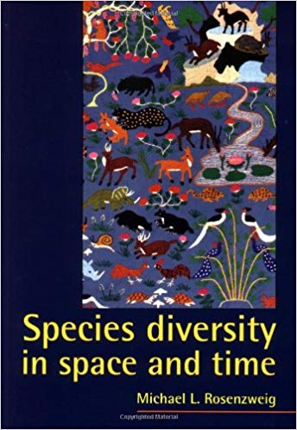
Species diversity in space and time

Slide 2
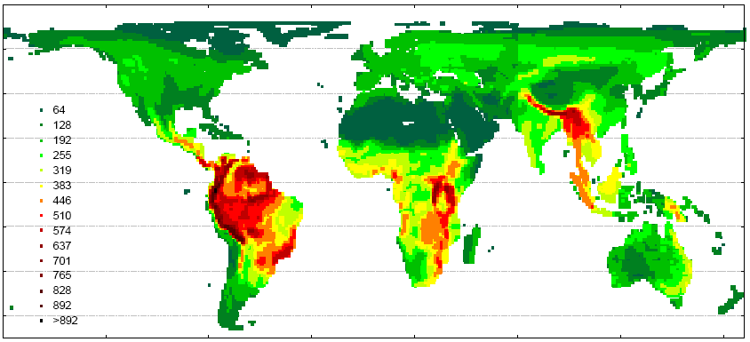
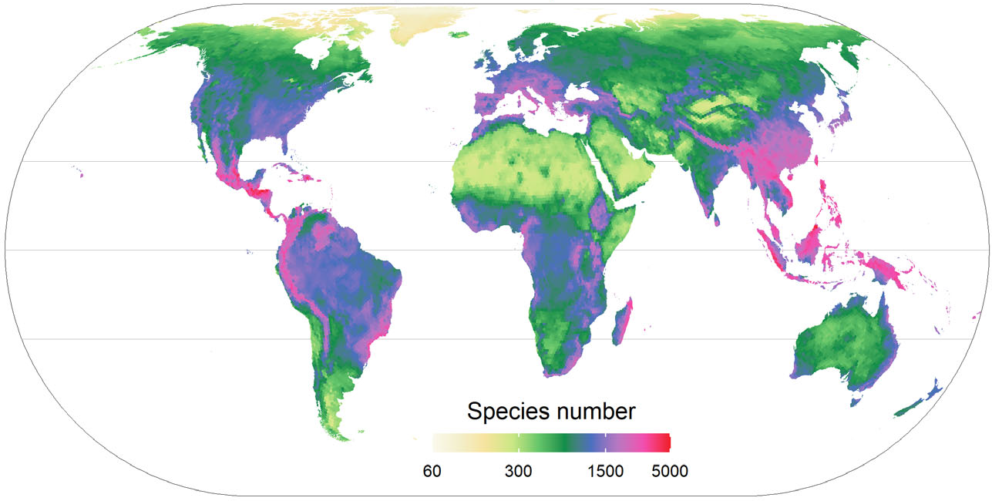
BIRDS
Storch et al. 2006 Ecology Letters
VASCULAR PLANTS
Cai et al. 2022 New Phytologist

Slide 3
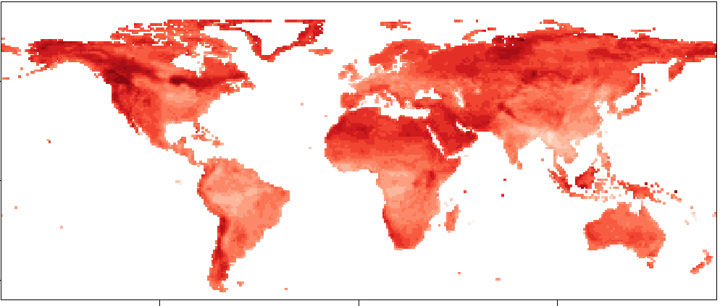
Latitudinal diversity gradient
Vetrovsky et al. 2019 Nature Communications
Interesting exceptions: aphids, aquatic macrophytes, soil fungi

Slide 4
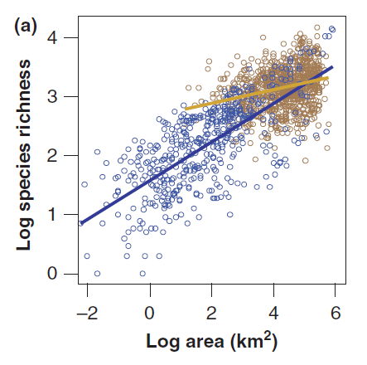
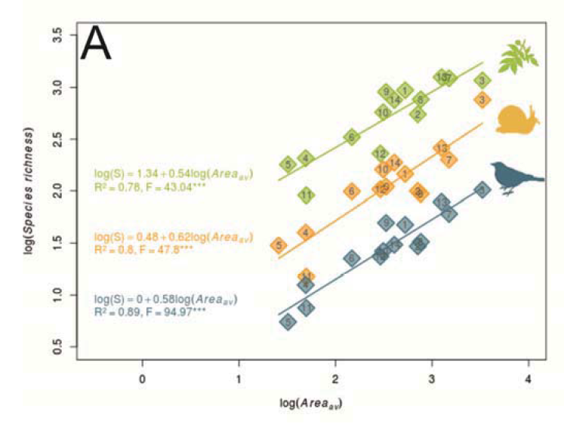
What do we know about large-scale diversity patterns?
Diversity scales with land mass

Slide 5
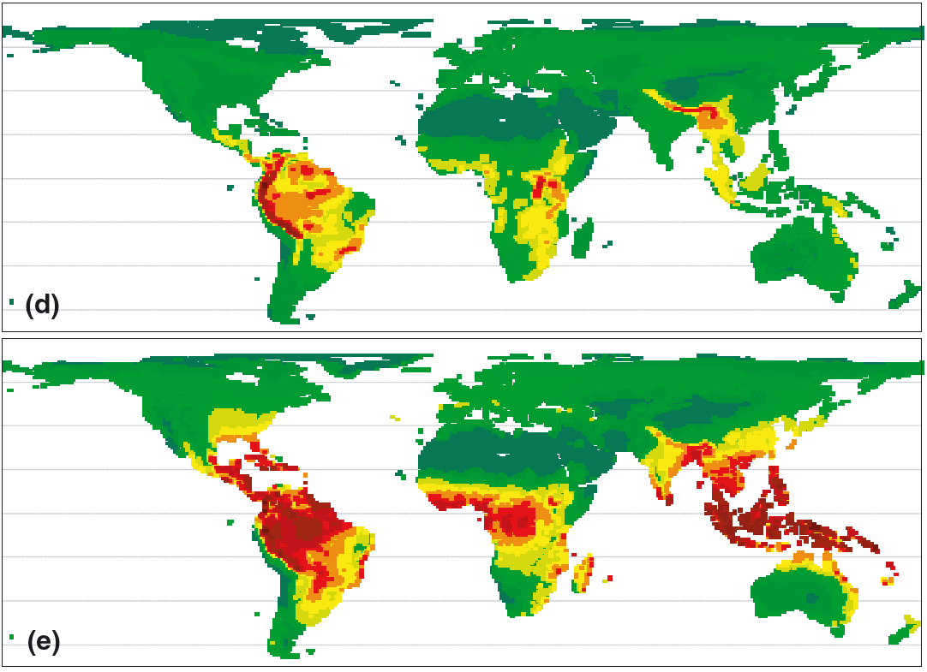
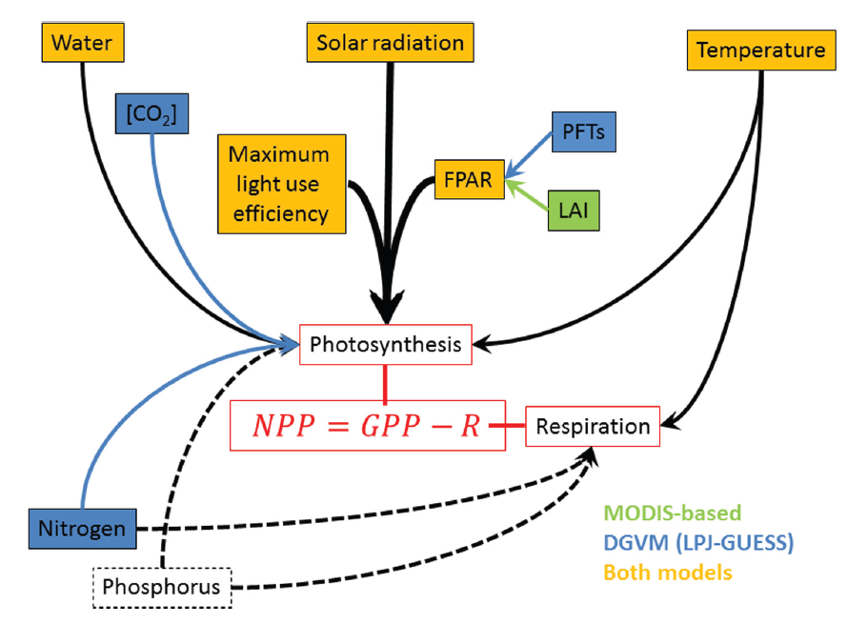
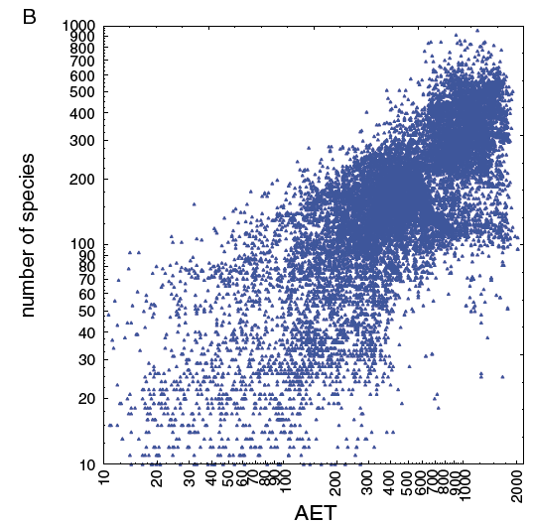
What do we know about large-scale diversity patterns?
Diversity scales with land mass
Productivity is the best single correlate of diversity
Šímová & Storch 2017 Ecography 40: 239-352
Storch D. et al. (2006) Ecology Letters 9, 1308-1320

Slide 6
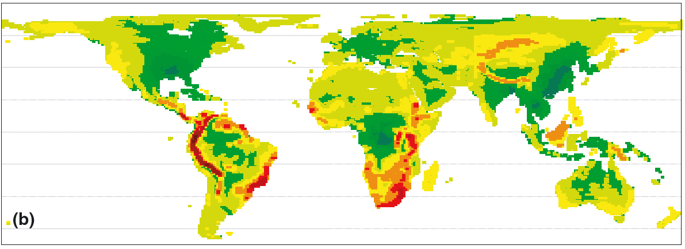
What do we know about large-scale diversity patterns?
Diversity scales with land mass
Productivity is the best single correlate of diversity
Mountains host relatively higher diversity

Slide 7
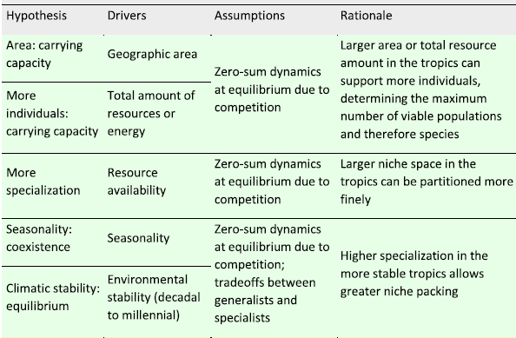
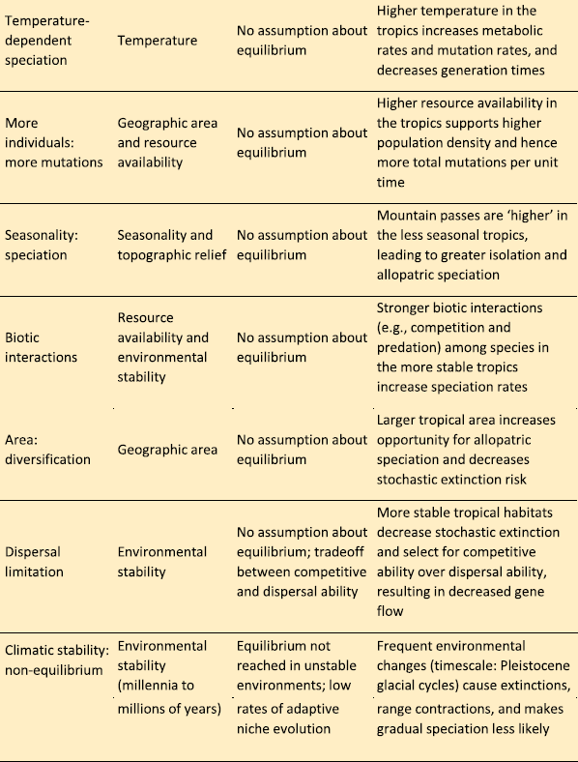
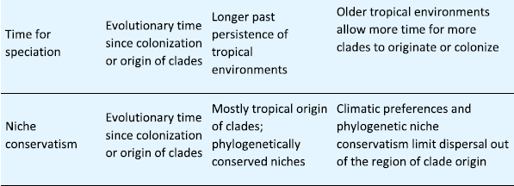
What do we know about large-scale diversity patterns?
SR carrying capacity
Why more species
in the tropics
Diversification
rate
Time for species accumulation
Pontarp et al. 2019 Trends Ecol. Evol.

Slide 8
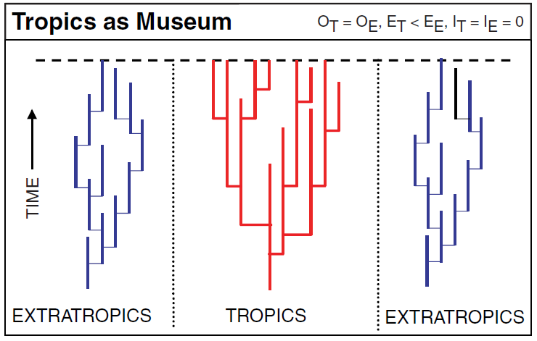
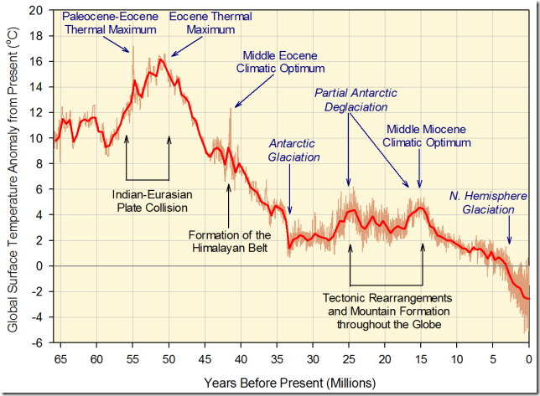
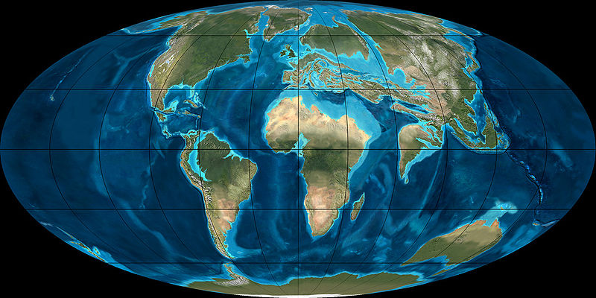
Is it all about history?
SR carrying capacity
Why more species
in the tropics
Diversification
rate
Time for species accumulation
Problems
How distant history is relevant?
Why the lineages adapted to warm and not cold climate?

Slide 9
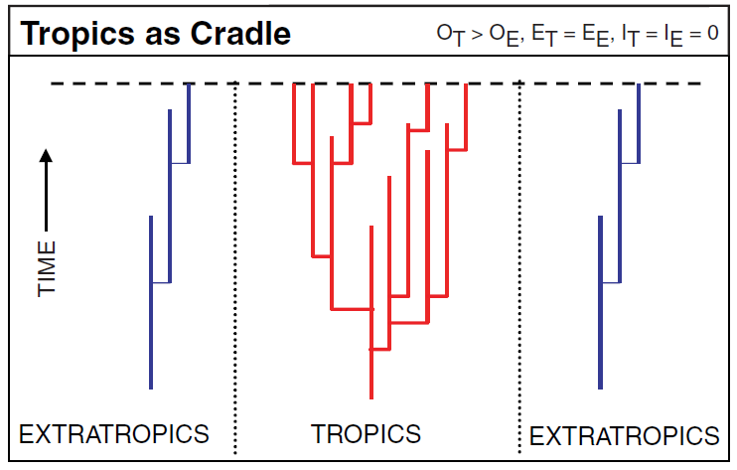
Is it about rate of species origination?
SR carrying capacity
Why more species
in the tropics
Diversification
rate
Time for species accumulation
Problems
Limited evidence of higher speciation in the tropics (warmer regions)
Unclear link between diversification and diversity

Slide 10
Is it about diversity limits?
“What then checks an indefinite increase in the number of species? The amount of life supported on an area must have a limit, depending on physical conditions; therefore, if an area be inhabited by very many species, each or nearly each species will be represented by few individuals; and such species will be liable to extermination from accidental fluctuations in the nature of the seasons or in the number of their enemies”.
Darwin 1859; 6th edition
SR carrying capacity
Why more species
in the tropics
Diversification
rate
Time for species accumulation
less resources
or more variable
speciation or extinction
per species
more resources
or less variable
Problems
Higher diversity is typically not associated with higher total number of individuals
No evidence of higher specialization in the tropics
number of species

Slide 11
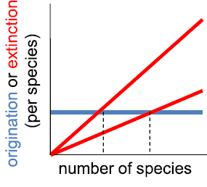

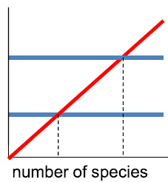
Hypotheses concerning biodiversity dynamics
Role of speciation rate
 | low | high
Low (equilibrium) | Stable persistence | Speciation balance
High (disequilibrium) | Historical legacy | Diversity cradles
Role of time

Slide 12
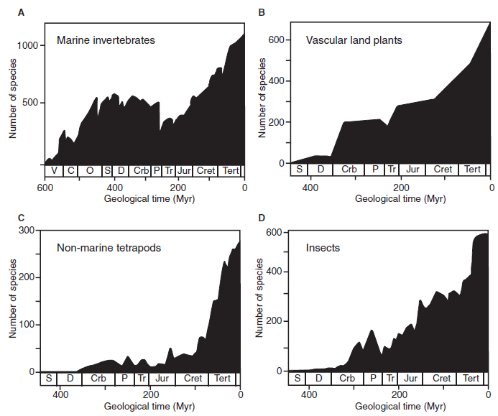
What do we know about diversity dynamics from the fossil record?
Stability or continuous increase?

Slide 13
What do we know about diversity dynamics from the fossil record?
Problem I: „Pull of the recent“
čas
současnost

Slide 14
What do we know about diversity dynamics from the fossil record?
Problem I: „Pull of the recent“
time
the present

Slide 15
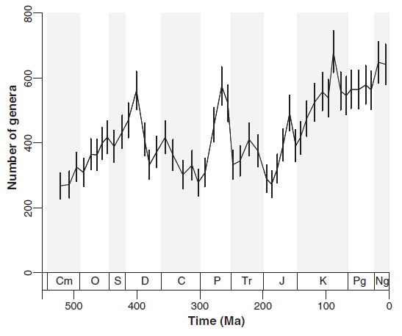
What do we know about diversity dynamics from the fossil record?
Problem I: „Pull of the recent“
Problem II: Amount of fosiliferous layers
Solutions:
take only „short-lived“ species
count only real number of taxa, not interpolated
Solutions:
standardize number of samples
filter out the amount of fossiliferous rock

Slide 16
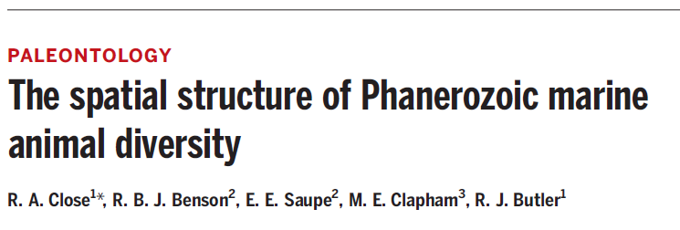
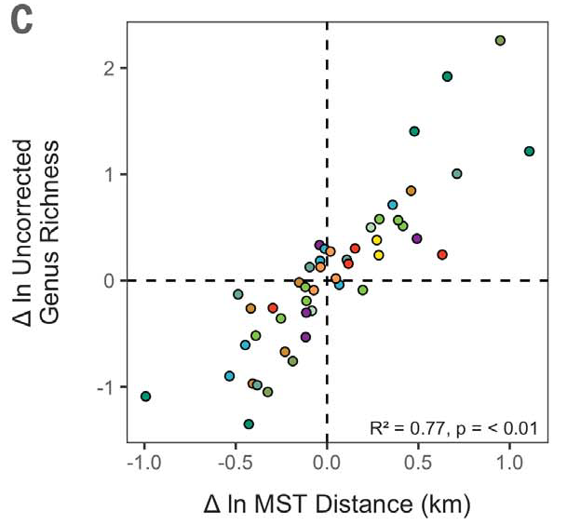
What do we know about diversity dynamics from the fossil record?
Problem I: „Pull of the recent“
Problem II: Amount of fosiliferous layers
Solutions:
take only „short-lived“ species
count only real number of taxa, not interpolated
Solutions:
standardize number of samples
filter out the amount of fossiliferous rock
Problem III: Extent of sampled area

Slide 17
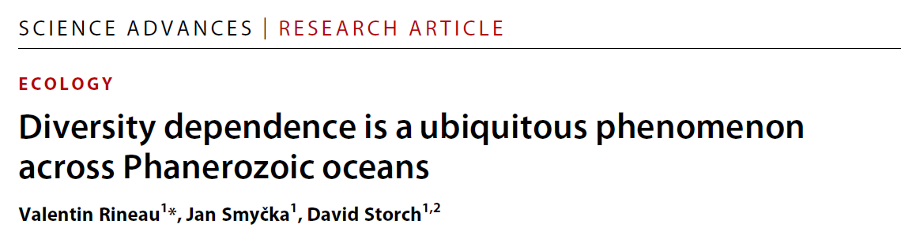

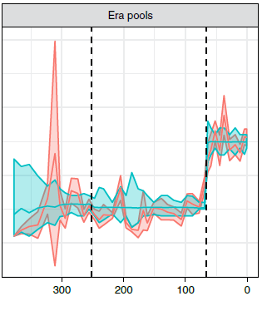
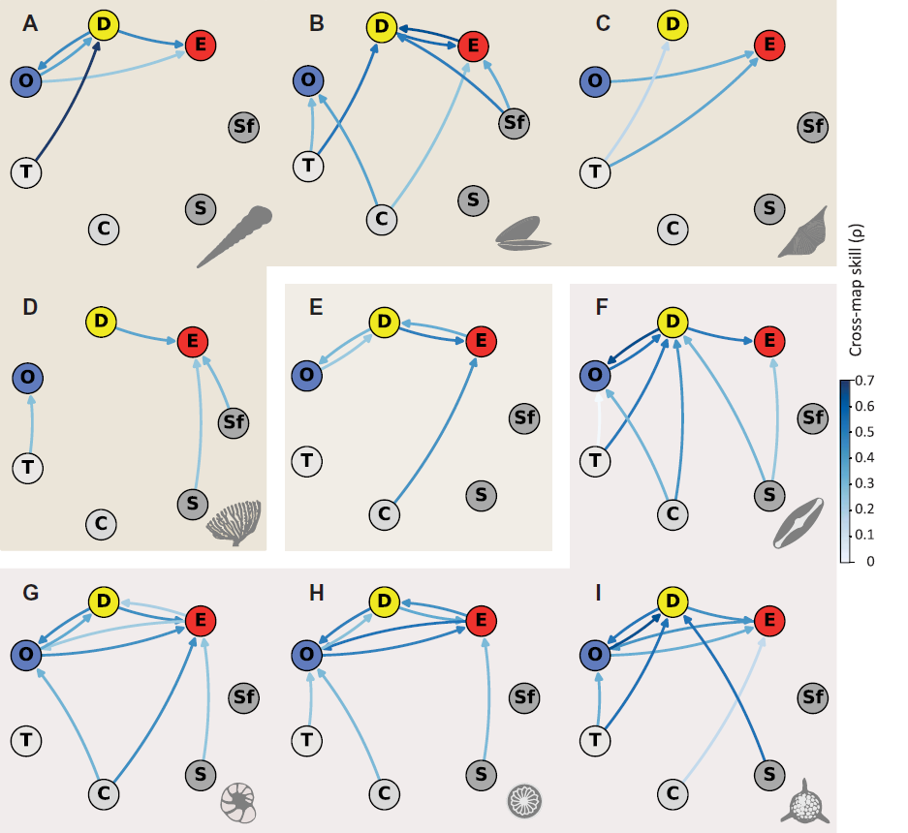
What do we know about diversity dynamics from the fossil record?
When controlled for artefacts, diversity looks quite stable
Negative diversity-dependence seems ubiquitous
Diversity
Origination
Extinction
Resources
Temperature
Close et al. 2019 Nature Ecology & Evolution

Slide 18
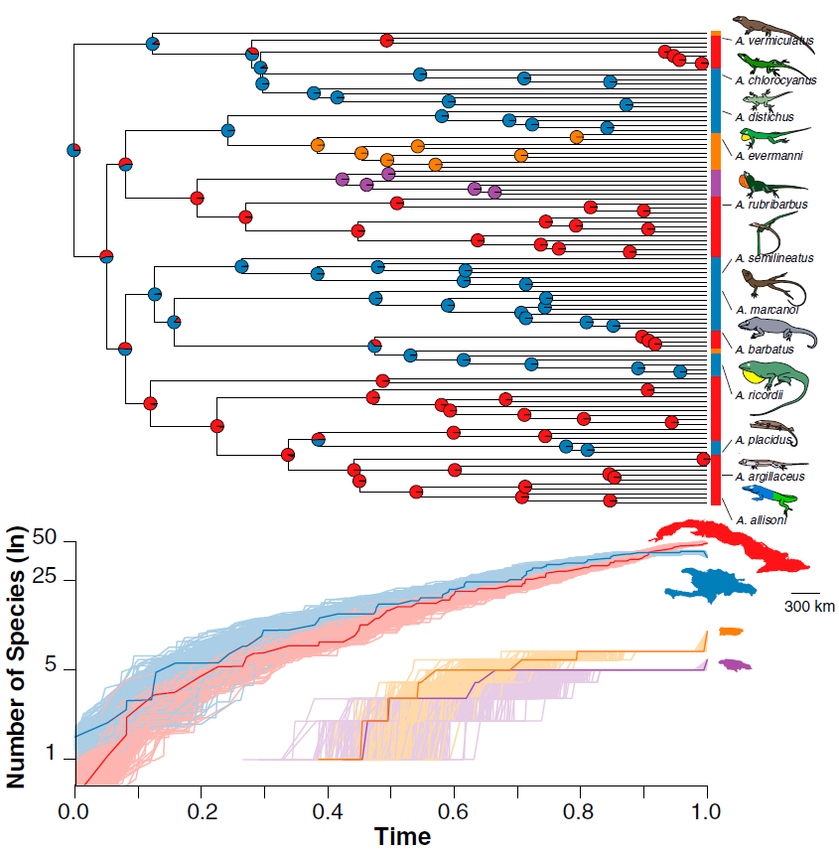
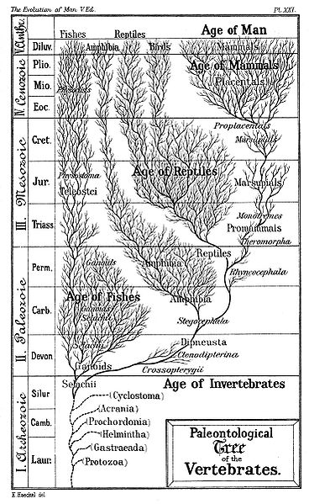
What do we know about diversity dynamics from phylogenetic trees?
Not much:
Clades often reveal diversification slowdown
Rabosky & Glor 2010 PNAS 107: 22178-22183

Slide 19
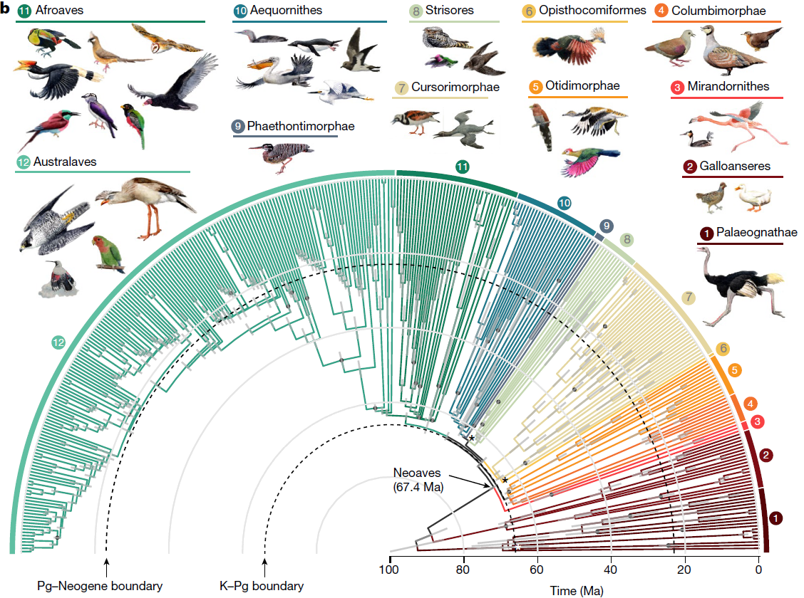
What do we know about diversity dynamics from phylogenetic trees?
Not much:
Clades often reveal diversification slowdown

Slide 20
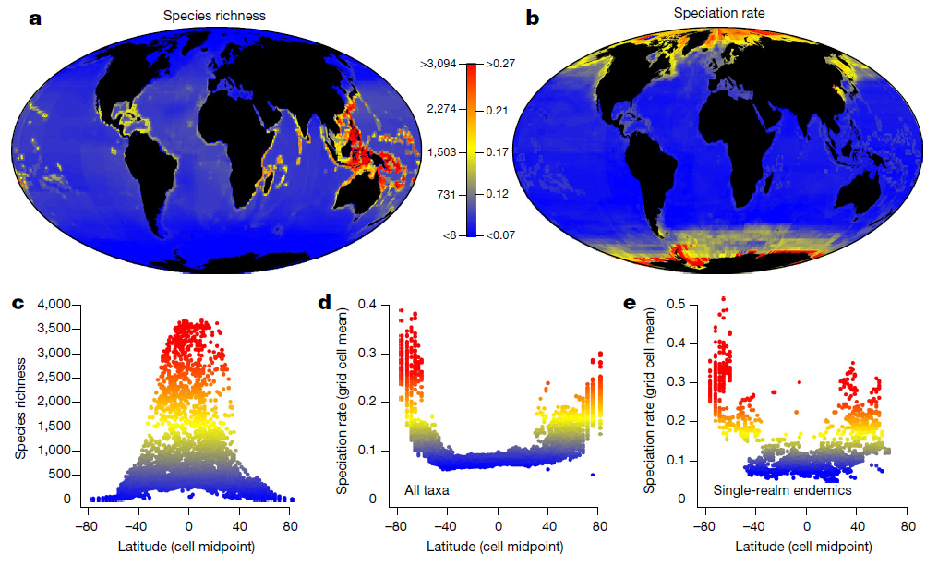
What do we know about diversity dynamics from phylogenetic trees?
Not much:
Clades often reveal diversification slowdown
Diversification seems typically higher in low-diversity regions
Rabosky et al. 2018 Nature

Slide 21
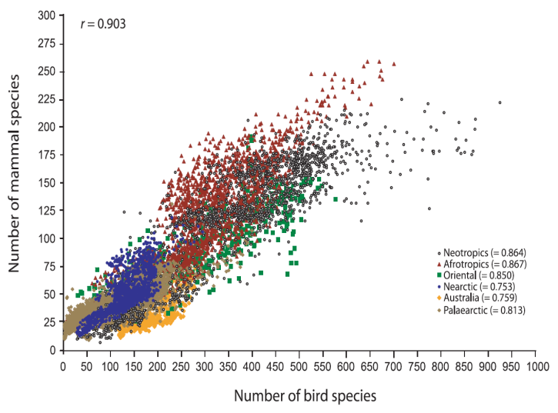
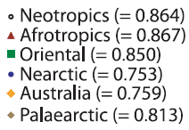
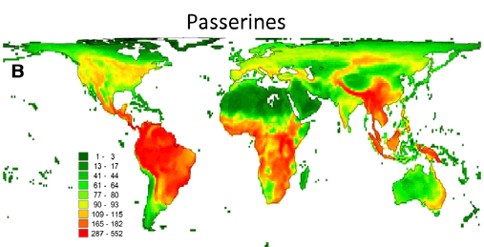
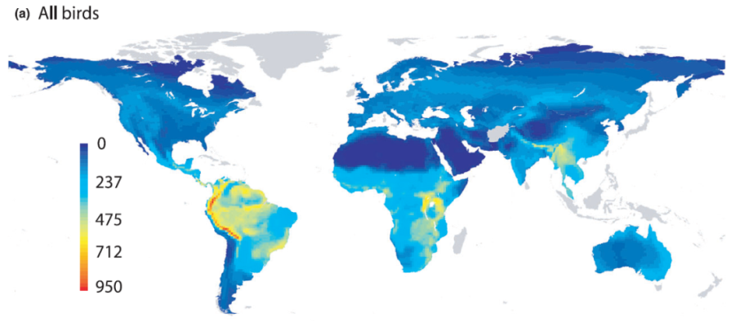
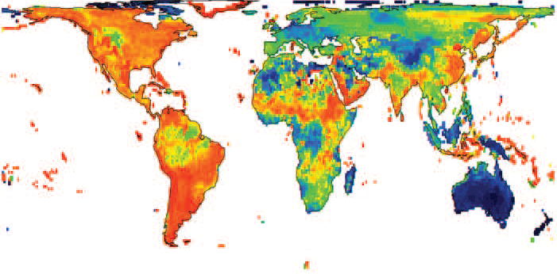
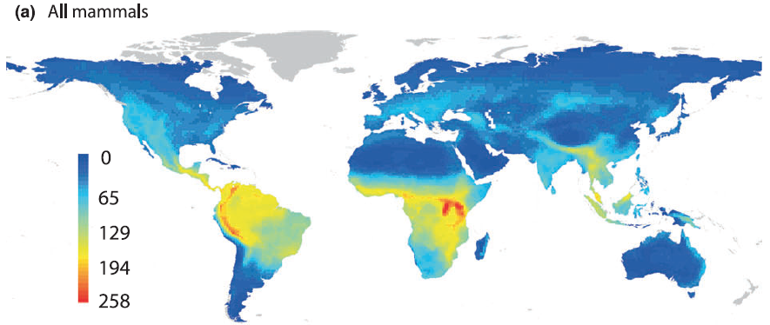
What do we know about diversity dynamics from phylogenetic trees?
Not much:
Clades often reveal diversification slowdown
Diversification seems typically higher in low-diversity regions
Diversity patterns are largely convergent and decoupled from diversification rates
species richness
diversification
Jetz et al. 2012 Nature
Hawkins et al. 2012 J.Biogeogr. 39: 825-841

Slide 22
Hypotheses concerning biodiversity dynamics
Role of speciation rate
 | low | high
Low (equilibrium) | Stable persistence | Speciation balance
High (disequilibrium) | Historical legacy | Diversity cradles
Role of time

Slide 23
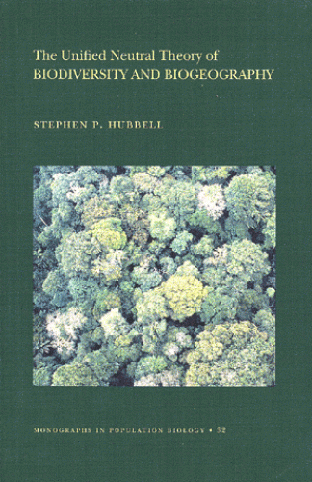
Three possible frameworks addressing equilibrium diversity dynamics
sophistication
generality
Community-based
theories
Species-based
ETBD
Individuals-based
models
speciation or extinction per species
number of species

Slide 24

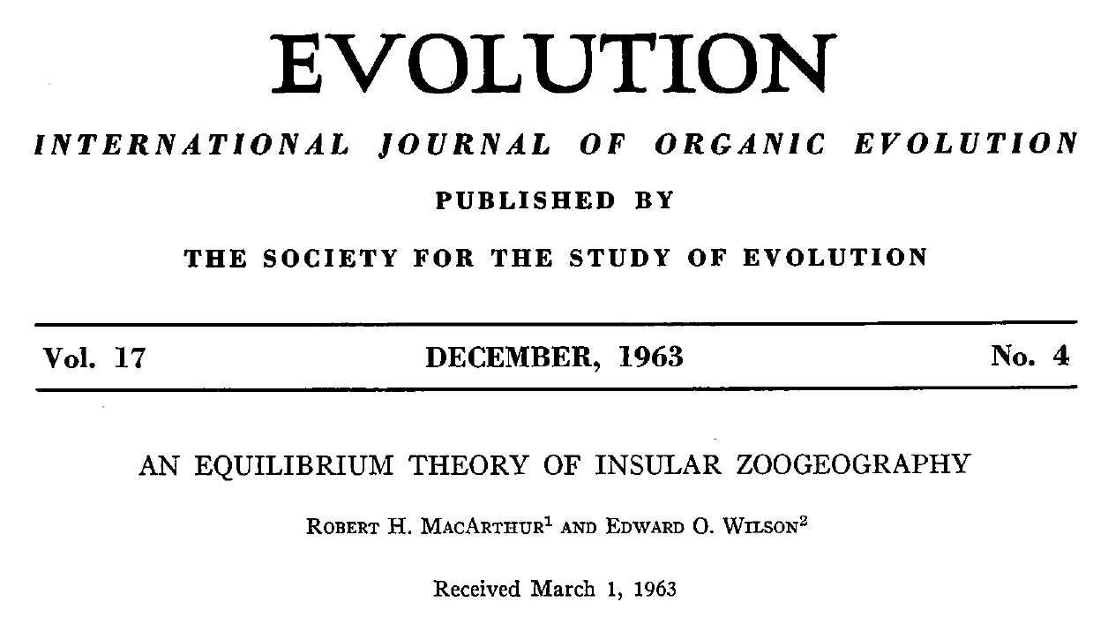
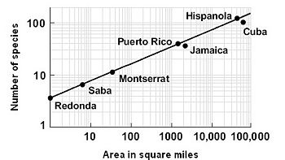
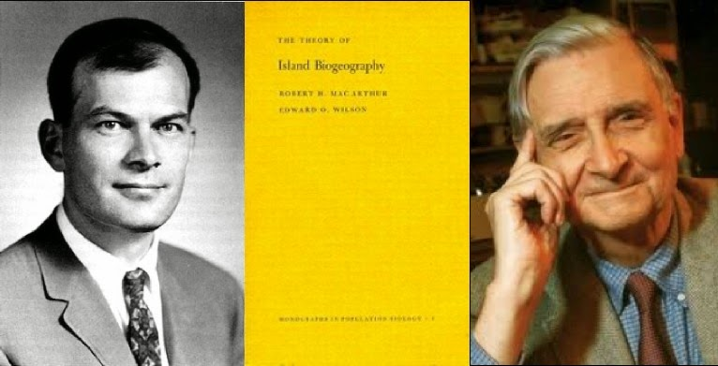
Theory of Island Biogeography
S
A

Slide 25
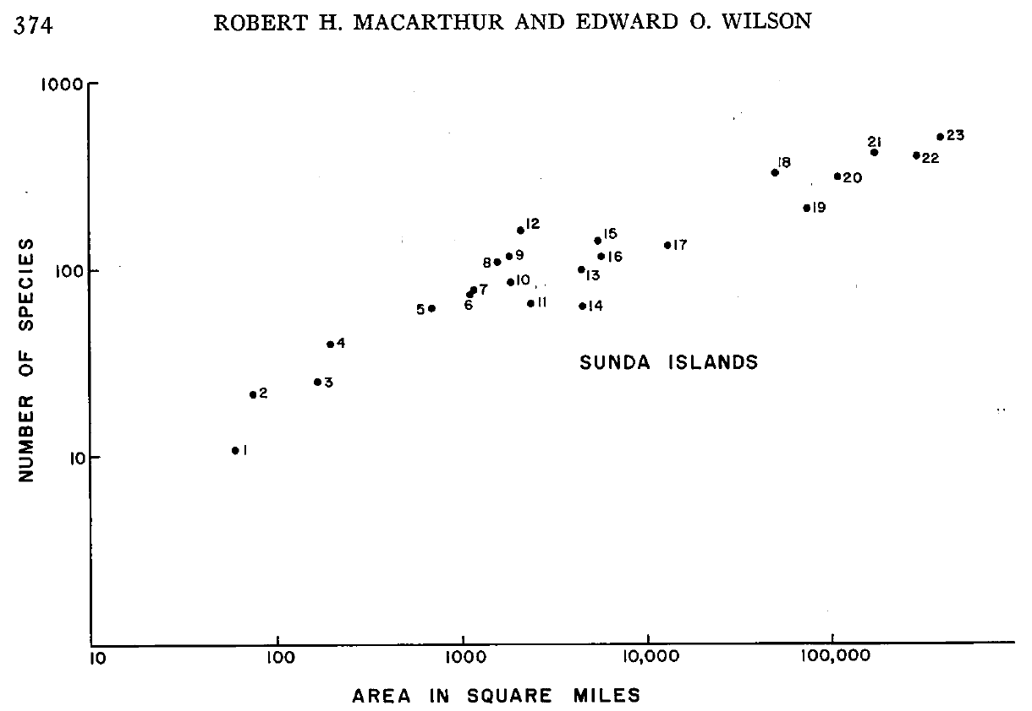
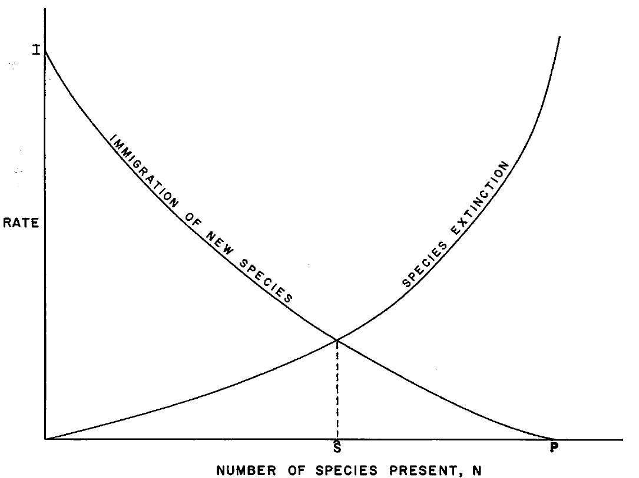
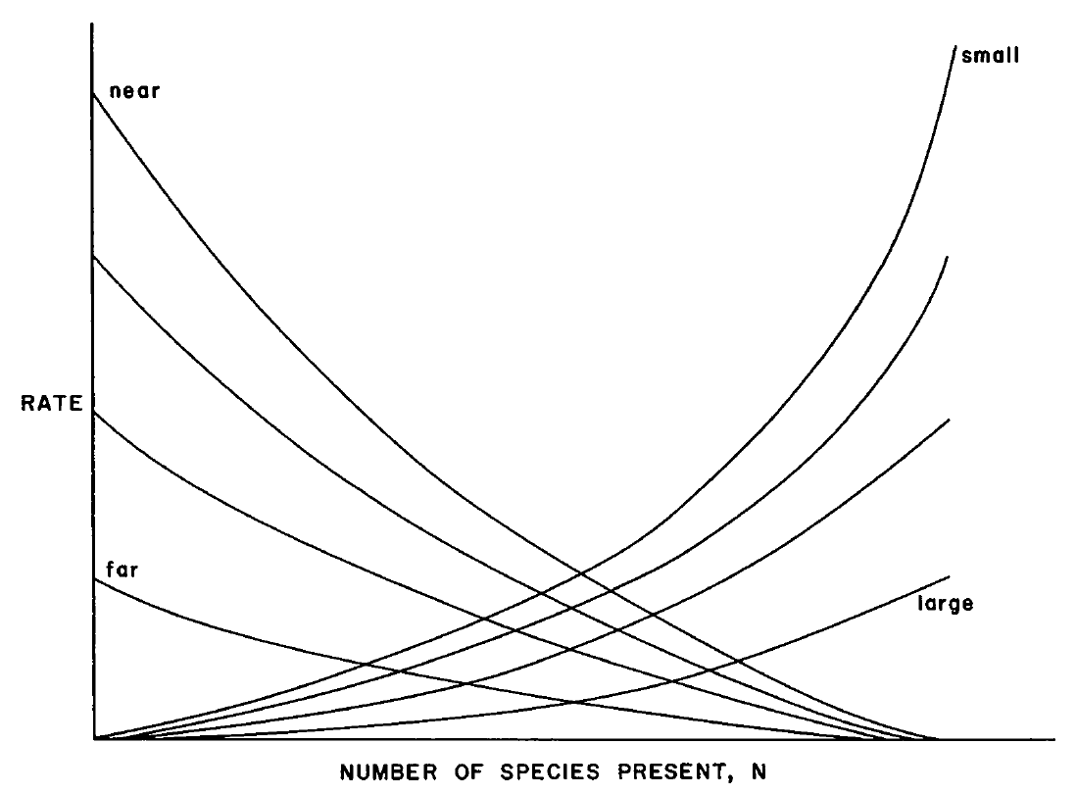
Theory of Island Biogeography

Slide 26
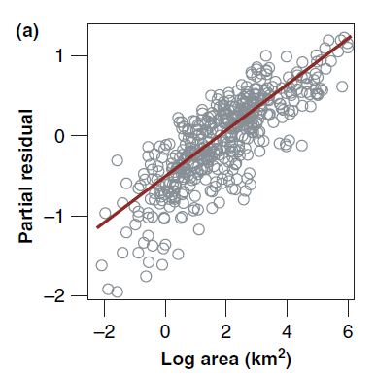
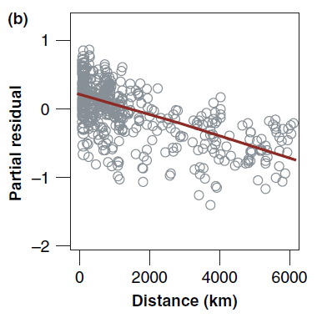
Theory of Island Biogeography
small
close
colonization extinction
colonization extinction
colonization extinction
big
remote
number of species
number of species
number of species
Assumptions:
Colonization depends on the distance of species pool (and species pool itself)
Extinction depends on island size (due to population size-dependence of extinction probability)

Slide 27
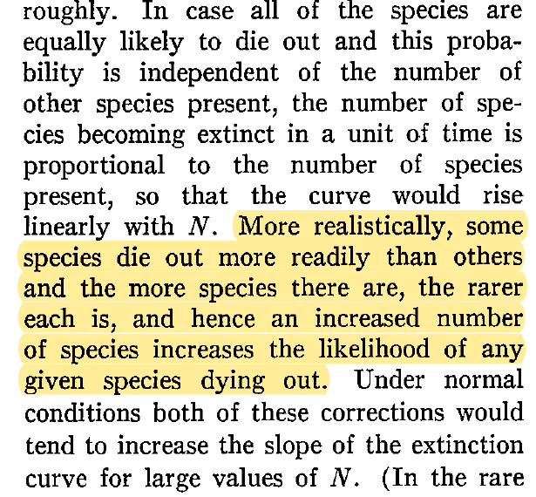
Theory of Island Biogeography - Misunderstandings
ETIB is not a theory about species saturation due to competition
(but the theory admits the role of limited energy and competition)
colonization extinction
number of species

Slide 28
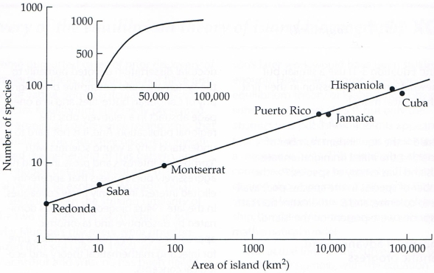
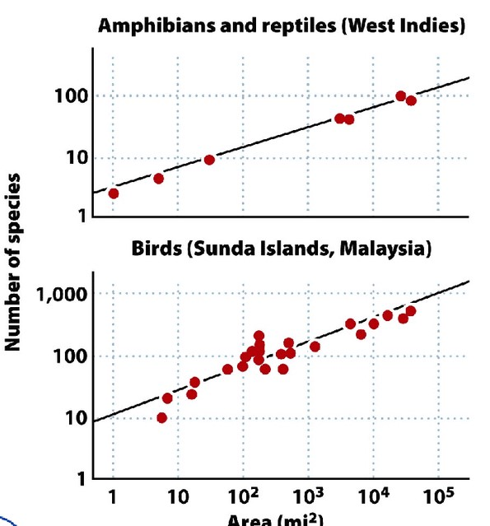
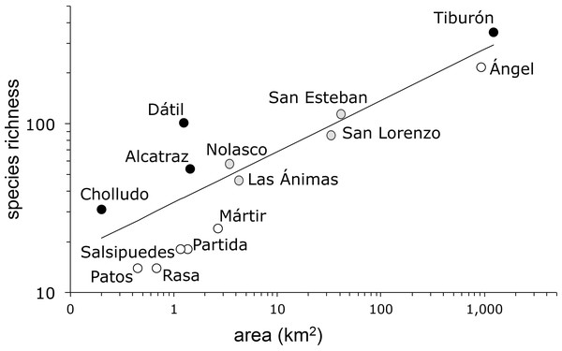
Theory of Island Biogeography - Misunderstandings
ETIB is not a theory about species saturation due to competition
ETIB is not a theory on the species-area relationship

Slide 29
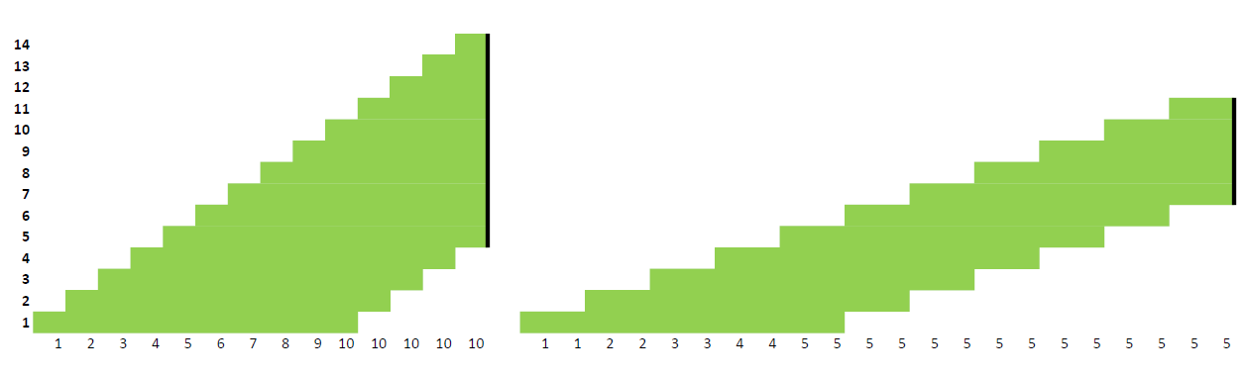
Theory of Island Biogeography - Misunderstandings
ETIB is not a theory about species saturation due to competition
ETIB is not a theory on the species-area relationship
Equilibrium would emerge even if just one rate was diversity-dependent
colonization extinction
colonization extinction
number of species
number of species

Slide 30


Neutral Theory
Steven Hubbell 2001

Slide 31
Neutral Theory
Assumptions:
Individuals of all species are ecologically and demographically equivalent
Total number of individuals is constant (biotic saturation)
Metacommunity
Local community

Slide 32
Neutral Theory
Assumptions:
Individuals of all species are ecologically and demographically equivalent
Total number of individuals is constant (biotic saturation)
Metacommunity
Local community

Slide 33
Neutral Theory
Metacommunity
1. MORTALITY (disturbance)
Local community

Slide 34
Neutral Theory
Metacommunity
1. MORTALITY (disturbance)
Local community
2. REPRODUCTION (from within the local community and/or from other communities)
-› COMMUNITY DRIFT (slows down by migration from other communities)
(but the opposite effect in metacommunities)

Slide 35
Neutral Theory
Metacommunity
1. MORTALITY (disturbance)
Local community
2. REPRODUCTION (from within the local community and/or from other communities)
3. SPECIATION
balances occasional extinction due to (very slow) metacommunity drift

Slide 36


Neutral Theory
Predicted patterns:
Aggregated species distribution
Species-abundance distribution
Role of dispersal limitation and island effects (impoverishment and density compensation)
Species-area relationship
Correlation of species richness with total abundance and speciation rate
S
A
Problems
Extinction is only due to community drift
Total abundance is given a priori
Equal access of all species to the same resources (no space for niche differentiation and expansion)

Slide 37


Equilibrium Theory of Biodiversity Dynamics (ETBD)
Equilibrium follows from population size-dependent extinction (origination) rate
$\hat{N}=\frac{J}{S}$
origination > extinction
$$\hat{N}$$
community abundance J
extinction and origination rate
per species
extinction > origination
population size N
species richness S
equilibrium mean abundance
(determined by extinction and origination parameters)
Storch, Šímová, Smyčka, Bohdalková, Toszogyova & Okie 2022 Ecography

Slide 38
Equilibrium Theory of Biodiversity Dynamics (ETBD)
Equilibrium follows from population size-dependent extinction (origination) rate
Equilibrium follows from population size-dependent extinction (origination) rate
There is limited amount of resources, but more species utilize them better
community abundance J
species richness S
Storch, Šímová, Smyčka, Bohdalková, Toszogyova & Okie 2022 Ecography

Slide 39
Equilibrium Theory of Biodiversity Dynamics (ETBD)
Equilibrium follows from population size-dependent extinction (origination) rate
There is limited amount of resources, but more species utilize them better
maximum attainable number
of individuals
(energy available/metabolic rate)
Jmax
effect of species richness on resource utilization
community abundance J
species richness S
equilibrium mean abundance
(determined by extinction and origination parameters)
Storch, Šímová, Smyčka, Bohdalková, Toszogyova & Okie 2022 Ecography

Slide 40
Equilibrium Theory of Biodiversity Dynamics (ETBD)
Equilibrium follows from population size-dependent extinction (origination) rate
There is limited amount of resources, but more species utilize them better
Jmax
Equilibria emerge even if increase of species richness increases niche space
Three principally different ways how diversity equilibria may change (e.g. along environmental gradients)
community abundance J
CHANGING ORIGINATION
OR EXTINCTION RATES
species richness S
Jmax
Jmax
community abundance J
community abundance J
CHANGING RESOURCES
species richness S
species richness S
Jmax
community abundance J
CHANGING THE WAY SPECIES UTILIZE RESOURCES
species richness S
Storch, Šímová, Smyčka, Bohdalková, Toszogyova & Okie 2022 Ecography

Slide 41
Application of ETBD for understanding current diversity changes
Equilibrium follows from population size-dependent extinction (origination) rate
There is limited amount of resources, but more species utilize them better
Jmax
hunting, overfishing
(increases extinction rate)
community abundance J
CHANGING ORIGINATION
OR EXTINCTION RATES
species richness S
Jmax
habitat destruction/transformation
(decreases total community size)
community abundance J
CHANGING RESOURCES
species richness S
Jmax
change of species interactions
(affects ability of resource use)
community abundance J
CHANGING THE WAY SPECIES UTILIZE RESOURCES
species richness S
Storch, Šímová, Smyčka, Bohdalková, Toszogyova & Okie 2022 Ecography

Slide 42
Factors affecting equilibrium diversity
topographic
heterogeneity
(isolation)
temperature
area
productivity
environmental stochasticity
metabolic rate
(in ectotherms)
number
of individuals
?
demographic stochasticity
immigration rate
(locally)
speciation rate
(regionally)
extinction rate
species richness

