Slide 1
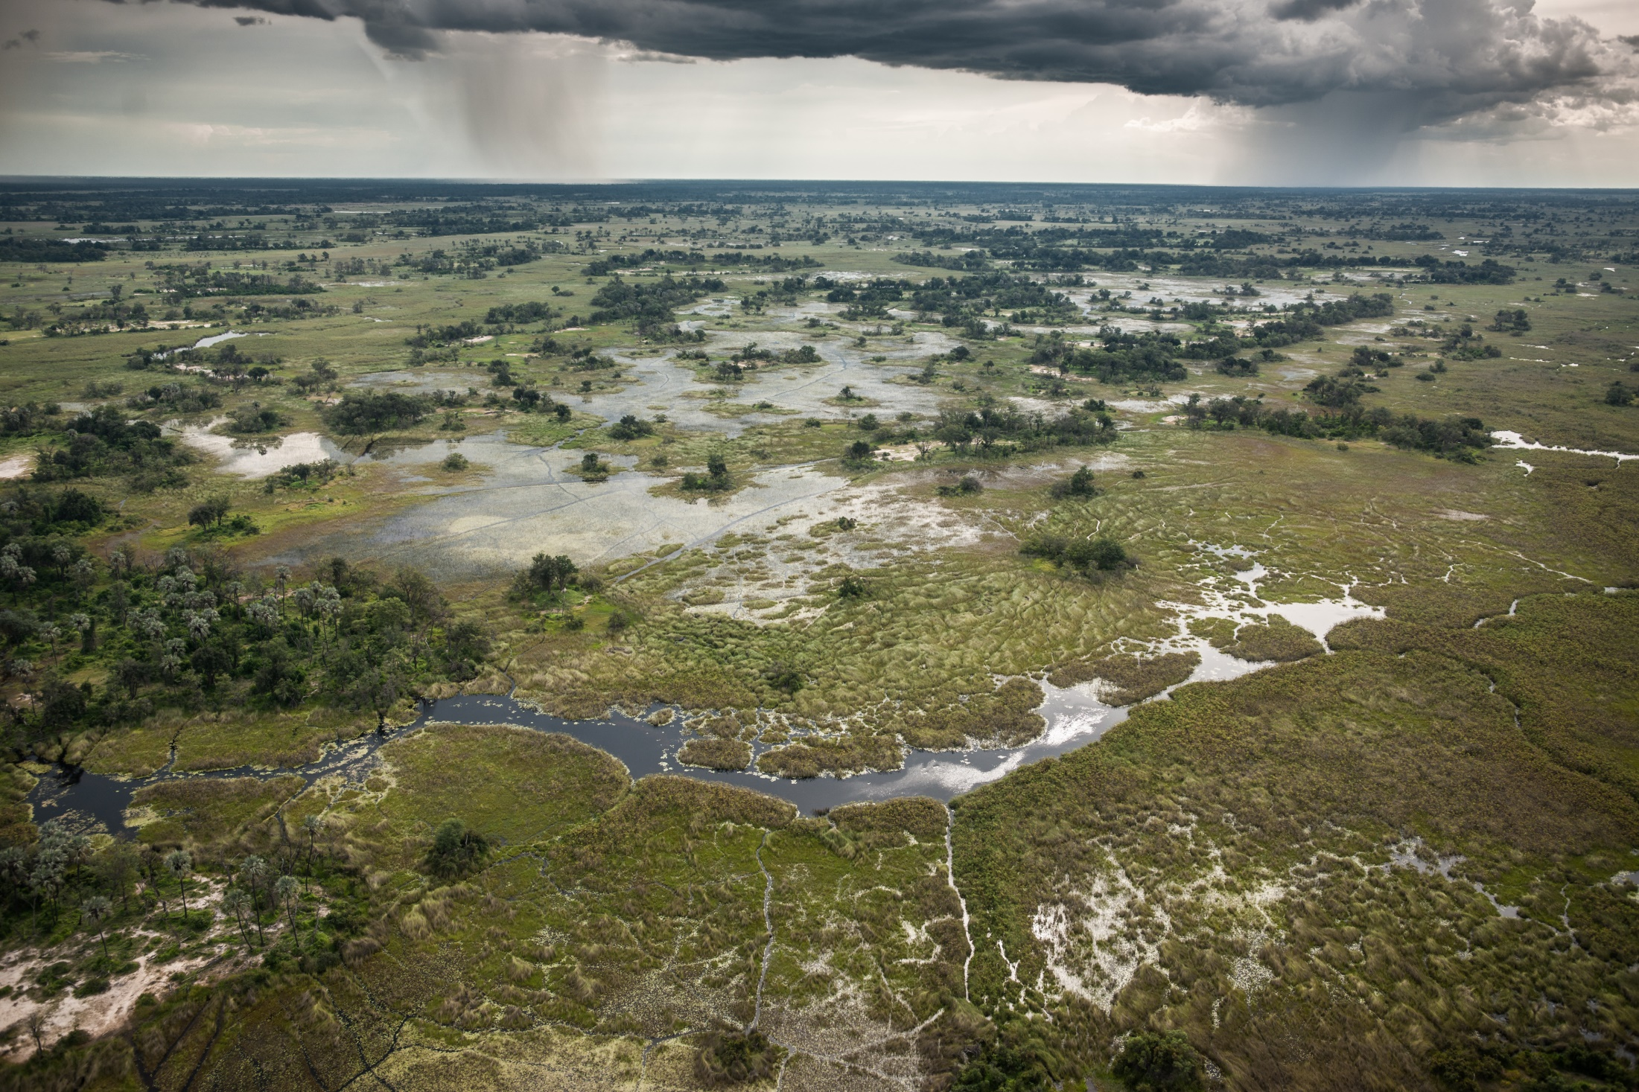
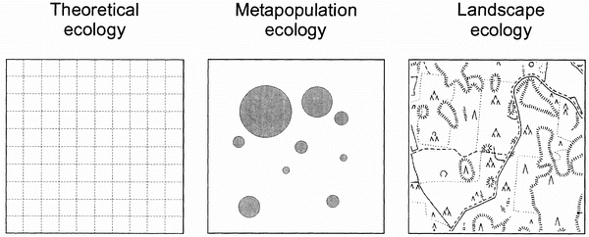
Spatial ecology
THEORY
EMPIRY

Slide 2
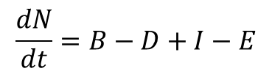
Spatial ecology
birth
death
immigration
emigration
$$\frac{dN}{dt}=B−D+I−E$$

Slide 3
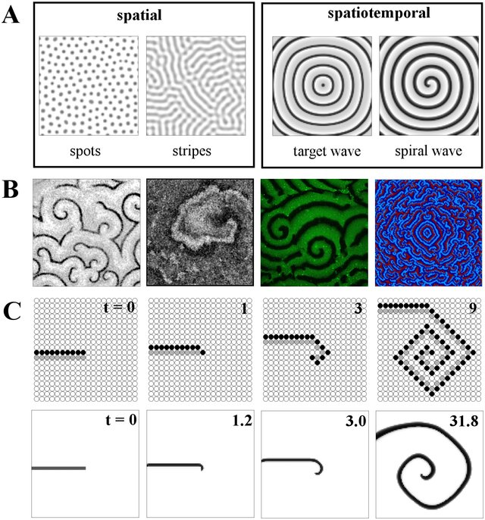
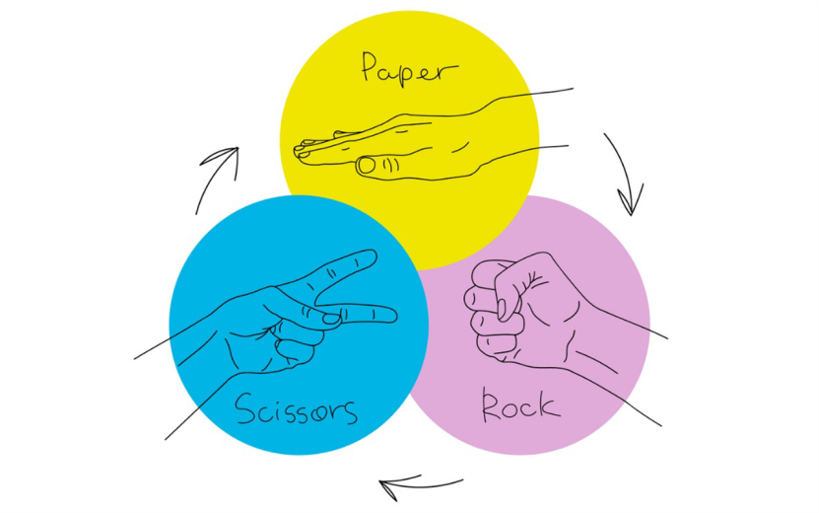
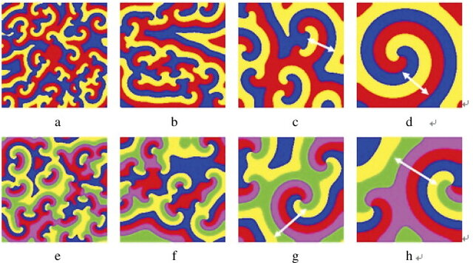
Spatiotemporal dynamics
Models of dynamics on a lattice typically lead to spatial patterns

Slide 4
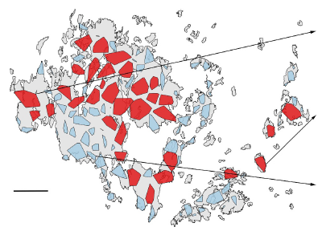
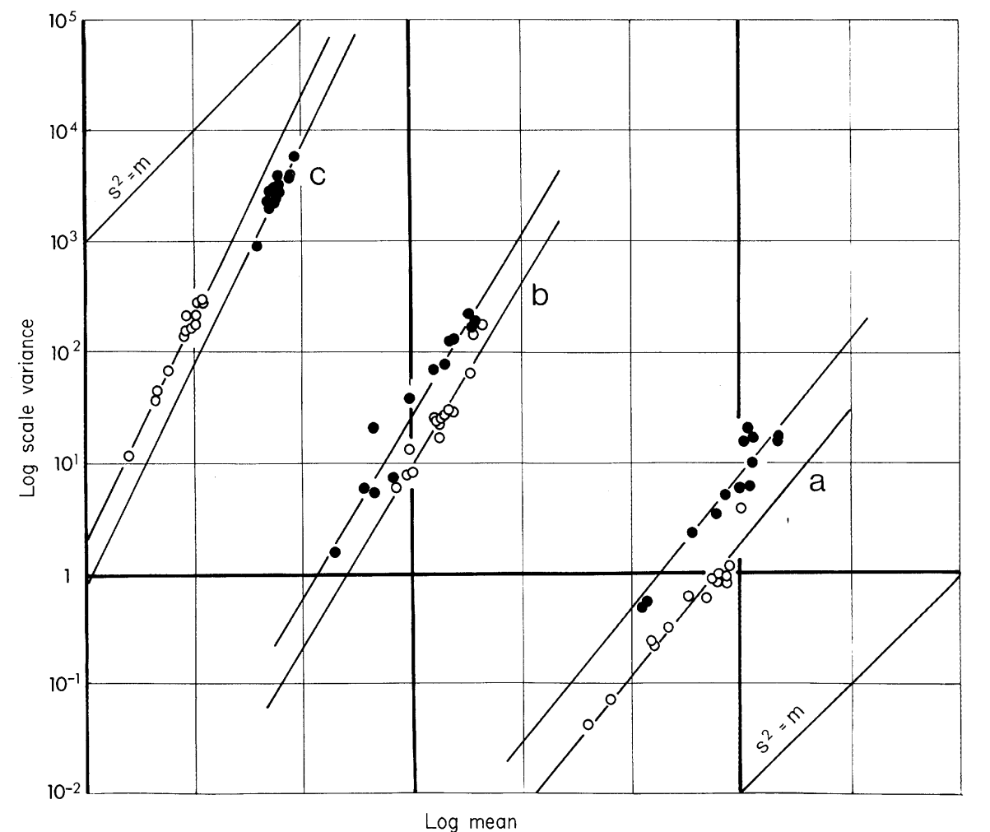
Spatiotemporal dynamics
Models of dynamics on a lattice typically lead to spatial patterns
Taylor’s power-law – the only real spatiotemporal regularity
Different species have different slopes of the mean-variance relationship

Slide 5
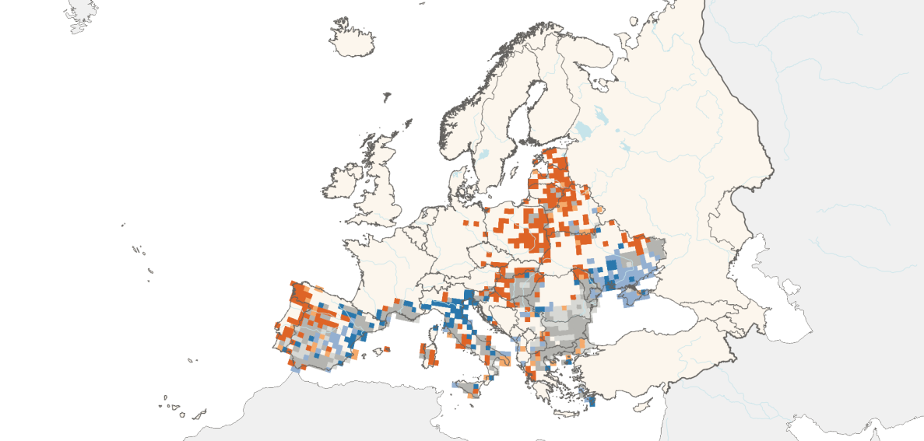
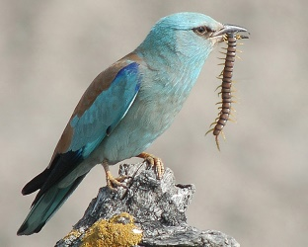

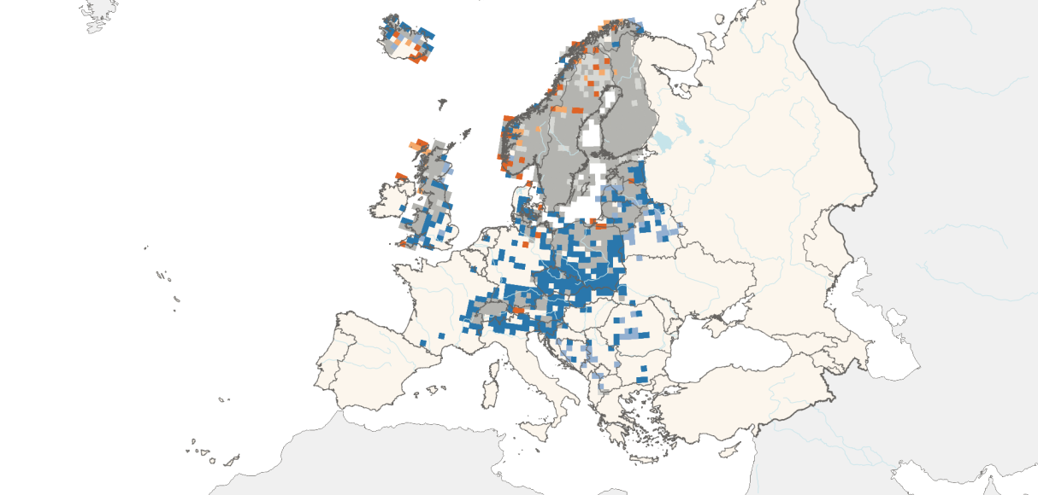
Spatiotemporal dynamics of populations
birth
death
immigration
emigration
European roller
$$\frac{dN}{dt}=B−D+I−E$$
Problems with modeling within
one framework
individual-based models
higher-level models
Goosander
Colonization/extinction dynamics

Slide 6
Colonization and extinction
Colonization
Extinction
Distance
(dispersal kernel)
Abundance
(mass effect)
Population size
Population fluctuations

Slide 7
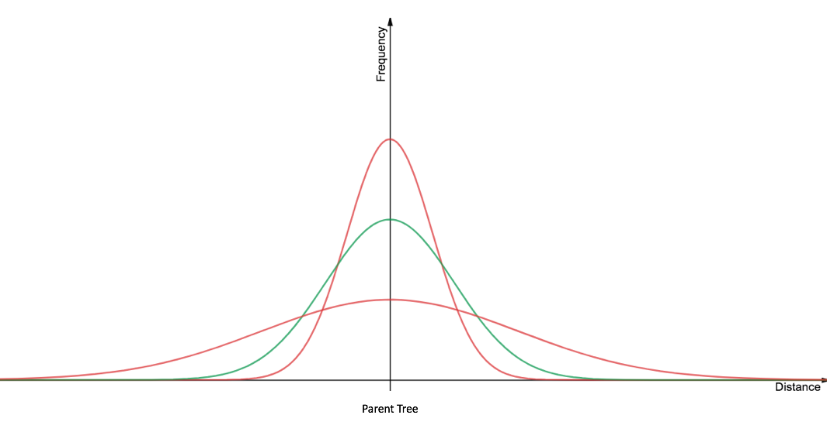
Colonization and extinction
Colonization
Extinction
Distance
(dispersal kernel)
Abundance
(mass effect)
Population size
Population fluctuations

Slide 8
Colonization and extinction
Colonization
Extinction
Distance
(dispersal kernel)
Abundance
(mass effect)
Population size
Population fluctuations
Small populations:
Problems with genetics
Problems with population growth
Problems with stochasticity

Slide 9
Colonization and extinction
Colonization
Extinction
Distance
(dispersal kernel)
Abundance
(mass effect)
Population size
Population fluctuations
Problems with genetics
Problems with population growth
Problems with stochasticity
Allee effect – positive density dependence in low population density
per capita
population growth
abundance

Slide 10
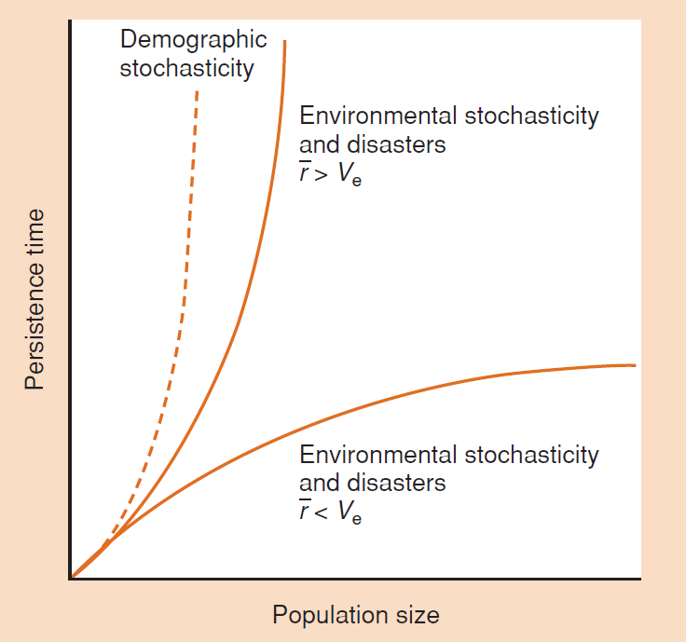
Colonization and extinction
Colonization
Extinction
Distance
(dispersal kernel)
Abundance
(mass effect)
Population size
Population fluctuations
Problems with genetics
Problems with population growth
Problems with stochasticity
demographic
environmental
Smaller populations are more vulnerable to extinction for several reasons, but most important is the role of environmental stochasticíty
→ extinction probability is additionally negatively affected by population growth and positively by variation

Slide 11


Metapopulation biology
Metapopulation: set of local populations linked by occasional migration
(population of populations)
Ilkka Hanski 1999
Two-level processes (within and among patches)
Distinction between habitable patch and surrounding matrix

Slide 12
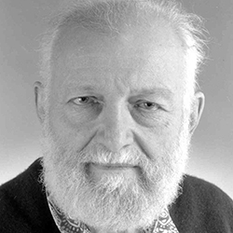
Metapopulation biology
colonization
extinction
Levins’ equation
dP
dt
= iP(k-P) - eP
P – number of occupied patches
k – total number of patches
(k-P) – number of unoccupied patches
i – immigration constant
e – extinction constant
Richard Levins 1969
colonization extinction
P
k

Slide 13
Metapopulation biology
colonization
extinction
dP
dt
= iP(k-P) - eP
P
k
Application: Importance of unoccupied sites for metapopulation persistence

Slide 14
Metapopulation biology
colonization
extinction
dP
dt
= iP(k-P) - eP
P
k

Slide 15
Metapopulation biology
Rescue effect – migrants decrease extinction probability
(rescue local populations)
P
k

Slide 16
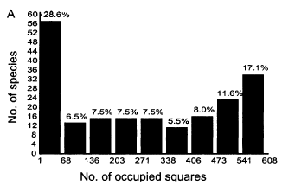
Metapopulation biology
Rescue effect – migrants decrease extinction probability
(rescue local populations)
Multiple equilibria
P
k

Slide 17
Metapopulation biology
The core-satellite hypothesis
Local population densities
Rescue of decreasing populations
Number of migrating individuals
Speed of colonization
of new sites
Number of occupied sites

Slide 18
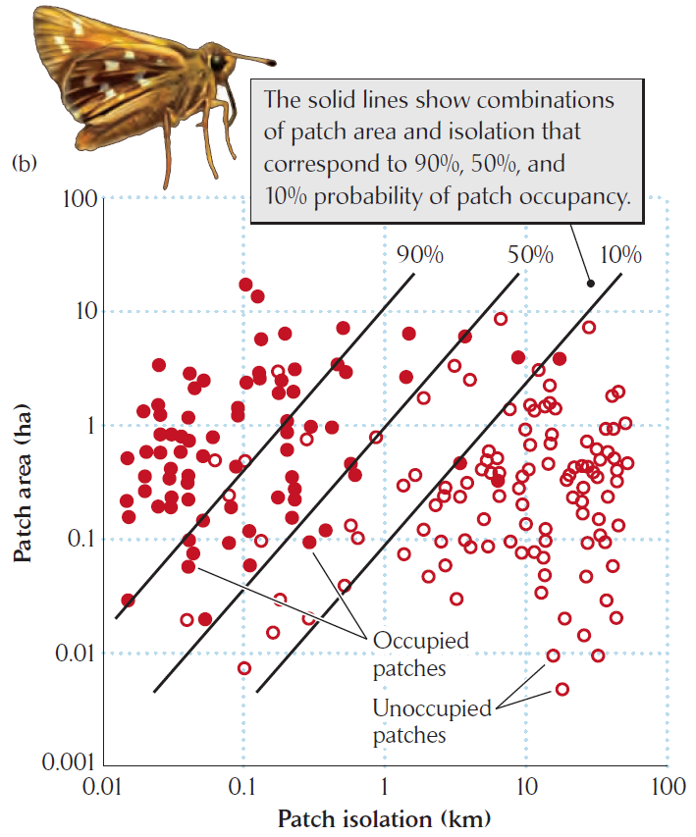
Metapopulation biology
Spatially implicit
(Levin’s equation)
Models
Spatially explicit
(incidence functions)
colonization decreases with distance
extinction decreases with patch size
Spatially realistic
(parameterized by data)
Key observation (Lenore Fahrig):
Population persistence is affected only by the total amount of habitat within an area

Slide 19
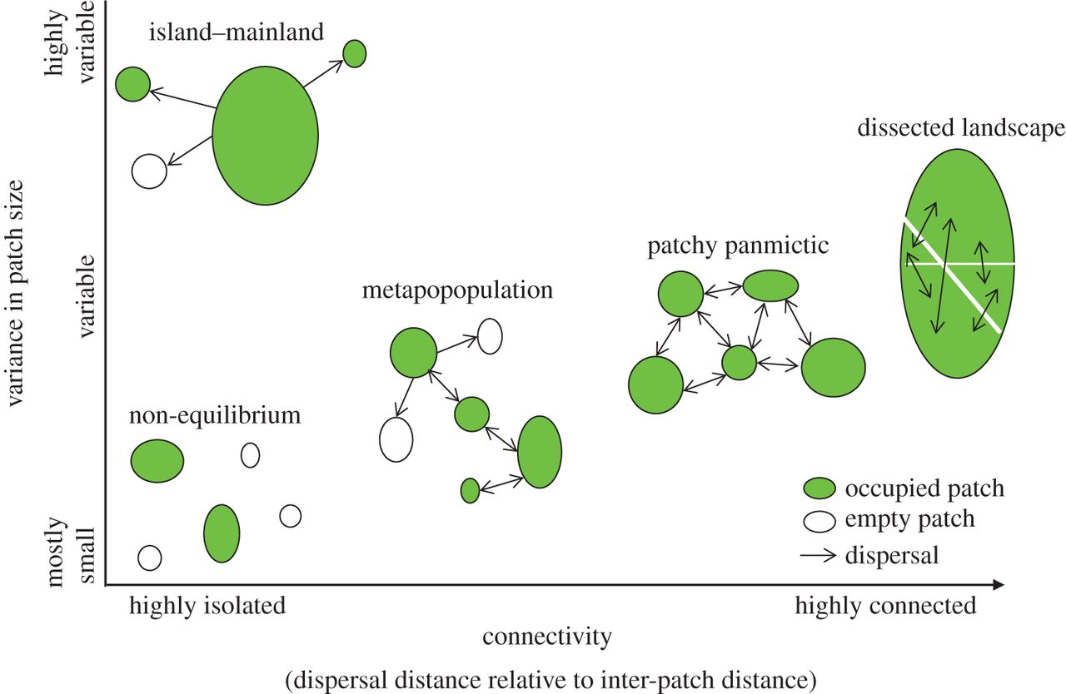


Metapopulation biology
Types of metapopulation structure
Source-sink system
$$λ>1$$
$$λ<1$$

Slide 20
Metapopulation biology and the structure of species ranges
Different (meta)population states characterize different parts of species ranges
source
population
sink
population
metapopulation
with rescue effect
Levin’s
metapopulation
non/equilibrium
metapopulation

Slide 21
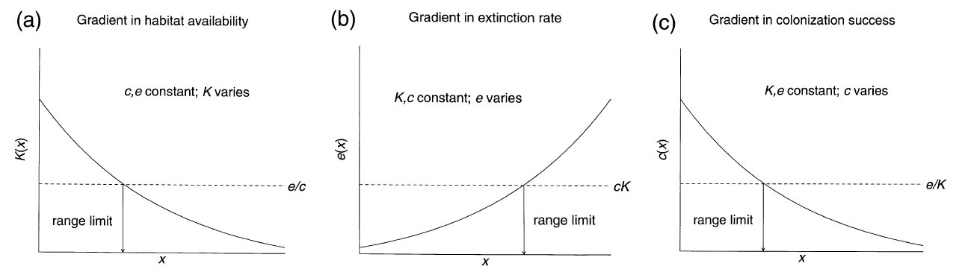
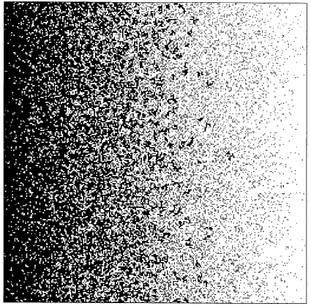
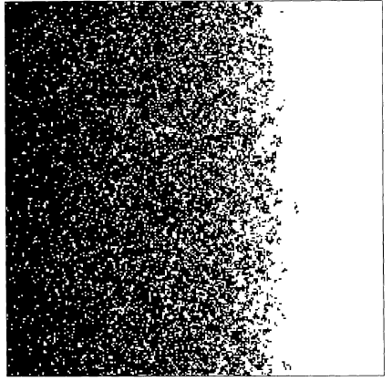
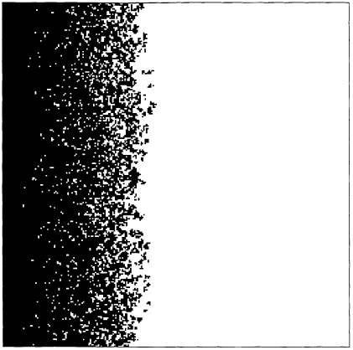
Metapopulation biology and the structure of species ranges
Different (meta)population states characterize different parts of species ranges
Metapopulation processes may delimit range edges
k

Slide 22
Metapopulation biology
Concluding remarks
Metapopulation dynamics reveal non-linearities, and thus can explain abrupt large-scale changes
Metapopulations represent mostly a boundary phenomenon or a transitory state, as evolution leads rather to patchy population, where local populations are connected by continuous migration
Many-species metapopulations may promote coexistence of species which otherwise would not coexist – spatial structure is a coexistence mechanism!
0
prey
predator
predator
prey

Slide 23
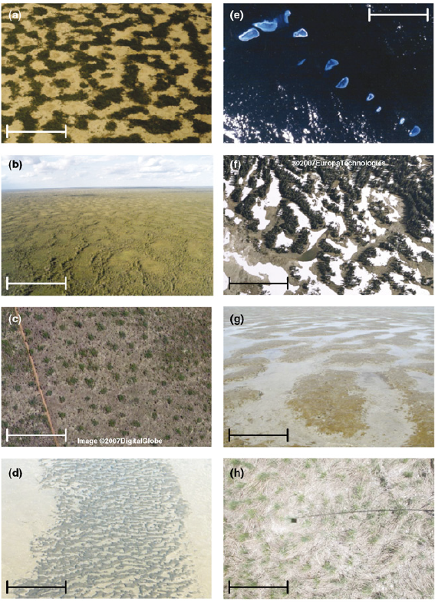
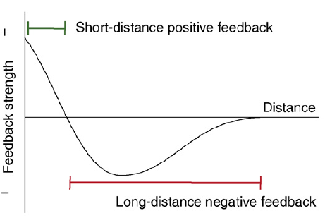
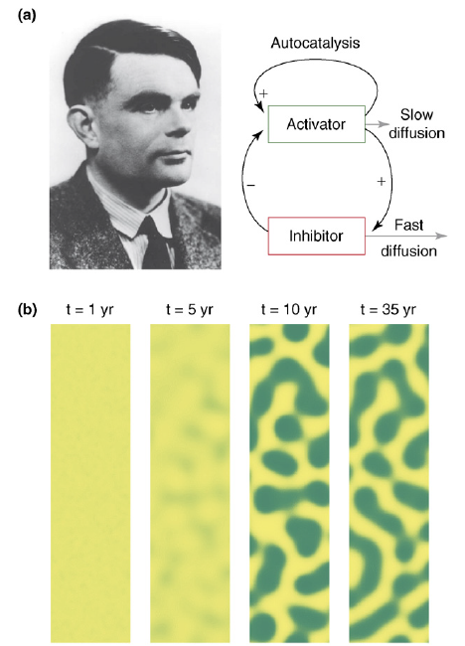
Patch dynamics and the emergence of spatial patterns
Spatial patterns are sometimes regular

Slide 24
Patch dynamics and the emergence of spatial patterns
Spatial patterns are sometimes regular
Spatial distribution often has fractal properties
1
5/9
Cover (log scale)
25/81
125/729
1/27
1/9
1/3
1
Length (log scale)

Slide 25
Patch dynamics and the emergence of spatial patterns
Spatial patterns are sometimes regular
Spatial distribution often has fractal properties
→ Species range size depends on resolution
Some level of scale-invariance
To some extent, extrapolation across scales is possible
2×2
8×8
16×16

Slide 26
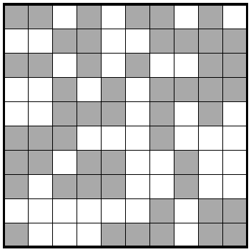
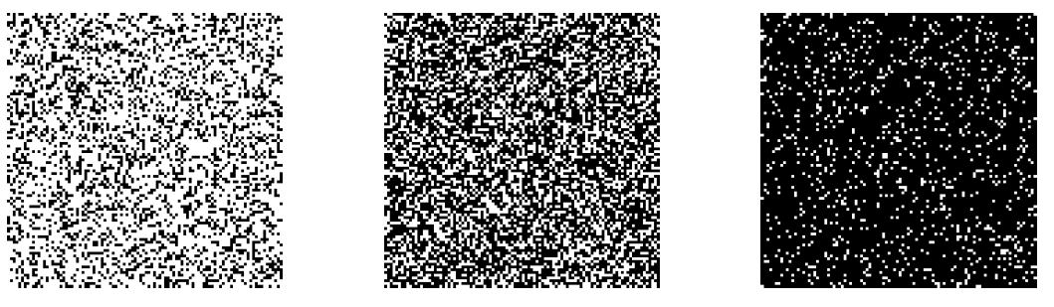
Patch dynamics and the emergence of spatial patterns
Possible causes of fractal habitats:
Percolation

Slide 27
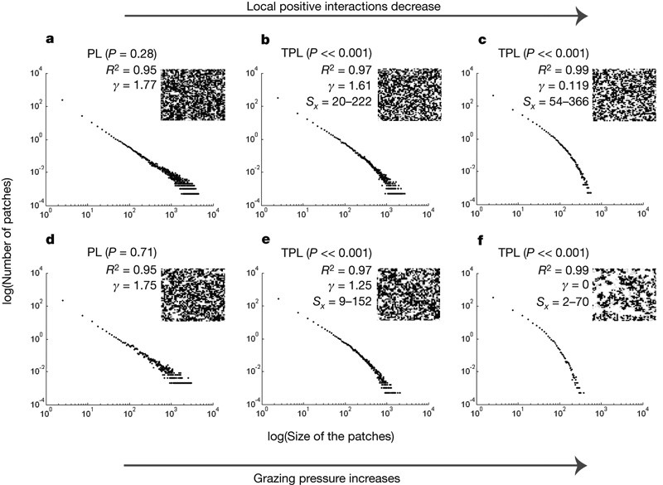
Patch dynamics and the emergence of spatial patterns
Possible causes of fractal habitats:
Percolation
Robust scaling

Slide 28
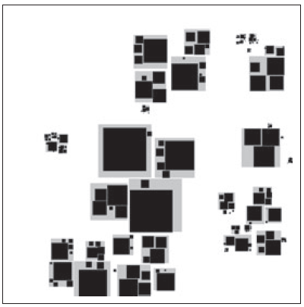
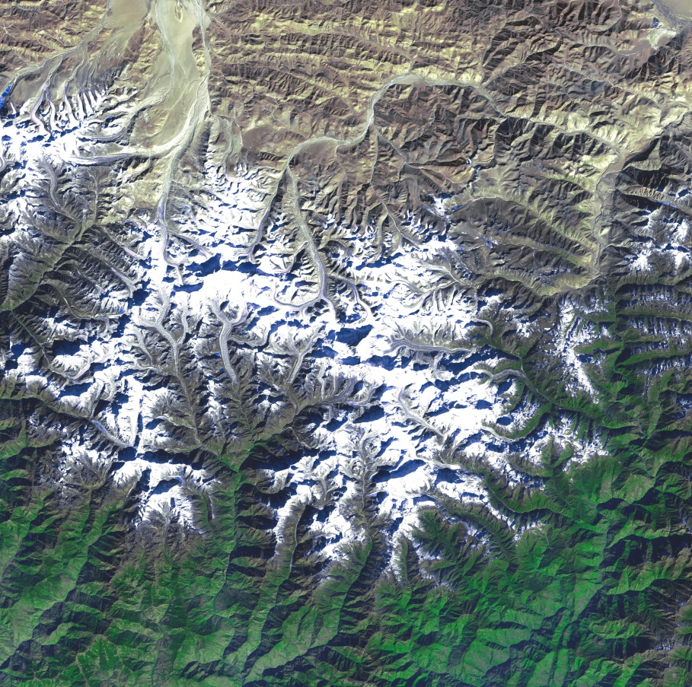
Patch dynamics and the emergence of spatial patterns
Possible causes of fractal habitats:
Percolation
Robust scaling
Habitat hierarchy
Abiotic fractal template

Slide 29

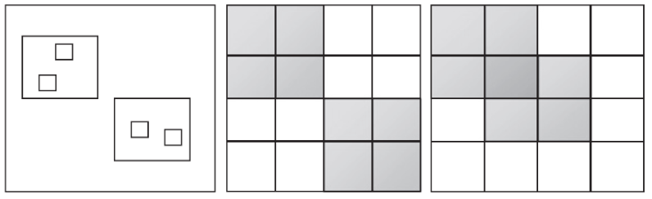
Spatial scaling of biodiversity
γ
β
α

Slide 30
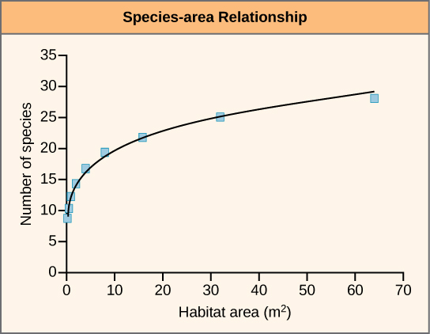
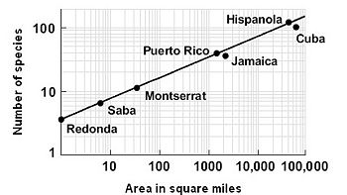
species-area relationship (SAR)
S
A
y = ax + b
logS = ZlogA + logC
intercept corresponding
to mean species number per unit area
S = CA^{Z}
slope of SAR in log-log space
0.1-0.2 for areas within a continuous mainland
0.25-0.5 for islands
cca 1 for comparison among continents

Slide 31
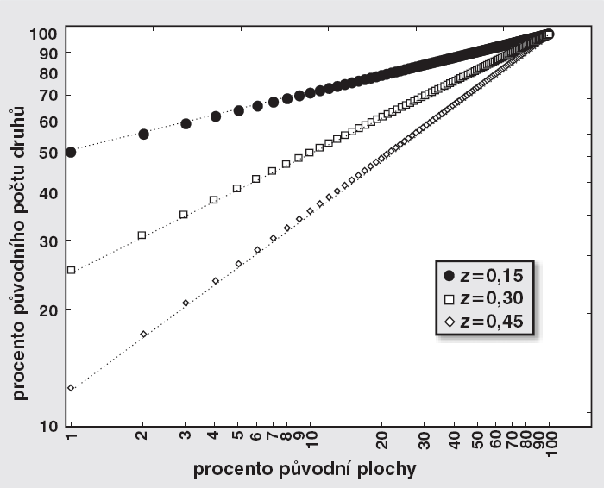
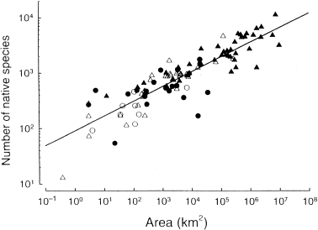
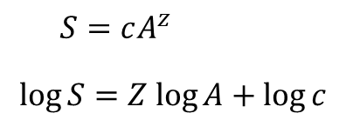
species-area relationship (SAR)
percentage of total number of species
percentage of the total area
logS = ZlogA + logC
intercept corresponding
to mean species number per unit area
S = CA^{Z}
slope of SAR in log-log space
0.1-0.2 for areas within a continuous mainland
0.25-0.5 for islands
cca 1 for comparison among continents

Slide 32
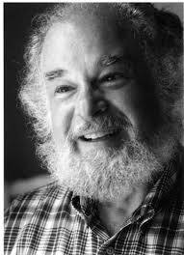
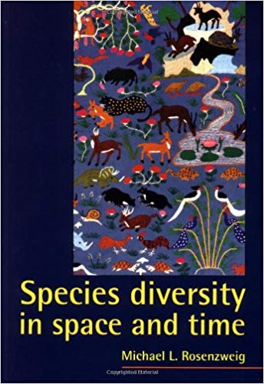
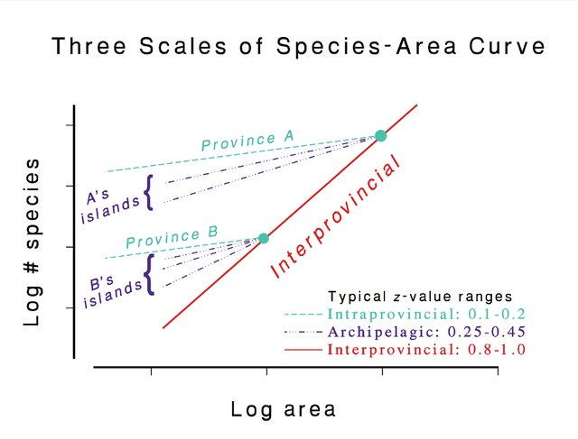
species-area relationship (SAR)
M. Rosenzweig 1995

Slide 33
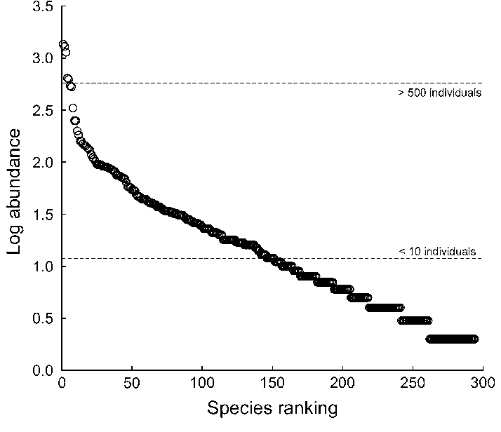
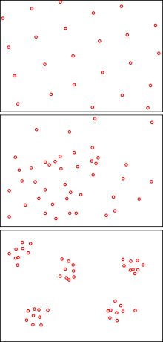

species-area relationship (SAR)
Why is SAR a power-law?
Sampling from a SAD
Habitat heterogeneity
Spatial population dynamics
spatial aggregation of indidividuals
S = S_{tot}
log S
S =
A = 1
(one grid cell)
log A
A = A_{tot}
(total number of grid cells)

Slide 34
species-area relationship (SAR)
Why is SAR a power-law?
Sampling from a SAD
Habitat heterogeneity
Spatial population dynamics
spatial aggregation of indidividuals
S = S_{tot}
Shape of nested SAR is driven by spatial aggregation of individuals; higher aggregation leads to steeper slope – slope depends on mean occupancy across species
log S
S =
A = 1
(one grid cell)
log A
A = A_{tot}
(total number of grid cells)

Slide 35
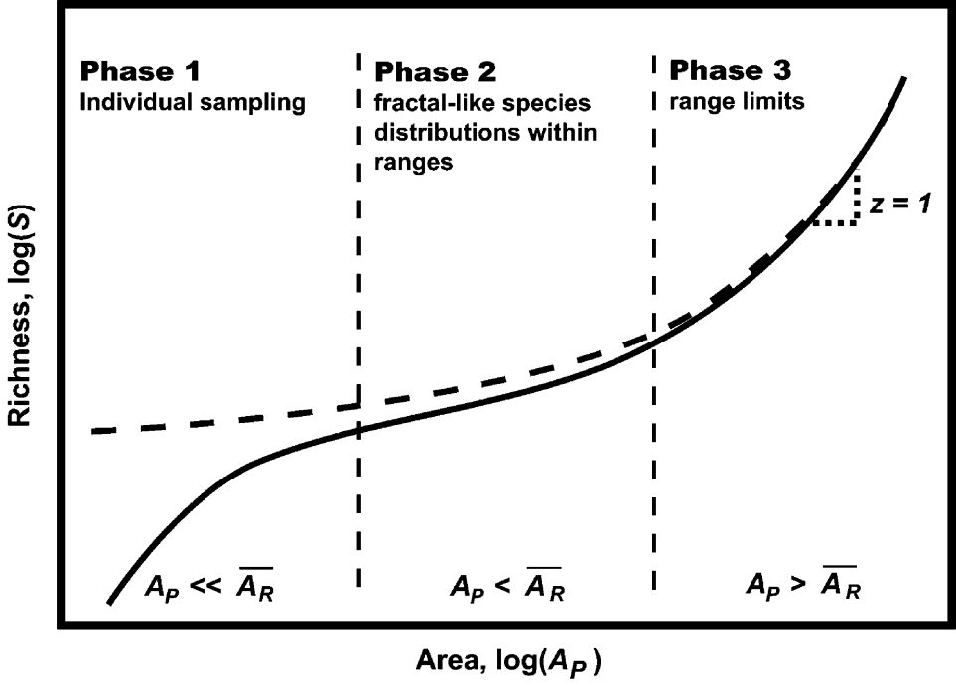
species-area relationship (SAR) is triphasic!
Lower phase of the SAR
individuals
species
log species ^ individuals
log area
Šizling AL, Kunin WE, Šizlingová E, Reif J & Storch D 2011 American Naturalist 178: 602-611

Slide 36
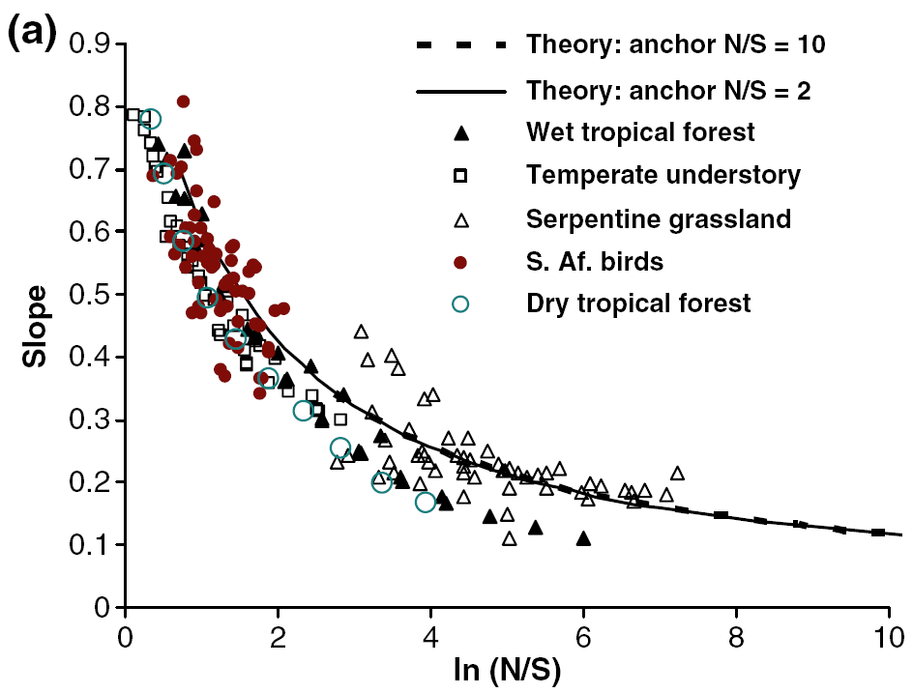
species-area relationship (SAR)
Lower phase of the SAR
Since only individuals-area relationship is linear in log-log space, all SARs must be curvilinear, with the curvilinearity dependent on mean number of individuals per species
individuals
= logN-logS=log(N/S)
species
Šizling AL, Kunin WE, Šizlingová E, Reif J & Storch D 2011 AmNat 178: 602-611
Harte J, Smith AB & Storch D 2009 Ecology Letters 12: 789

Slide 37

species-area relationship (SAR)
Upper phase of the SAR
SAR is upward-accelerating at large scales, and this curvature depends on mean species range
Storch D, Keil P & Jetz W 2012 Nature 488: 78-81

Slide 38
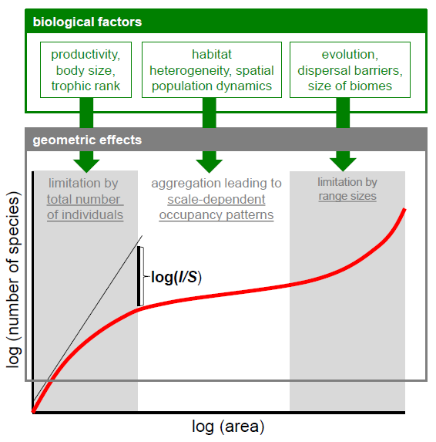
species-area relationship (SAR)
Storch D. 2016 J.Veg.Sci

