Slide 1
Advanced Ecology II
Advances in Ecology
19 February Dynamical systems and population dynamics (Storch)
26 February Trophic interactions (Storch)
5 March Interspecific competition and coexistence (Šímová)
12 March Species and the environment (Hořák)
19 March Trait and functional ecology (Hořák)
26 March Ecology and evolution of life-histories (Remeš)
2 April Fundamentals of macroecology (Storch)
9 April q Spatial ecology and metapopulation dynamics (Storch)
16 April Local diversity patterns and dynamics (Šímová)
23 April Large-scale species diversity in space and time (Storch)
30 April Ecology of the Anthropocene (Storch)
https://www.cts.cuni.cz/ ~ storch/AdvancedEcology.html

Slide 2
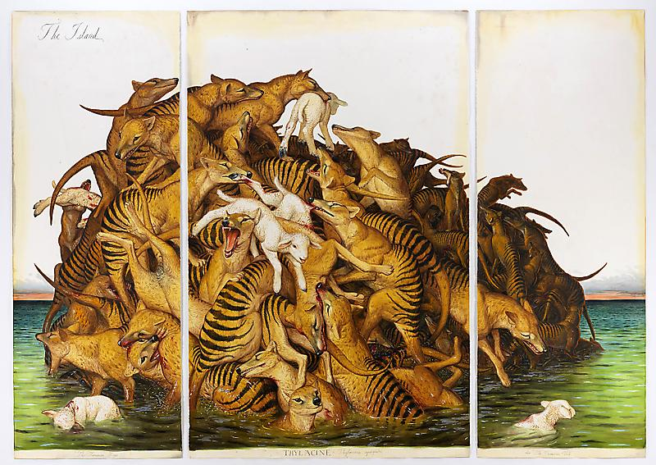
Advanced Ecology II: Dynamical systems and population dynamics
David Storch
Theory: Overview of what is possible in nature (landscape of possibilities)
Model: Formal development of one such possibility

Slide 3
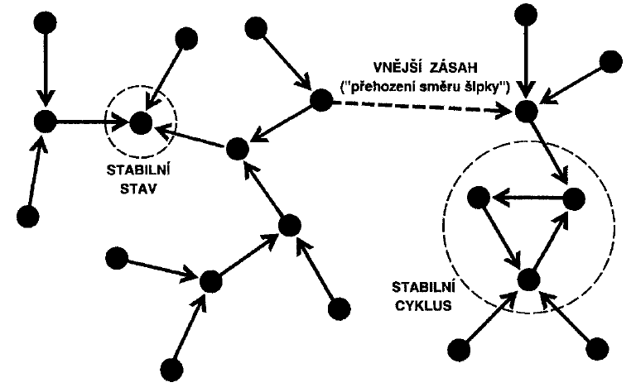
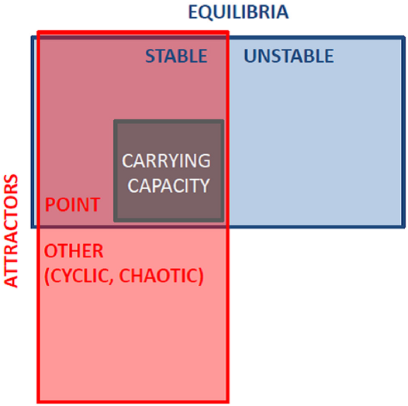
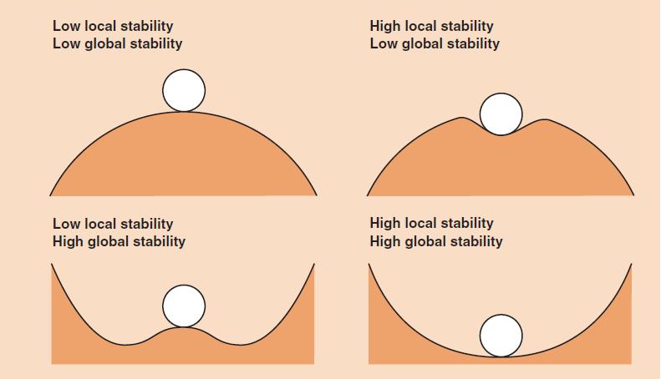
DYNAMICAL SYSTEMS
Dynamics – movement in a state space (driven by deterministic or stochastic rules)
Key concepts:
Attractors
Basin of attraction
Equilibria (fixed points)
Stability
EXTERNAL
DISTURBANCE
STABLE STATE
STABLE
CYCLE

Slide 4
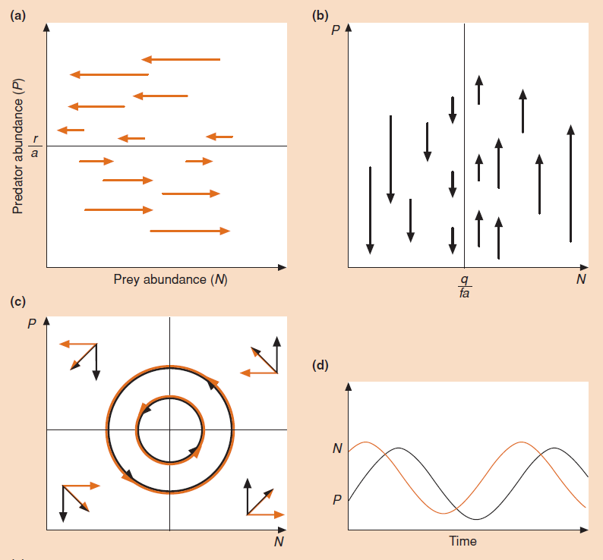
DYNAMICAL SYSTEMS
Dynamics – movement in a state space (driven by deterministic or stochastic rules)
Key concepts:
Attractors
Basin of attraction
Equilibria (fixed points)
Stability
State variables

Slide 5
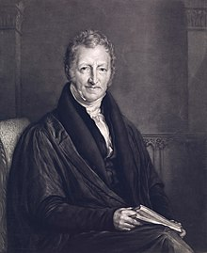
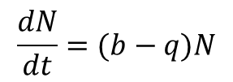
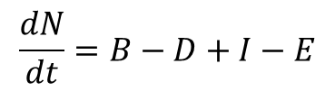
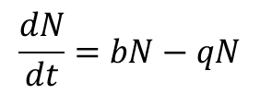
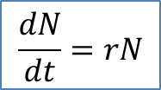
BASIC MODEL OF POPULATION GROWTH
Dynamics of a population – movement in a unidimensional state space
birth
death
immigration
emigration
$$\frac{dN}{dt}=B−D+I−E$$
$$\frac{dN}{dt}=bN−qN$$
N
Thomas R. Malthus 1798
$$\frac{dN}{dt}=(b−q)N$$
$$\frac{dN}{dt}=rN$$
time

Slide 6
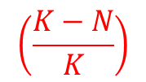
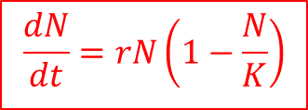
POPULATION REGULATION AND CARRYING CAPACITY – LOGISTIC EQUATION
dN
dt
= r N
K-N
$$\frac{dN}{dt}=rN\left(1−\frac{N}{K}\right)$$
N
K
K
N
time

Slide 7
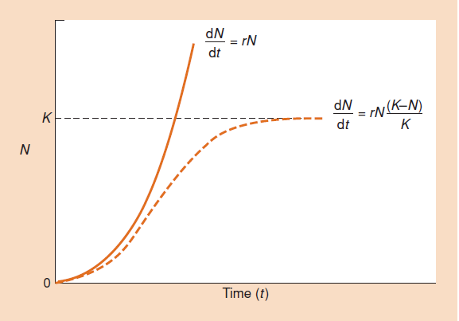
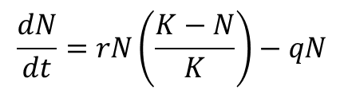
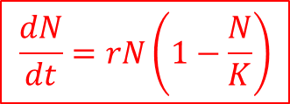
POPULATION REGULATION AND CARRYING CAPACITY – LOGISTIC EQUATION
dN
dt
= r N
$$\frac{dN}{dt}=rN\left(1−\frac{N}{K}\right)$$
Problems with logistic equation defined using K
Levins paradox:
If N>K and r is negative – positive growth
Ginzburg paradox:
Added mortality leads to lower equilibrium
Paradox of r-K strategies:
Increase of r leads to increasing K
$$\frac{dN}{dt}=rN\left(\frac{K−N}{K}\right)−qN$$

Slide 8
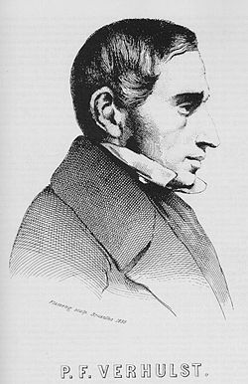


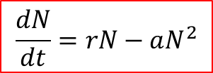
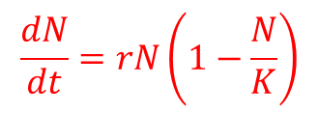


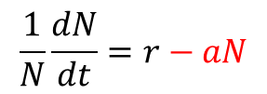

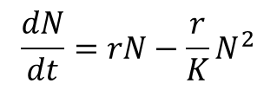


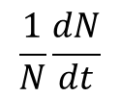
POPULATION REGULATION AND CARRYING CAPACITY
$$\frac{1}{N}\frac{dN}{dt}$$
$$\frac{1}{N}\frac{dN}{dt}=r−aN$$
per-capita population growth
$$r$$
$$\frac{dN}{dt}=rN−aN^{2}$$
$$a$$
$$=r/K$$
$$0$$
$$N$$
$$K$$
$$=r/a$$
Logistic equation can be derived (and has been originally derived) from density-dependent growth
Pierre F. Verlhust 1838
$$\frac{dN}{dt}=rN−\frac{r}{K}N^{2}$$
$$\frac{dN}{dt}=rN\left(1−\frac{N}{K}\right)$$

Slide 9
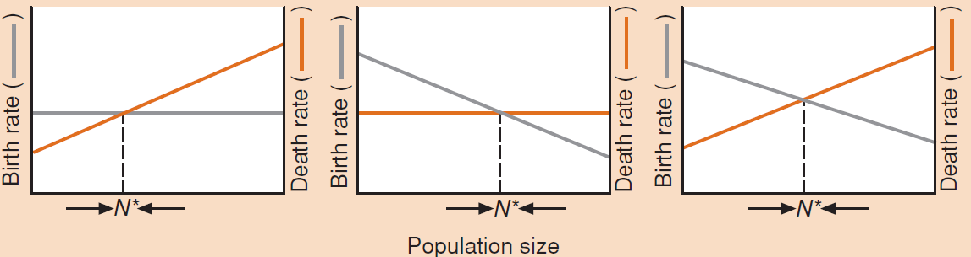
POPULATION REGULATION AND CARRYING CAPACITY
$$\frac{1}{N}\frac{dN}{dt}$$
$$\frac{1}{N}\frac{dN}{dt}=r−aN$$
per-capita population growth
$$r$$
$$\frac{dN}{dt}=rN−aN^{2}$$
$$a$$
$$=r/K$$
$$0$$
$$N$$
$$K$$
$$=r/a$$
Logistic equation can be derived (and has been originally derived) from density-dependent growth

Slide 10




POPULATION REGULATION AND CARRYING CAPACITY
$$\frac{1}{N}\frac{dN}{dt}$$
$$\frac{1}{N}\frac{dN}{dt}=r−aN$$
per-capita population growth
$$r$$
$$\frac{dN}{dt}=rN−aN^{2}$$
$$a$$
$$=r/K$$
$$0$$
$$N$$
$$K$$
$$=r/a$$
$$\frac{dN}{dt}$$
$$0$$
$$N$$
$$K$$

Slide 11

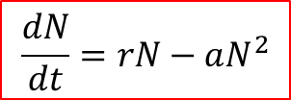

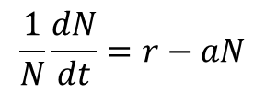

POPULATION REGULATION AND CARRYING CAPACITY
$$\frac{1}{N}\frac{dN}{dt}$$
$$\frac{1}{N}\frac{dN}{dt}=r−aN$$
$$r$$
$$\frac{dN}{dt}=rN−aN^{2}$$
$$a=r/K$$
$$0$$
$$N$$
$$K$$
Levins paradox:
If N>K and r is negative – positive growth
Ginzburg paradox:
Added mortality leads to lower equilibrium
Paradox of r-K strategies:
Increase of r leads to increasing K
$$r$$

Slide 12



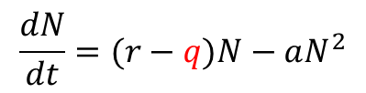
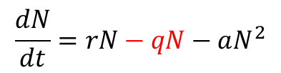
POPULATION REGULATION AND CARRYING CAPACITY
$$\frac{1}{N}\frac{dN}{dt}$$
$$\frac{1}{N}\frac{dN}{dt}=r−aN$$
$$r$$
$$\frac{dN}{dt}=rN−aN^{2}$$
$$r´=r−q$$
$$a=r/K$$
$$N$$
$$K′$$
=(r-q)/a
$$K$$
Levins paradox:
If N>K and r is negative – positive growth
Ginzburg paradox:
Added mortality leads to lower equilibrium
Paradox of r-K strategies:
Increase of r leads to increasing K
$$\frac{dN}{dt}=rN−qN−aN^{2}$$
$$\frac{dN}{dt}=(r−q)N−aN^{2}$$

Slide 13

POPULATION REGULATION AND CARRYING CAPACITY
$$\frac{1}{N}\frac{dN}{dt}$$
$$\frac{1}{N}\frac{dN}{dt}=r−aN$$
$$r$$
$$\frac{dN}{dt}=rN−aN^{2}$$
$$r´=r−q$$
$$a=r/K$$
$$N$$
$$K′$$
=(r-q)/a
$$K$$
Levins paradox:
If N>K and r is negative – positive growth
Ginzburg paradox:
Added mortality leads to lower equilibrium
Paradox of r-K strategies:
Increase of r leads to increasing K
Carrying capacity emerges due to density-dependent population growth rate and is affected by r

Slide 14

POPULATION REGULATION AND CARRYING CAPACITY
Carrying capacity emerges due to density-dependent population growth rate and is affected by r

Slide 15
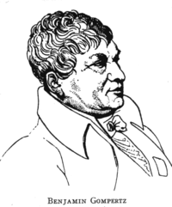
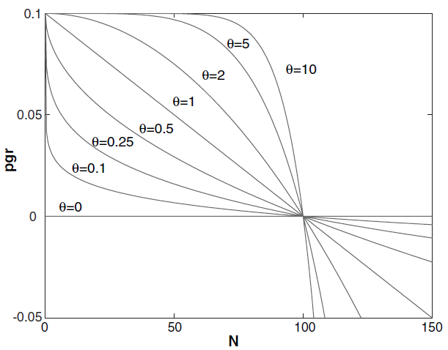
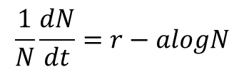
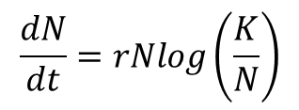


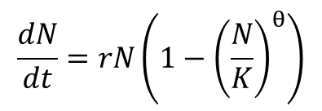

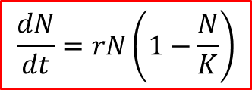

POPULATION REGULATION AND CARRYING CAPACITY
Some notes on logistic equation:
Linear density-dependence is not the only possibility
$$\frac{dN}{dt}=rN\left(1−\frac{N}{K}\right)$$
Generalized logistic / Theta logistic equation
Gompertz equation
Benjamin Gompertz 1825
$$\frac{dN}{dt}=rN\left(1−{\left(\frac{N}{K}\right)}^{θ}\right)$$
$$\frac{dN}{dt}=rNlog\left(\frac{K}{N}\right)$$
$$\frac{1}{N}\frac{dN}{dt}=r−alogN$$
$$r$$
$$0$$
$$K$$
$$logN$$
$$=r/a$$

Slide 16
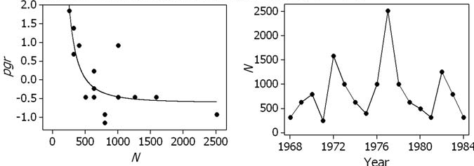
POPULATION REGULATION AND CARRYING CAPACITY
Some notes on logistic equation:
Linear density-dependence is not the only possibility
Generalized logistic / Theta logistic equation
Gompertz equation
$$\frac{dN}{dt}=rN\left(1−{\left(\frac{N}{K}\right)}^{θ}\right)$$
$$\frac{dN}{dt}=rNlog\left(\frac{K}{N}\right)$$

Slide 17



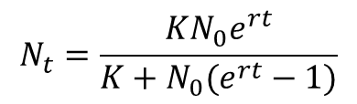



POPULATION REGULATION AND CARRYING CAPACITY
Some notes on logistic equation:
Linear density-dependence is not the only possibility
Logistic equation is not the logistic function
$$\frac{dN}{dt}$$
$$\frac{dN}{dt}=rN\left(1−\frac{N}{K}\right)$$
$$0$$
$$N$$
integration
$$K$$
N
$$N_{t}=\frac{KN_{0}e^{rt}}{K+N_{0}(e^{rt}−1)}$$
$$K$$
The sigmoidal curve is only a solution of logistic equation for initial N close to zero
time

Slide 18
POPULATION REGULATION AND CARRYING CAPACITY
Some notes on logistic equation:
Linear density-dependence is not the only possibility
Logistic equation is not the logistic function
Carrying capacity depends on r, but it does not mean it is independent of resources (see next lecture!)

Slide 19
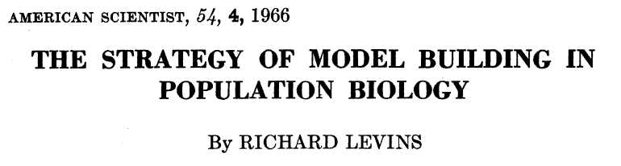
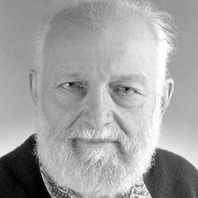
MORE COMPLEX/REALISTIC POPULATION MODELS
Models
simple
complex
heuristic
predictive
phenomenological
mechanistic
„Levins triangle“ of models
Richard Levins 1966
GENERALITY
logistic equation
PRECISION
REALISM

Slide 20
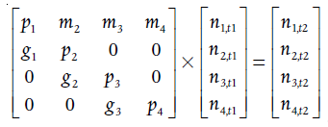

MORE COMPLEX/REALISTIC POPULATION MODELS
Populations with non-overlapping generations
Populations with overlapping generations
Difference equations that include delayed density dependences
Projection matrix population models
$$N_{t}=f(N_{t−1}, N_{t−2},…)$$

Slide 21
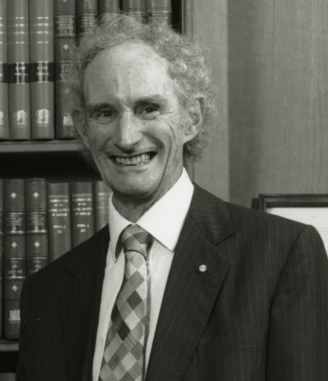



MAY EQUATION AND COMPLEX DYNAMICS GENERATED BY A SIMPLE RULE
$$N_{t+1}=RN_{t}(1−N_{t})$$
1:1 line
$$N_{t+1}$$
Robert May 1976
$$N_{t}$$

Slide 22
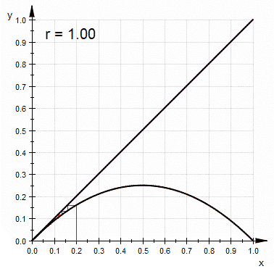
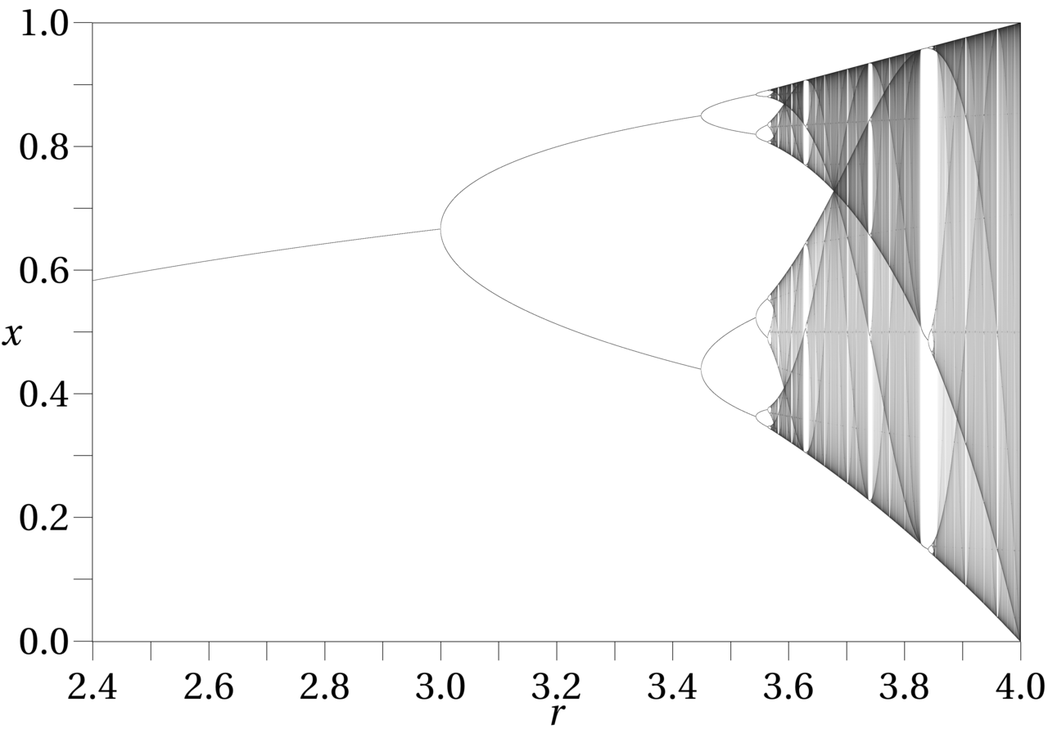
MAY EQUATION AND COMPLEX DYNAMICS GENERATED BY A SIMPLE RULE
$$N_{t+1}=RN_{t}(1−N_{t})$$
Robert May 1976

Slide 23
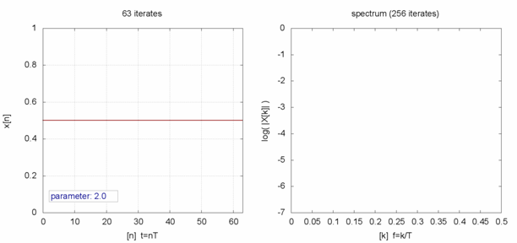
MAY EQUATION AND COMPLEX DYNAMICS GENERATED BY A SIMPLE RULE
$$N_{t+1}=RN_{t}(1−N_{t})$$
Under particular values of R, oscillations change to chaos
= cycles with infinite length
= limiting sensitivity to initial conditions
= impossibility to predict population state by other means than just going (deterministically) step-by-step
Robert May 1976
saileesakhalkar.shinyapps.io/MaysEquation/

Slide 24
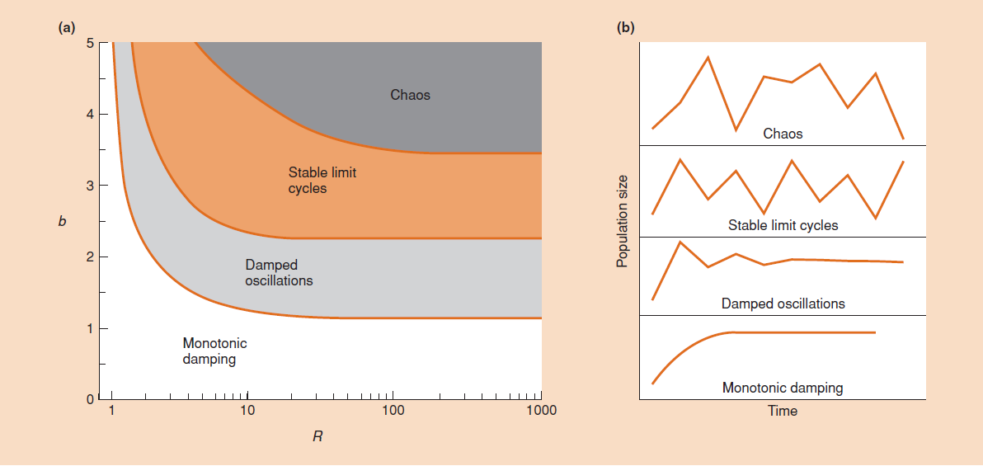
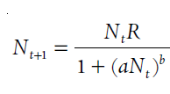
MAY EQUATION AND COMPLEX DYNAMICS GENERATED BY A SIMPLE RULE
$$N_{t+1}=RN_{t}(1−N_{t})$$
Simple difference equation with negative density-dependence generates a wide range of population behaviour, including stabilization, cycles, and chaos
Determinism is not equivalent to predictability!
Robert May 1976

Slide 25
MAY EQUATION AND COMPLEX DYNAMICS GENERATED BY A SIMPLE RULE
$$N_{t+1}=RN_{t}(1−N_{t})$$
GENERALITY
Robert May 1976
logistic equation
PRECISION
REALISM

Slide 26
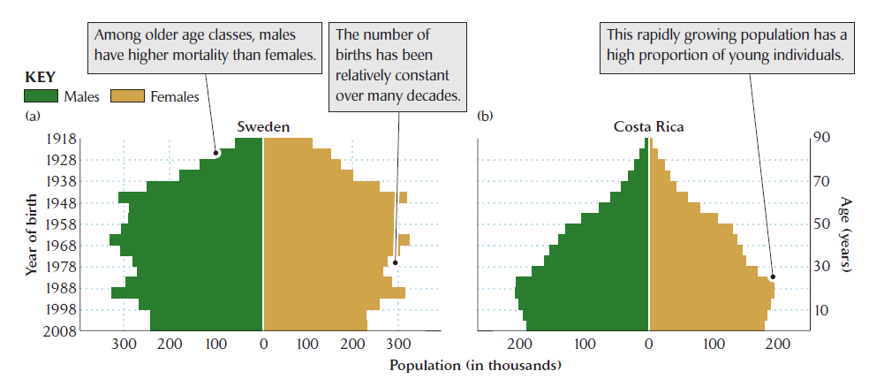
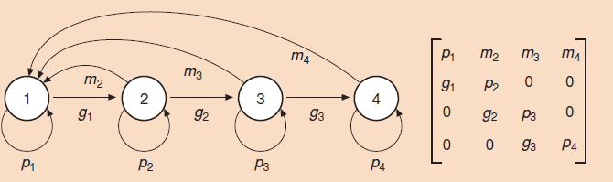
MATRIX PROJETION MODELS OF POPULATIONS WITH AGE STRUCTURE
Different age classes or life stages differently contribute to population changes, having different survival and recruitment

Slide 27
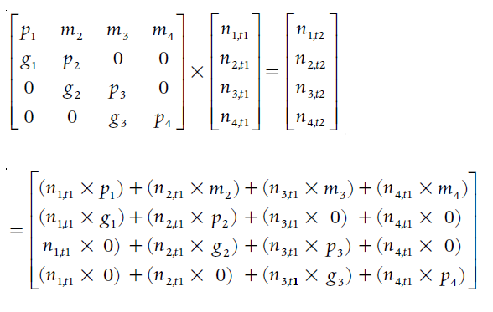
MATRIX PROJETION MODELS OF POPULATIONS WITH AGE STRUCTURE
Different age classes or life stages differently contribute to population changes, having different survival and recruitment
Stages in year t
1 2 3 4
1234
Stages in year t+1

Slide 28



MATRIX PROJETION MODELS OF POPULATIONS WITH AGE STRUCTURE
Different age classes or life stages differently contribute to population changes, having different survival and recruitment
Populations with non-overlapping generations
Populations with overlapping generations
Difference equations with delayed density dependences
Projection matrix population models
$$N_{t+1}={λN}_{t}$$
$$n_{t+1}={Ln}_{t}$$
$$N_{t}={λ_{}^{k}N}_{t−k}$$
$$n_{t}={L_{}^{k}n}_{t−k}$$
$$L$$
$$n_{t}$$
$$n_{t+1}$$

Slide 29
MATRIX PROJETION MODELS OF POPULATIONS WITH AGE STRUCTURE
Different age classes or life stages differently contribute to population changes, having different survival and recruitment
GENERALITY
logistic equation
difference equations/simulations
matrix projection models
PRECISION
REALISM

Slide 30
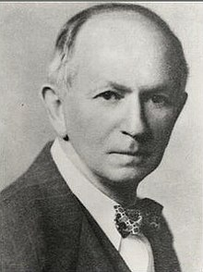
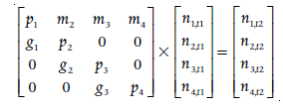

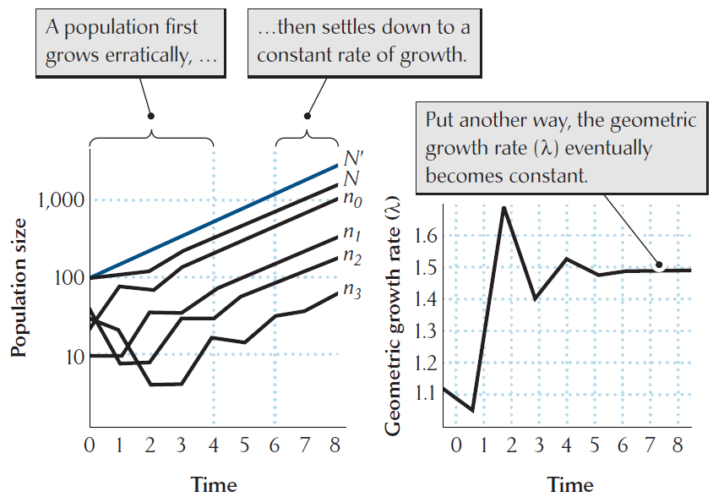
MATRIX PROJETION MODELS OF POPULATIONS WITH AGE STRUCTURE
Important results from matrix projection models:
If transition probabilities are constant, age structure stabilizes based on the projection matrix (it is its dominant eigenvector)
Alfred Lotka 1939

Slide 31




MATRIX PROJETION MODELS OF POPULATIONS WITH AGE STRUCTURE
Important results from matrix projection models:
If transition probabilities are constant, age structure stabilizes based on the Leslie matrix (it is its dominant eigenvector)
Population growth rate is then uniquely determined by the matrix (it is the eigenvalue of its dominant eigenvector); growth is then exponential
Euler-Lotka equation
Leonhard Euler 1760
$$1=\sum_{x=0}^{ω}{λ^{−x}l_{x}m_{x}}$$
$$λ=\lim_{n→∞}{\frac{N_{t}}{N_{t−1}}}$$
$$r=logλ$$
$$1=\sum_{x=0}^{ω}{e^{−rx}l_{x}m_{x}}$$

Slide 32


MATRIX PROJETION MODELS OF POPULATIONS WITH AGE STRUCTURE
Important results from matrix projection models:
If transition probabilities are constant, age structure stabilizes based on the Leslie matrix (it is its dominant eigenvector)
Population growth rate is then uniquely determined by the matrix (it is the eigenvalue of its dominant eigenvector); growth is then exponential
Population growth rate is differently sensitive to a perturbation of different elemens of the matrix
Sensitivity analysis – how sensitive is population growth rate to absolute change of given element
Elasticity analysis – how sensitive is population growth rate to relative change of given element
Application: Kemp’s ridley turtle (Lepidochelys kempi)

Slide 33


MATRIX PROJETION MODELS OF POPULATIONS WITH AGE STRUCTURE
Important results from matrix projection models:
If transition probabilities are constant, age structure stabilizes based on the Leslie matrix (it is its dominant eigenvector)
Population growth rate is then uniquely determined by the matrix (it is the eigenvalue of its dominant eigenvector); growth is then exponential
Population growth rate is differently sensitive to a perturbation of different elemens of the matrix
Different age stages are differently sensitive to various factors, including weather, competitors/predators and own population density; this can lead to delayed population responses to density and oscillations
total mortality
juvenile
mortality
relative mortality
adult
mortality
adult mortality
log abundance
time (years)

Slide 34
MATRIX PROJETION MODELS OF POPULATIONS WITH AGE STRUCTURE
Important results from matrix projection models:
If transition probabilities are constant, age structure stabilizes based on the Leslie matrix (it is its dominant eigenvector)
Population growth rate is then uniquely determined by the matrix (it is the eigenvalue of its dominant eigenvector); growth is then exponential
Population growth rate is differently sensitive to a perturbation of different elemens of the matrix
Different age stages are differently sensitive to various factors, including weather, competitors/predators and own population density; this can lead to delayed population responses to density and oscillations
Traditional distinction between population limitation and population regulation is obsolette – various vital rates react to various factors, and density-dependence in some form is ubiquitous
Presence of species depends on lambda >=1, affected by the combination of all the matrix elements (recruitment and survival of all age classes), but not with the same importance

Slide 35

Concluding remarks
Population trajectories are extremely variable, due to external and internal effects and various feedbacks
Still, they reveal common properties, namely (1) persistence, (2) boundedness, and (3) return tendency
Traditional distinction between population limitation and population regulation is obsolette – various vital rates react to various factors, and density-dependence in some form is ubiquitous
Logistic equation is a good general approximation of the dynamics; carrying capacity is the stable equilibrium of dynamics
Oscillations can be due to delayed response to population density, but other options are more probable
Strong delayed density-dependence can lead to chaos, but its presence in nature is unclear

