Slide 1
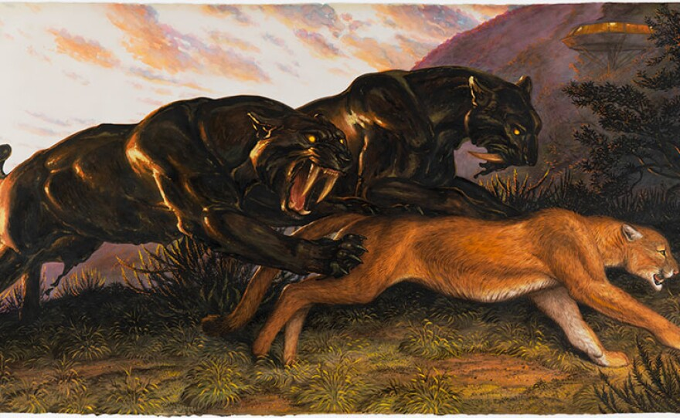
Advanced Ecology II: Complex population dynamics and trophic interactions
David Storch

Slide 2

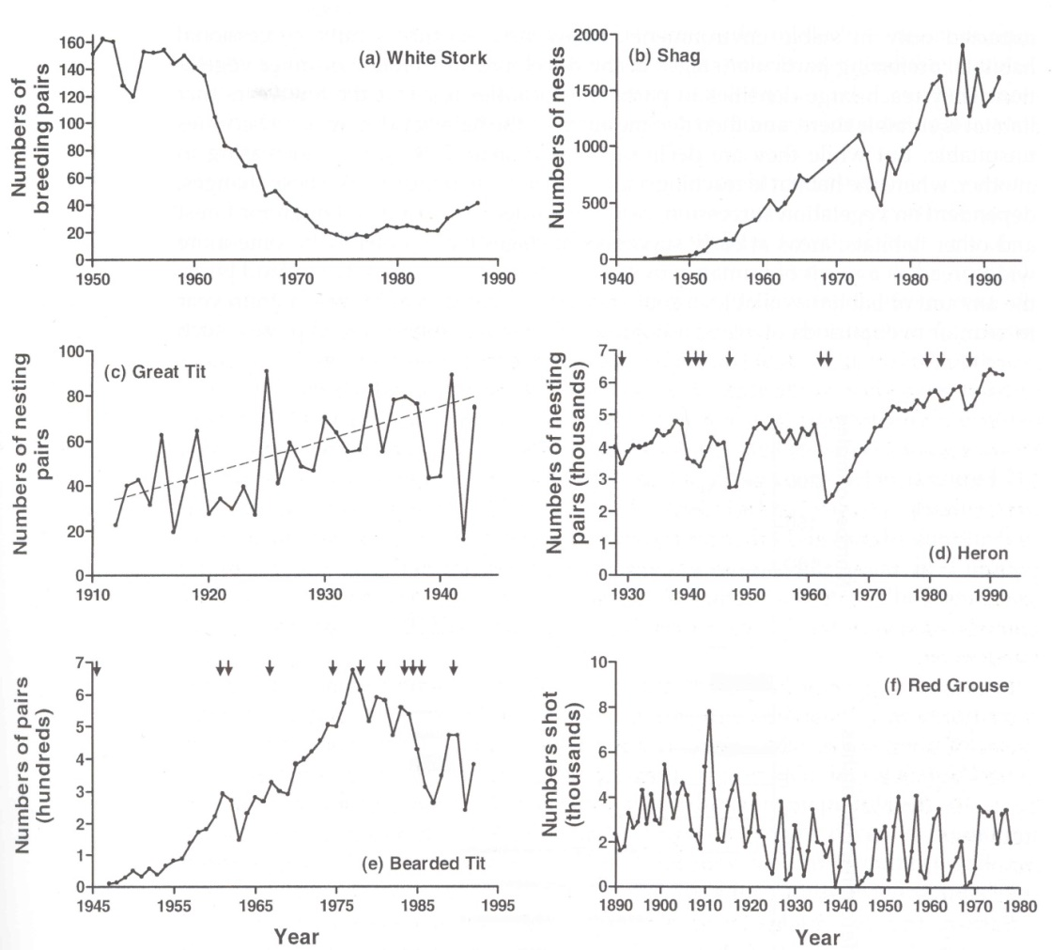
What have we learned so far
Regardless of population variability, populations reveal common properties, namely (1) persistence, (2) boundedness, and (3) return tendency
Logistic equation is a good general approximation of the dynamics, as it encompasses simple density-dependence
Carrying capacity is the stable equilibrium of dynamics, can be affected by population growth
There are more complex models that can lead to more complex behaviour
Oscillations can be due to delayed response to population density
Strong delayed density-dependence can lead to chaos
Populations with overlapping generations are modeled using projection matrices; real populations are differently sensitive to different elements of the matrix
Proper understanding of population dynamics requires insight into what happens inside as well as outside populations

Slide 3
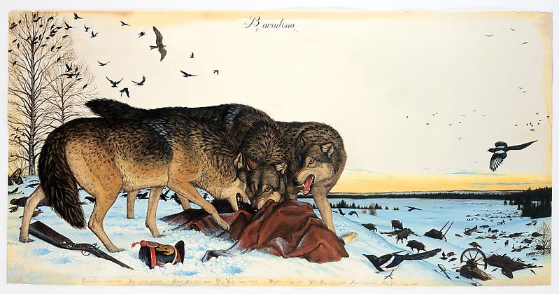
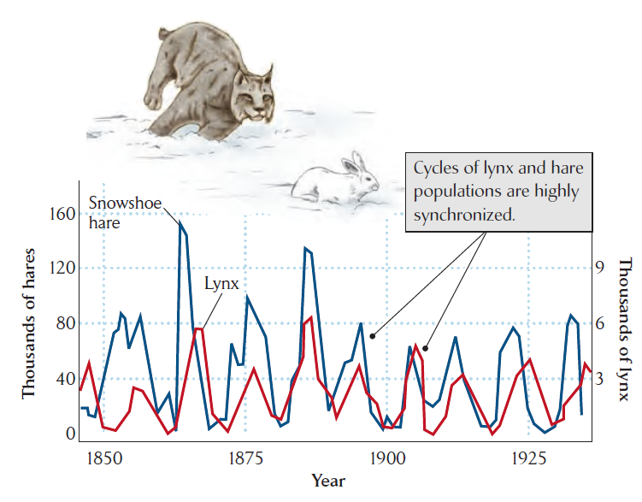
Predator-prey interactions
Predators may (but may not) affect population dynamics of prey
Predators may (but may not) regulate population of prey
Predator-prey dynamics may (but may not) lead to population cycles

Slide 4
Predator-prey interactions
Classification of predator-prey interactions

Slide 5
Predator-prey interactions
Classification of predator-prey interactions
high | predators | parasitoids
low | herbivores | parasites, pathogens
 | low | high
lethality
intimacy

Slide 6
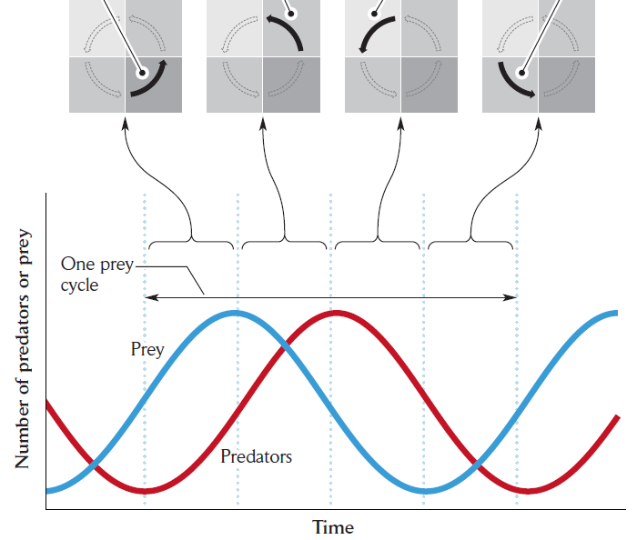

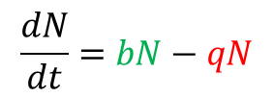




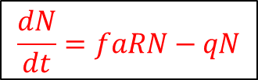
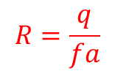
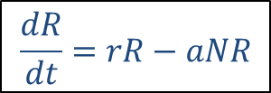


Predator-prey interactions – basic model (Lotka-Volterra)
Coupled dynamics of prey R
and predator N
natality
mortality
$$\frac{dN}{dt}=bN−qN$$
growth constant
efficiency of
resource removal
conversion
to biomass
mortality
$$N$$
$$\frac{dR}{dt}=rR−aNR$$
$$\frac{dN}{dt}=faRN−qN$$
Zero-growth isocline
Zero-growth isocline
$$N=\frac{r}{a}$$
$$0=rR−aNR$$
$$0=faRN−qN$$
$$N=\frac{r}{a}$$
$$R=\frac{q}{fa}$$
$$R=\frac{q}{fa}$$
$$R$$

Slide 7
Predator-prey interactions – basic model (Lotka-Volterra)
growth constant
efficiency of
resource removal
conversion
to biomass
mortality
$$N$$
$$\frac{dR}{dt}=rR−aNR$$
$$\frac{dN}{dt}=faRN−qN$$
natality
mortality
$$N=\frac{r}{a}$$
Mortality of prey is entirely due to predation, and natality of predator is entirely due to prey
(the other terms are constant→exponential)
$$R=\frac{q}{fa}$$
$$R$$
Lotka-Volterra model – leads to neutral cycles, as it is entirely symmetric

Slide 8

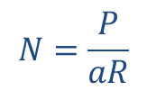

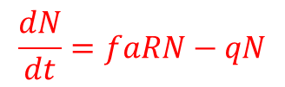


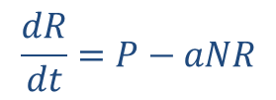
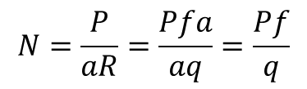

POPULATION REGULATION AND CARRYING CAPACITY
→ Coupled dynamics of resources R
and population size N
Constant growth of „prey“ (no self-catalysis)
$$N=\frac{P}{aR}$$
production
of resource
efficiency of
resource removal
conversion
to biomass
mortality
$$N$$
$$\frac{dR}{dt}=P−aNR$$
$$\frac{dN}{dt}=faRN−qN$$
Zero-growth isocline
Zero-growth isocline
$$0=P−aNR$$
$$0=faRN−qN$$
$$N=\frac{P}{aR}$$
$$R=\frac{q}{fa}$$
$$R=\frac{q}{fa}$$
$$R$$
Carrying capacity = zero growth for R and N
$$N=\frac{P}{aR}=\frac{Pfa}{aq}=\frac{Pf}{q}$$

Slide 9
POPULATION REGULATION AND CARRYING CAPACITY
→ Coupled dynamics of resources R
and population size N
$$N=\frac{P}{aR}$$
production
of resource
efficiency of
resource removal
conversion
to biomass
mortality
$$N$$
$$\frac{dR}{dt}=P−aNR$$
$$\frac{dN}{dt}=faRN−qN$$
higher
mortality
Zero-growth isocline
Zero-growth isocline
higher
conversion
rate
$$0=P−aNR$$
$$0=faRN−qN$$
$$N=\frac{P}{aR}$$
$$R=\frac{q}{fa}$$
$$R=\frac{q}{fa}$$
$$R$$
Carrying capacity depends not only on the influx of resource(s), but also on mortality – or, more generally, on the rate of the removal of the resource from the system!
Carrying capacity – zero growth for R and N
$$N=\frac{P}{aR}=\frac{Pfa}{aq}=\frac{Pf}{q}$$

Slide 10
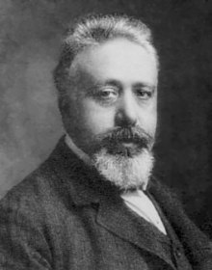

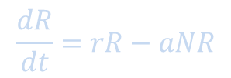
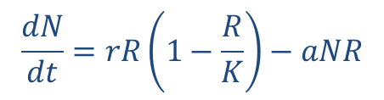
Predator-prey interactions – added prey resource limitation
Volterra model – added logistic growth to prey (R)
growth constant
efficiency of
resource removal
conversion
to biomass
mortality
Vito Volterra 1931
$$\frac{dR}{dt}=rR−aNR$$
$$\frac{dN}{dt}=faRN−qN$$
prey resouce limitation
predator
$$\frac{dN}{dt}=rR\left(1−\frac{R}{K}\right)−aNR$$
prey
Addition of resource limitation of prey leads to damped oscillations, which eventually stabilize on a particular predator-prey proportion

Slide 11

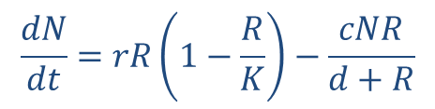
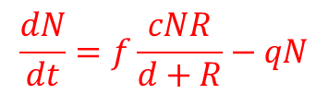
Predator-prey interactions – adding functional responses
Volterra model – added logistic growth to prey (R)
Rosenzweig-MacArthur model – added predator saturation
functional response type I
growth constant
efficiency of
resource removal
conversion
to biomass
mortality
$$\frac{dR}{dt}=rR−aNR$$
$$\frac{dN}{dt}=faRN−qN$$
functional response type II
prey resouce limitation
$$\frac{dN}{dt}=rR\left(1−\frac{R}{K}\right)−\frac{cNR}{d+R}$$
killing raete per predator
Predator is unable to consume proportionally higher number of prey if it has high densities (constant handling time)
predator saturation
$$\frac{dN}{dt}=f\frac{cNR}{d+R}−qN$$
functional response type III
density of prey

Slide 12
Predator-prey interactions – adding functional responses
Volterra model – added logistic growth to prey (R)
Rosenzweig-MacArthur model – added predator saturation
growth constant
efficiency of
resource removal
conversion
to biomass
mortality
$$\frac{dR}{dt}=rR−aNR$$
$$\frac{dN}{dt}=faRN−qN$$
prey resouce limitation
predator
$$\frac{dN}{dt}=rR\left(1−\frac{R}{K}\right)−\frac{cNR}{d+R}$$
predator saturation
$$\frac{dN}{dt}=f\frac{cNR}{d+R}−qN$$
prey
Addition of predator saturation leads to complex dynamics that depends on parameters

Slide 13
Predator-prey interactions – adding functional responses
Volterra model – added logistic growth to prey (R)
Rosenzweig-MacArthur model – added predator saturation
prey resouce limitation
predator
$$\frac{dN}{dt}=rR\left(1−\frac{R}{K}\right)−\frac{cNR}{d+R}$$
predator saturation
$$\frac{dN}{dt}=f\frac{cNR}{d+R}−qN$$
prey
Addition of predator saturation leads to complex dynamics that depends on parameters
The model leads to point attractor or cycles

Slide 14
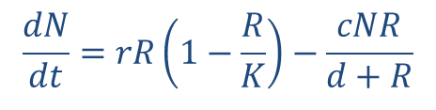
PARADOX OF ENRICHMENT
Volterra model – added logistic growth to prey (R)
Rosenzweig-MacArthur model – added predator saturation
The model leads to destabilization when there are more resources for the prey
prey resouce limitation
predator
$$\frac{dN}{dt}=rR\left(1−\frac{R}{K}\right)−\frac{cNR}{d+R}$$
predator saturation
$$\frac{dN}{dt}=f\frac{cNR}{d+R}−qN$$
prey
Addition of predator saturation leads to complex dynamics that depends on parameters
The model leads to point attractor or cycles, but leads to counterintuitive destabilization

Slide 15

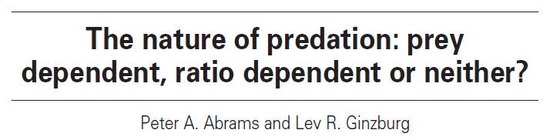

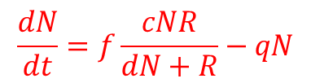
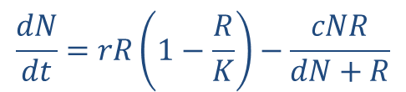
PARADOX OF ENRICHMENT
Volterra model – added logistic growth to prey (R)
Rosenzweig-MacArthur model – added predator saturation
The model leads to destabilization when there are more resources for the prey
One solution: Ratio-dependent (R/N) instead of Prey-dependent (R) killing rate
Lev Ginsburg 1989
prey resouce limitation
predator
$$\frac{dN}{dt}=rR\left(1−\frac{R}{K}\right)−\frac{cNR}{dN+R}$$
predator saturation
$$\frac{dN}{dt}=f\frac{cNR}{dN+R}−qN$$
prey

Slide 16
PARADOX OF ENRICHMENT
Volterra model – added logistic growth to prey (R)
Rosenzweig-MacArthur model – added predator saturation
The model leads to destabilization when there are more resources for the prey
One solution: Ratio-dependent (R/N) instead of Prey-dependent (R)
Or generally predator interference
predator
prey

Slide 17
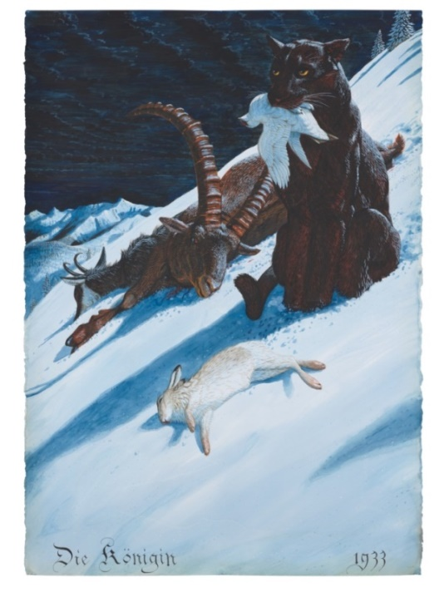
Role of predator switching
Volterra model – added logistic growth to prey (R)
Rosenzweig-MacArthur model – added predator saturation
functional response type I
The model leads to destabilization when there are more resources for the prey
One solution: Ratio-dependent (R/N) instead of Prey-dependent (R)
Or generally predator interference
Or Functional response III
functional response type II
killing raete per predator
functional response type III
Prey can recover in low densities, as the predator avoids it due to optimal foraging or refugia for prey
→ it consumes a different prey (generalist predator)
density of prey

Slide 18
Role of predator switching
Volterra model – added logistic growth to prey (R)
Rosenzweig-MacArthur model – added predator saturation
The model leads to destabilization when there are more resources for the prey
One solution: Ratio-dependent (R/N) instead of Prey-dependent (R)
Or generally predator interference
Or Functional response III
predator
prey
Stable predator-prey cycles can emerge under some conditions, and may be variously complex

Slide 19
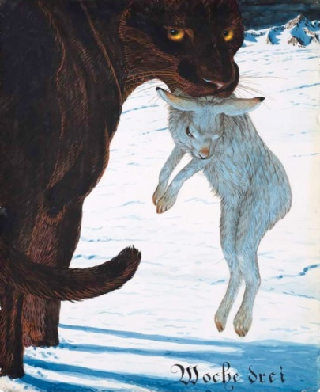


MULTIPLE EQUILIBRIA – THE CASE OF GENERALIST PREDATORS
Generalist predator – negligible numerical response, as it switches between prey
Gradual change of predation pressure can lead to abrupt change in the number of equilibria
predator
prey

Slide 20
MULTIPLE EQUILIBRIA – THE CASE OF GENERALIST PREDATORS
Generalist predator – negligible numerical response, as it switches between prey
Gradual change of predation pressure can lead to abrupt change in the number of equilibria
functional response type II
functional response type III
rates of prey growth
and removal by predator
rates of prey growth
and removal by predator
prey density
prey density
Application: Management of protected species or pest

Slide 21
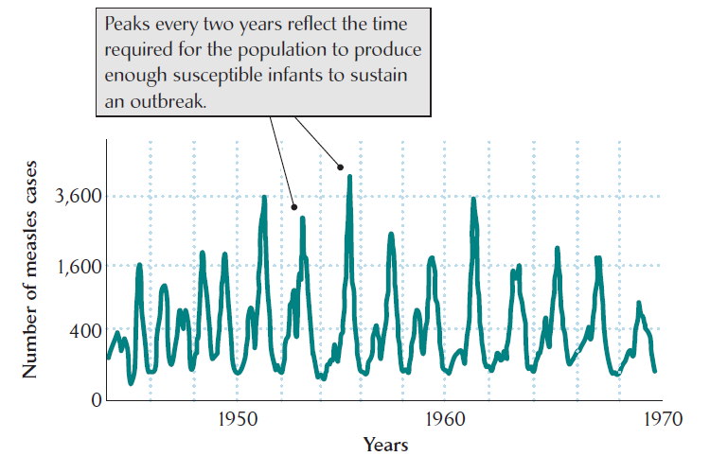
Predator-prey interactions
Classification of predator-prey interactions
high | predators classics | parasitoids like predators
low | herbivores ? | parasites, pathogens SIR models
 | low | High
lethality
intimacy

Slide 22

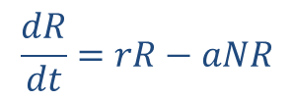

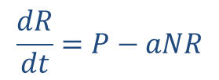


Herbivore-consumer dynamics
Consumption of whole individuals
Grazing (some tissues untouched)
$$\frac{dR}{dt}=rR−aNR$$
$$\frac{dR}{dt}=P−aNR$$
$$N=\frac{P}{aR}$$
$$N$$
predator
prey
$$R=\frac{q}{fa}$$
$$R$$

Slide 23
Herbivore-consumer dynamics
Consumption of whole individuals
Grazing (some tissues untouched)
Analogy of classical predator-prey cycles
(spruce-bark beetles, elephants and shrub)
No self-catalysis (i.e. not exponential growth) → stable point equilibrium due to decreasing ZGI
$$N=\frac{P}{aR}$$
$$N$$
predator
prey
$$R=\frac{q}{fa}$$
$$R$$

Slide 24
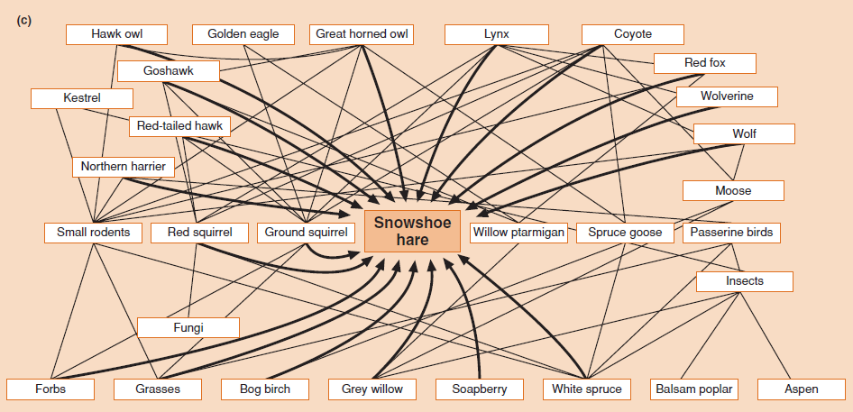
Multitrophic interactions

Slide 25
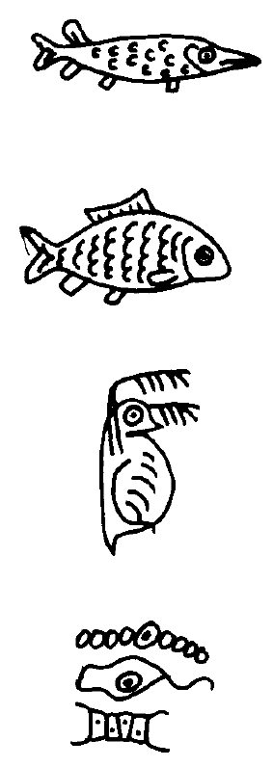
Multitrophic interactions
More trophic levels
Trophic cascades may or may not be stable, dependent on type of producer response (regrowth) and functional response of predators
Typically, longer food chains have a tendency to destabilize

Slide 26
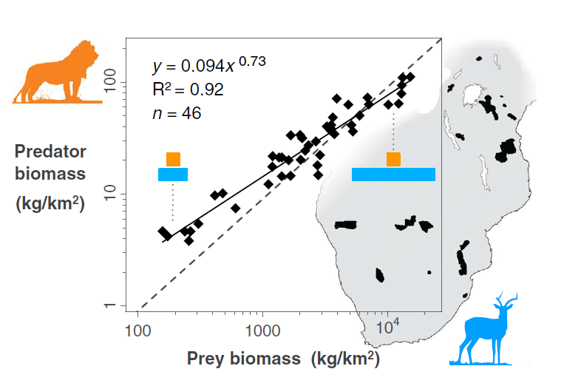
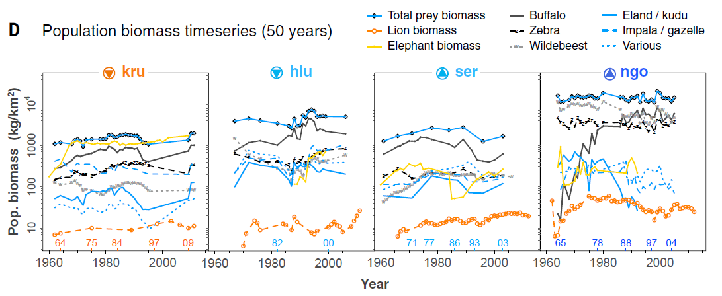
Multitrophic interactions
More trophic levels
Multiple species of prey and predators
Predator:Prey ratio depends itself predictably on prey biomass (ecosystem productivity) and thus violates the classical rule of trophic pyramid
PERHAPS INDIVIDUAL SPECIES‘ POPULATIONS ARE NOT THE PROPER UNITS FOR UNDERSTANDING TROPHIC INTERACTIONS?

Slide 27
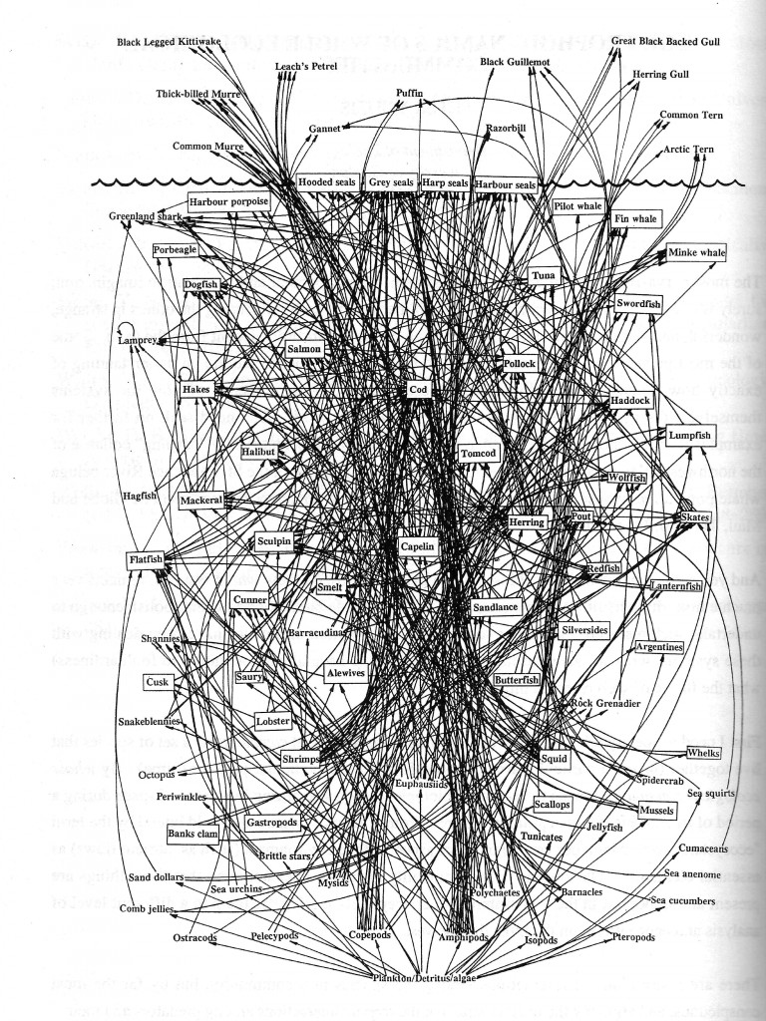
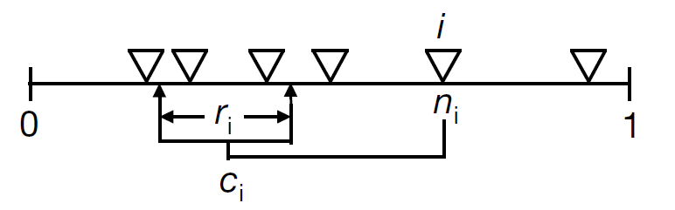
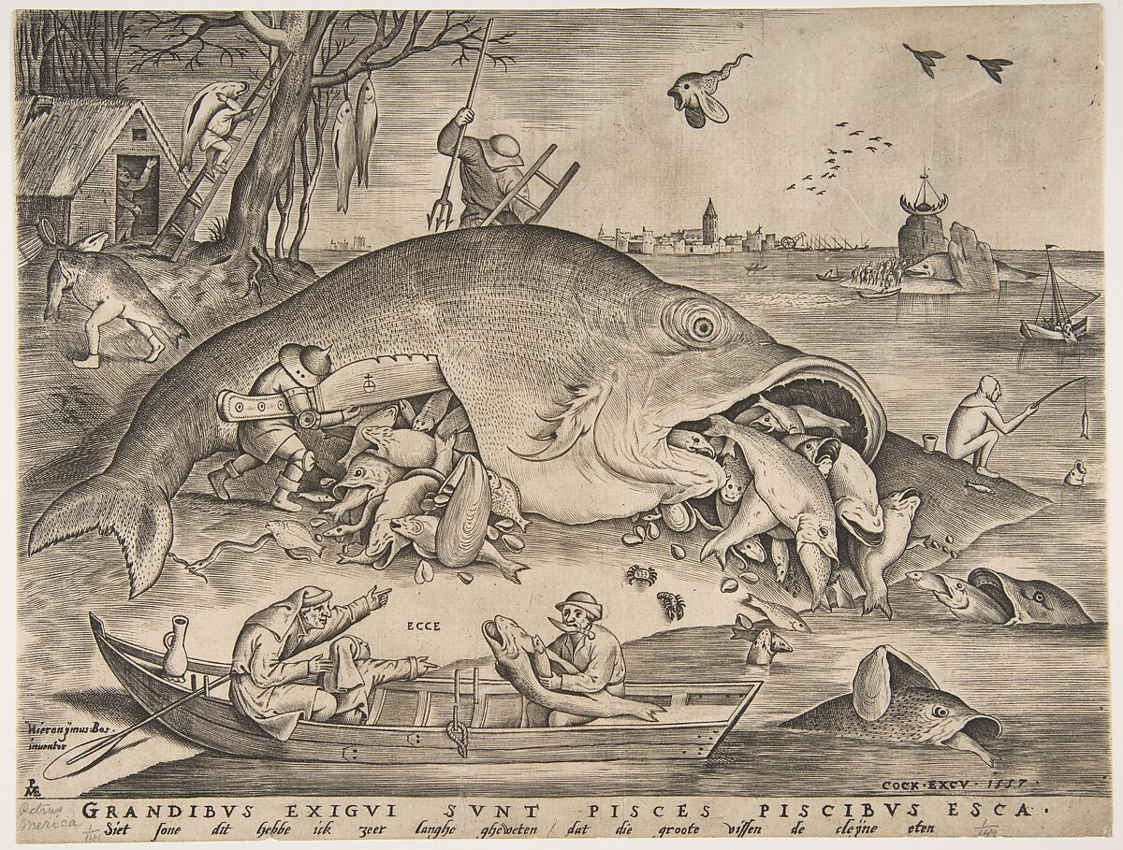
Multitrophic interactions
More trophic levels
Multiple species of prey and predators
Trophic networks (food webs)
Patterns in food web are well explained by niche model that assumes simple hierarchy in consumption
PERHAPS LINKS BETWEEN INDIVIDUAL SPECIES ARE NOT THE PROPER UNITS?

Slide 28
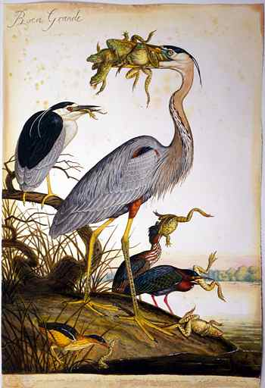
Concluding remarks
Mutual interactions between predators and prey prevent simple causal inferences
Cycles may last one generation or many generations; long cycles may be hardly observable, so we can underestimate cyclic dynamics
Patterns observed in nature, including predator-prey cycles, may reflect more complex multispecies processes
Predation can be promoted by parasites, who need to finish their life cycles
There are several other, so far unaccounted effects, namely space – spatial aggregation and movement may change dynamics from cyclic to stable at large scale
Predators may affect prey not only via direct consumption, but also via altered behaviour (ecology of fear)

