Slide 1
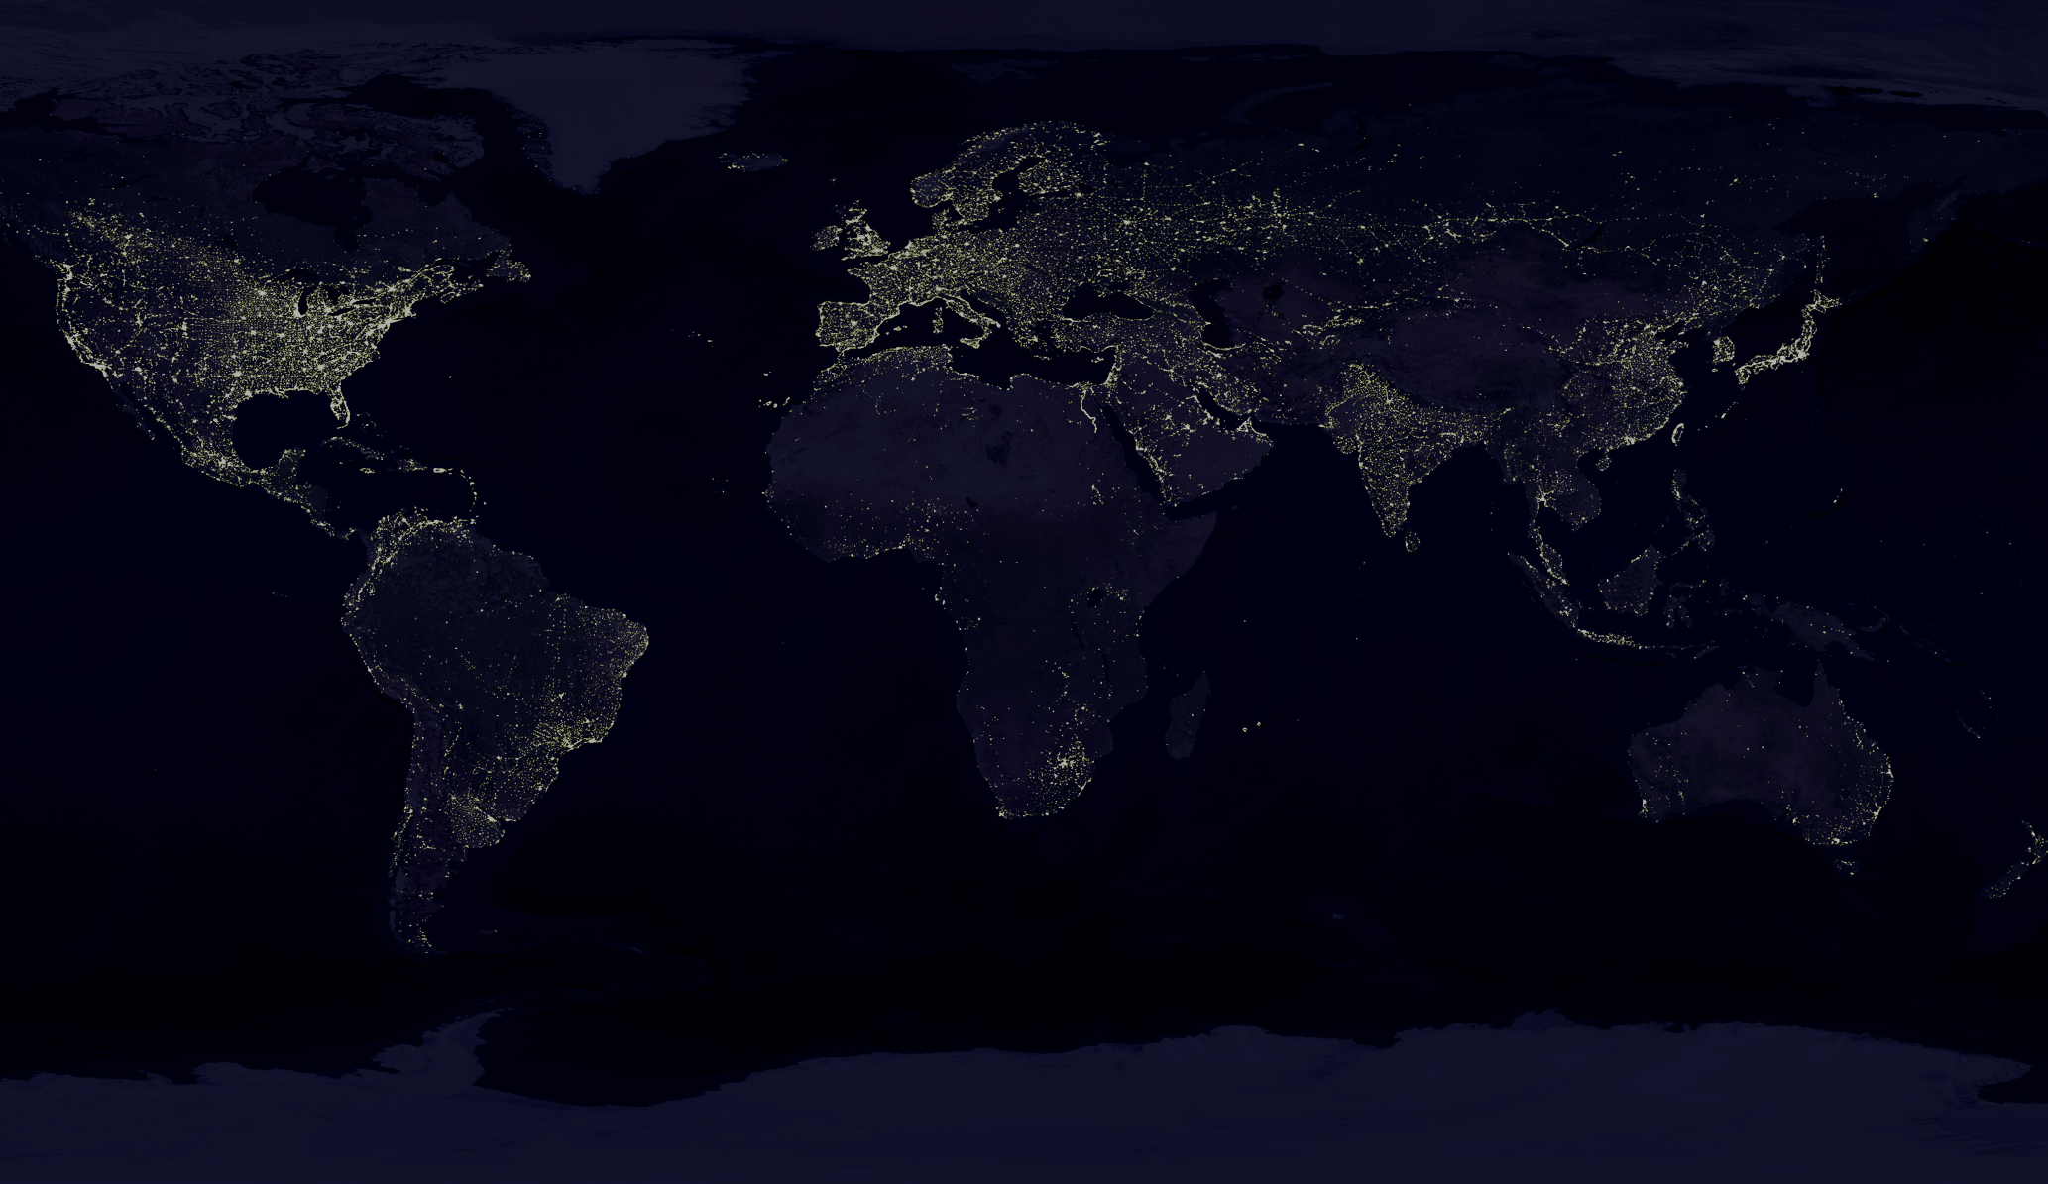
Advanced ecology of the Anthropocene
Journalist: „Wise rabbi, could you characterize in one word the situation in Israel?“
Rabbi: „Good“
Journalist: „OK, it is perhaps too brief, can you characterize it in two words?“
Rabbi: „Not good“

Slide 2
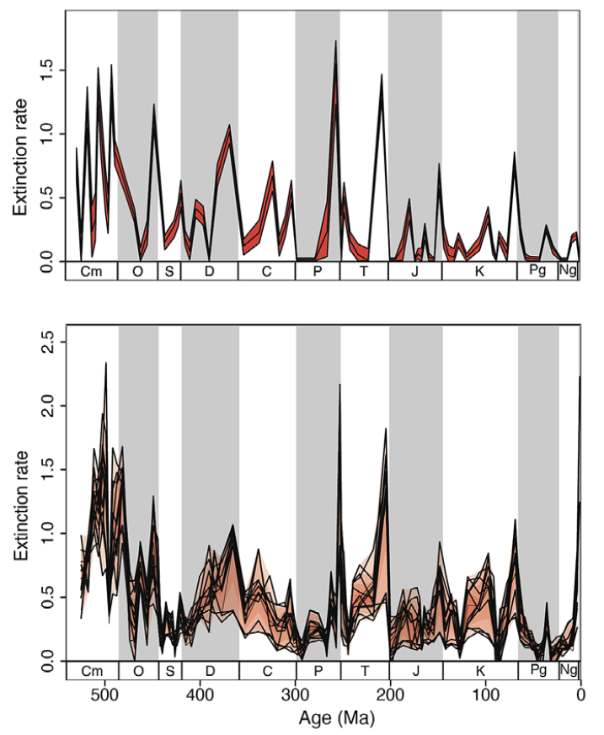
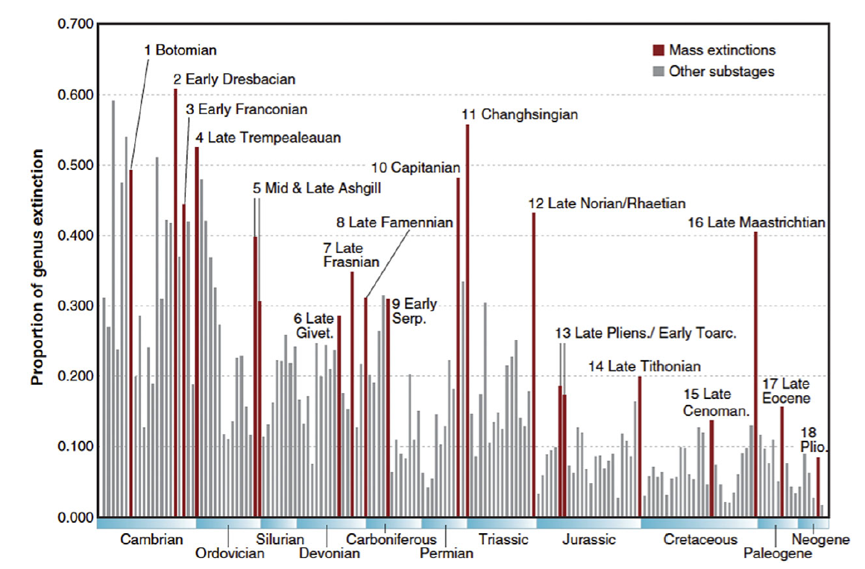
Large-scale historical context
Earth biodiversity has a tendency to stabilize, but there are big disruptions
Bambach 2006 Ann.Rev. Earth and Planetary Sciernces
Koscise et al. 2019 Proc.R.Soc. B

Slide 3
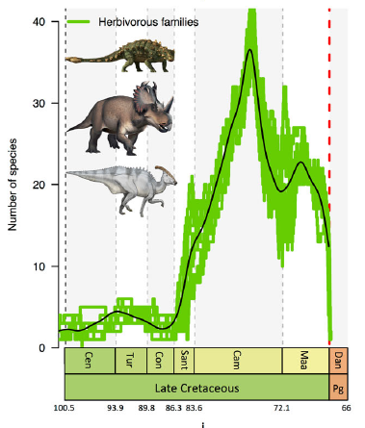
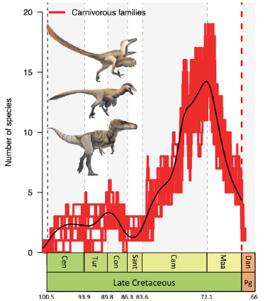
Large-scale historical context
Earth biodiversity has a tendency to stabilize, but there are big disruptions
Some biodiversity changes are slow
Condamine et al. 202 Nature Communications

Slide 4
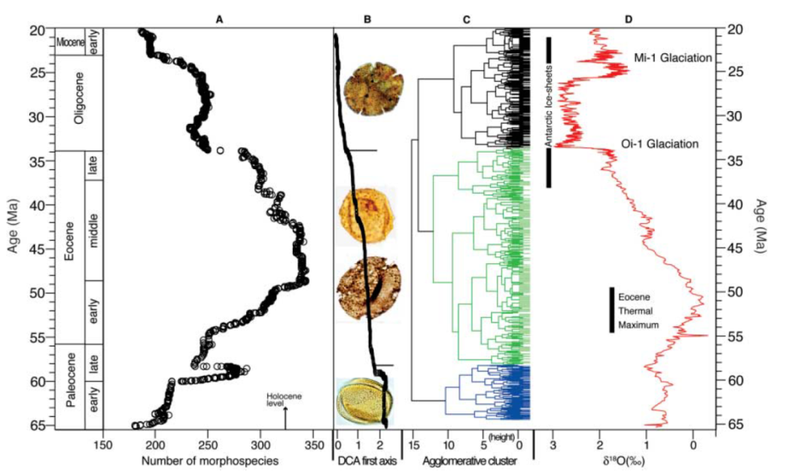
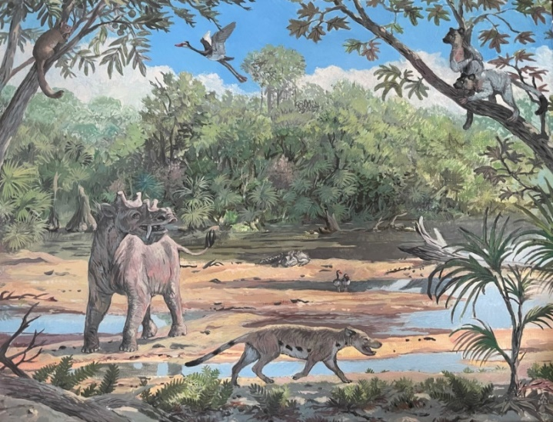
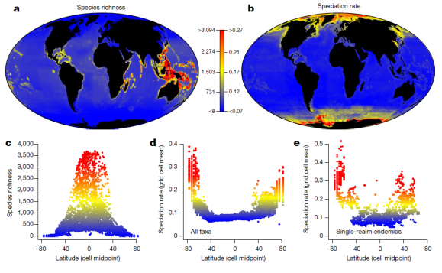
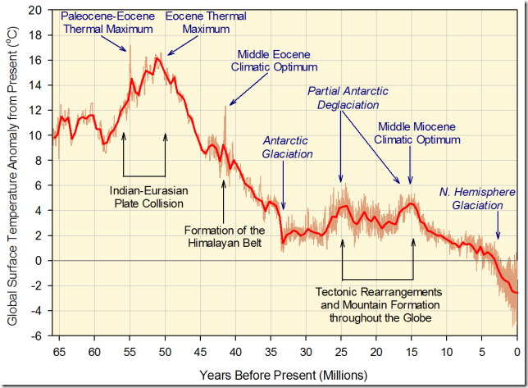
Large-scale historical context - are we in an equilibrium?

Slide 5
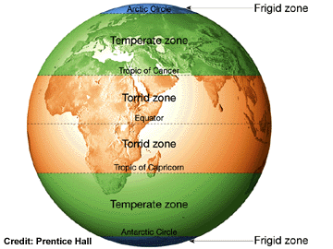

Large-scale historical context - are we in an equilibrium?
Jmax
extinction and origination rate
per species
community abundance J
population size N
Higher speciation rate in the temperate zone can be due to higher extinction rate
Temperate zone can be below and tropical zone above equilibrium diversity
species richness S

Slide 6
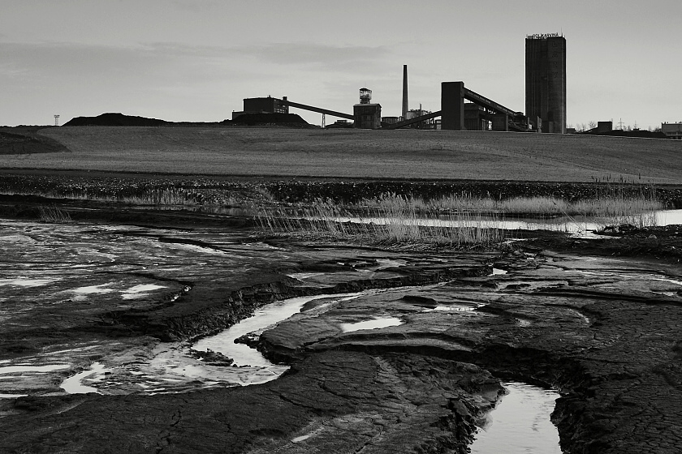
Anthropocene

Slide 7
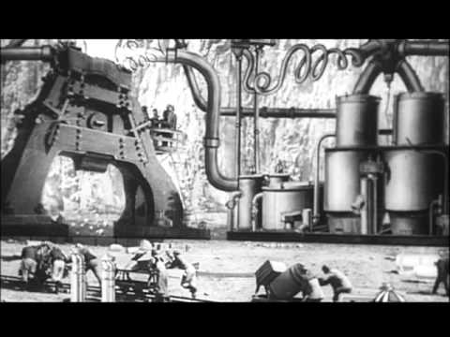
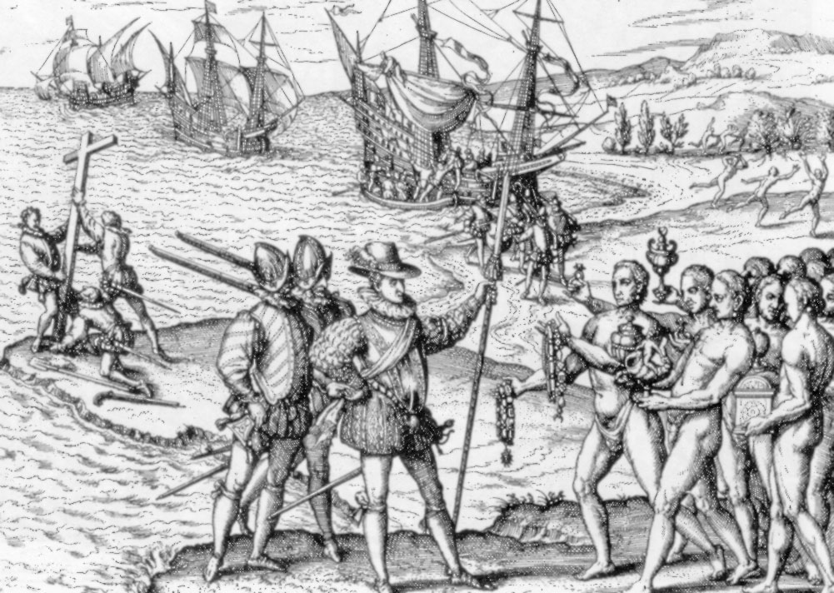
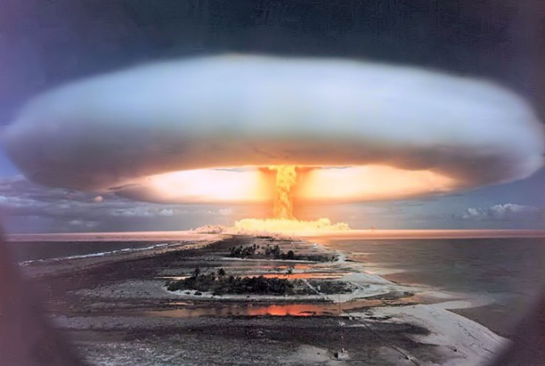
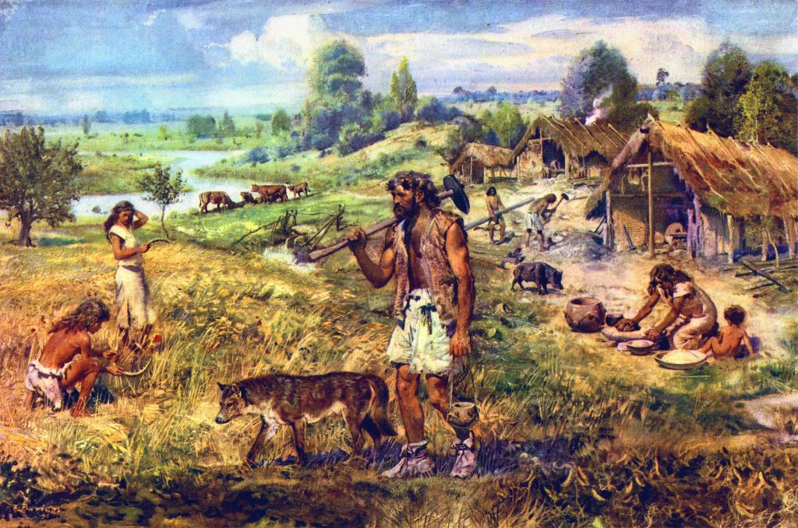
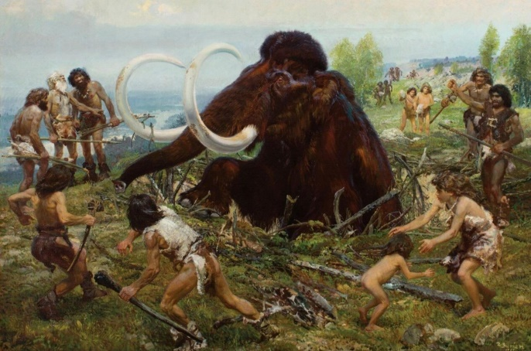
1765
1492
1960
8 thousands YBP
35 thousands YBP

Slide 8
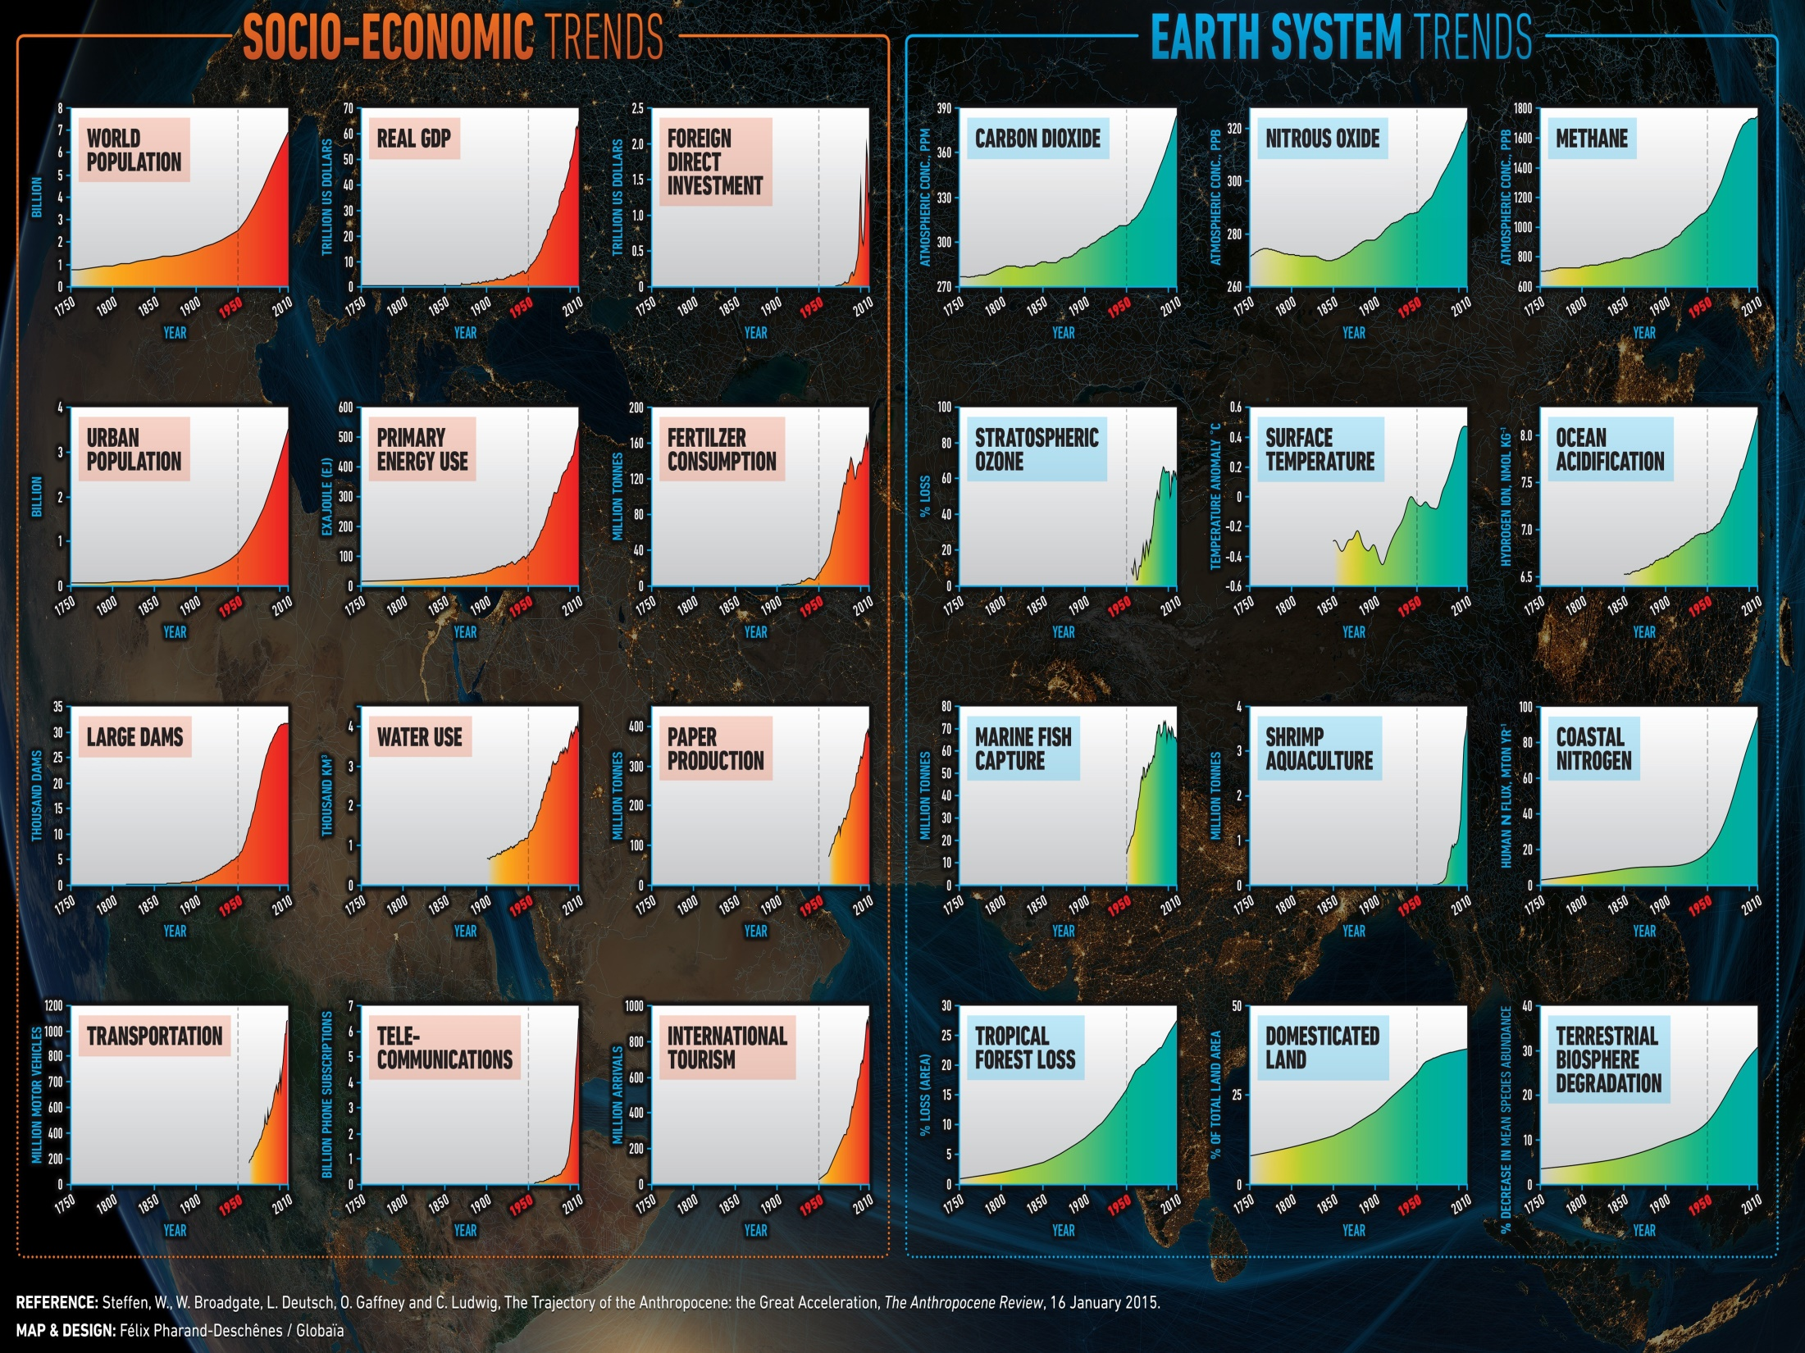

Slide 9
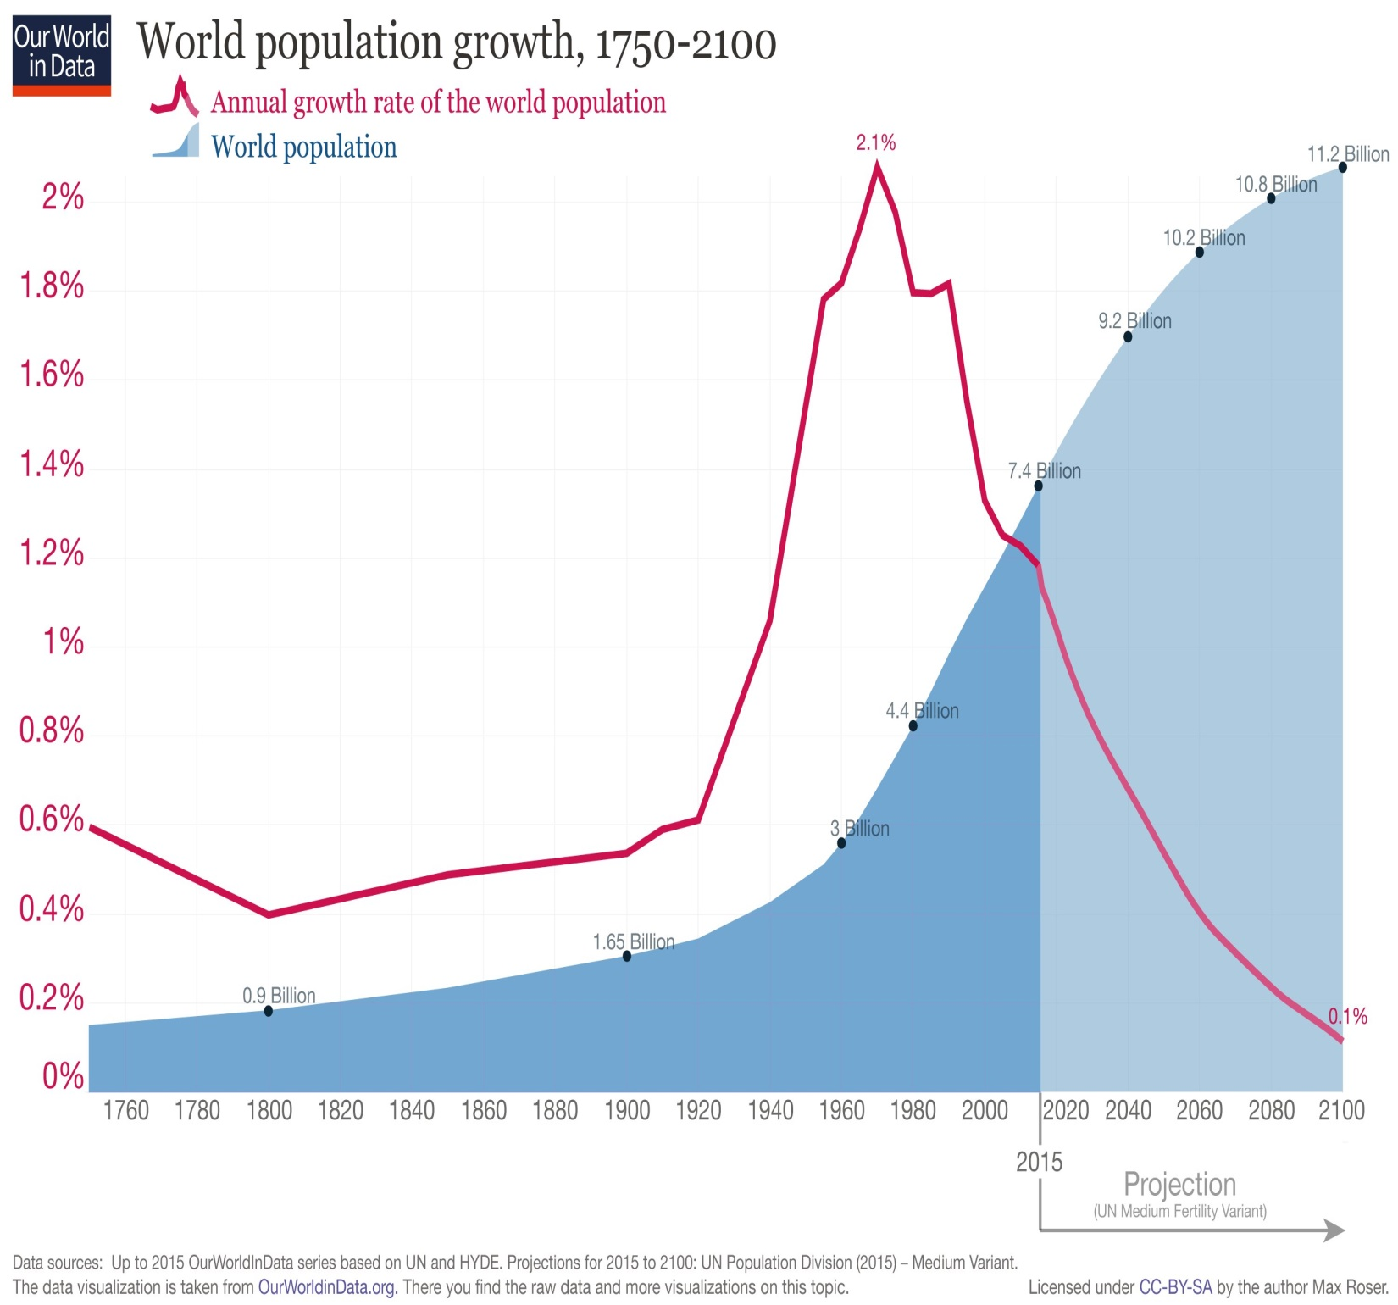

Slide 10
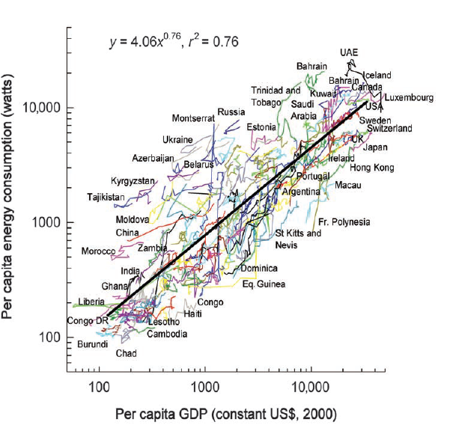
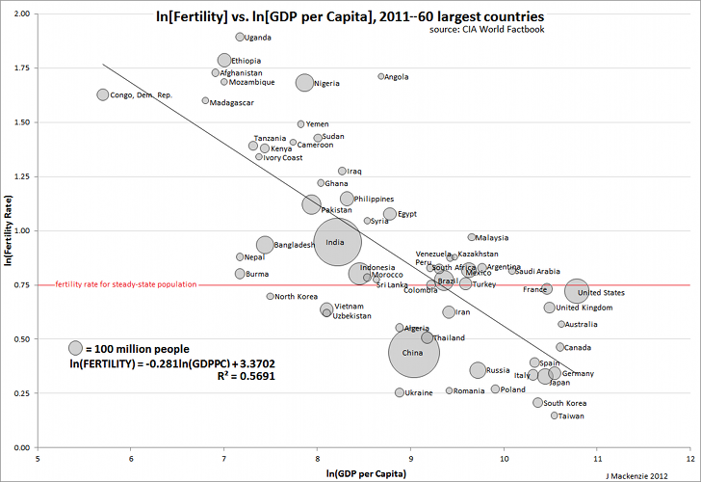

Slide 11
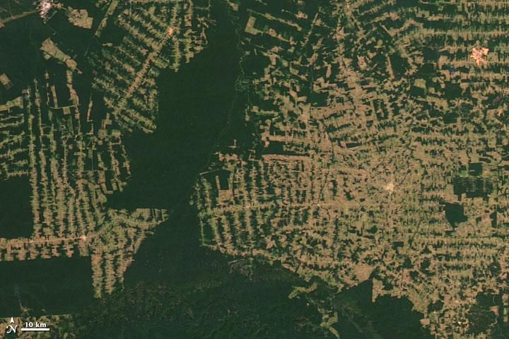
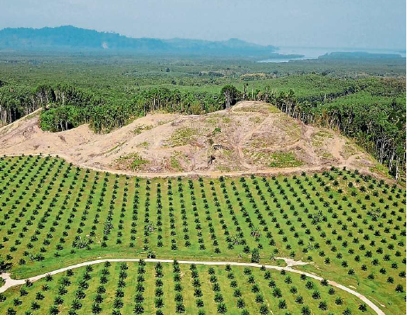
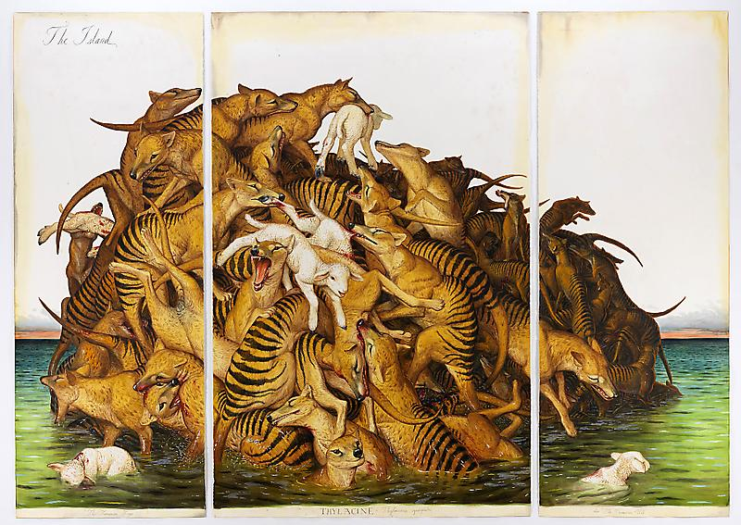
SIXTH MASS EXTINCTION ?

Slide 12
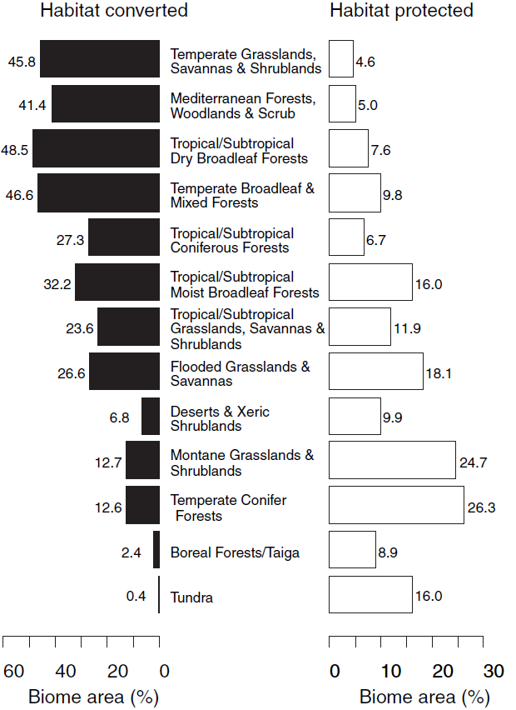
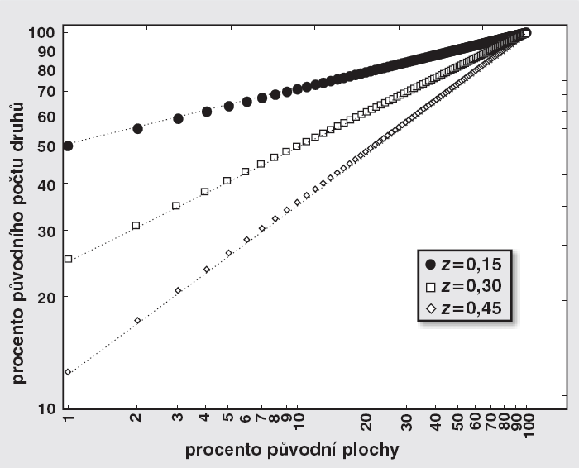
SIXTH MASS EXTINCTION ?
proportion of original number of species (%)
proportion of the original area (%)

Slide 13
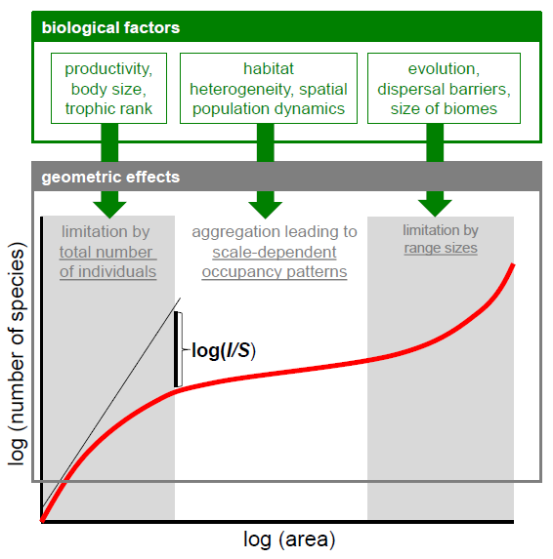
Problems with extinction estimates
SAR is more complicated
Storch 2016, Journal of Vegetation Science 27: 880-891

Slide 14
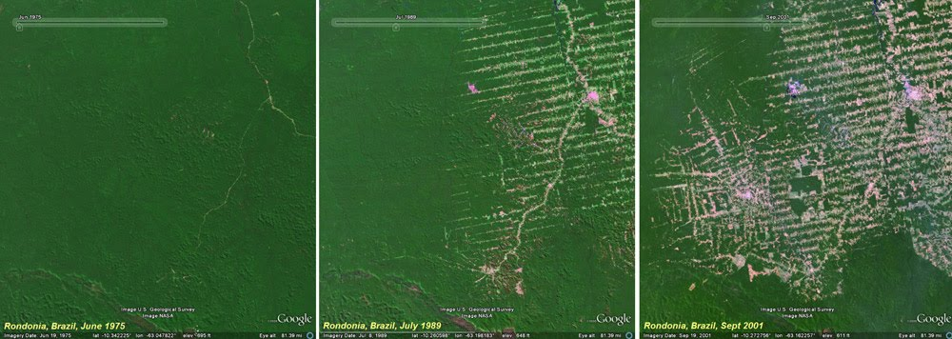
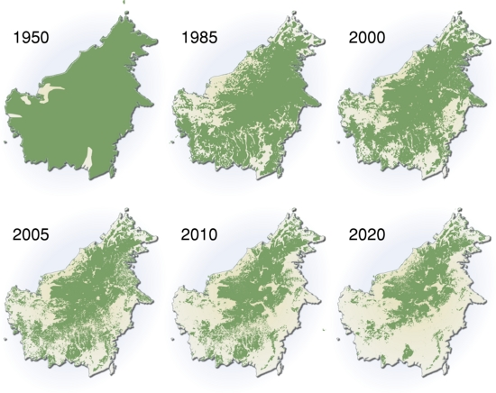
Problems with extinction estimates
SAR is more complicated
It depends whether destruction starts from the centre or the edge
Keil, Storch & Jetz 2015, Nature Communications

Slide 15
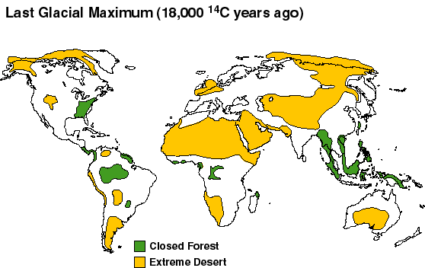
Problems with extinction estimates
SAR is more complicated
It depends whether destruction starts from the centre or the edge
Unclear, how it can be compared to past changes

Slide 16
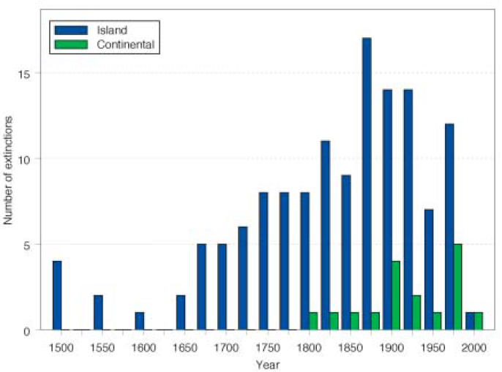
SIXTH MASS EXTINCTION ?
In average, less than 1% of species went extint, large majority on islands
Barnosky et al. 2011 Nature

Slide 17
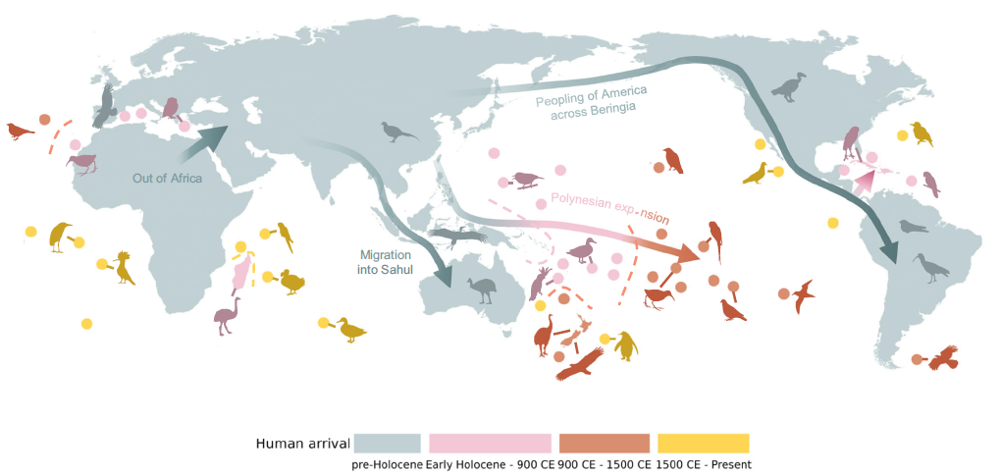
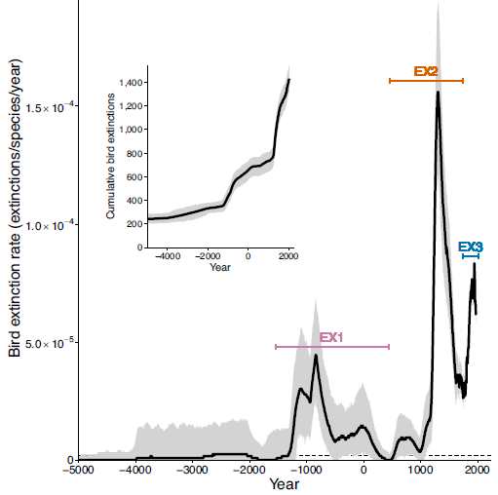
SIXTH MASS EXTINCTION ?
Up to 1500 island bird species went extinct, mostly on Pacific islands around 1300 CE
In average, less than 1% of species went extint, large majority on islands
Cooke et al. 2023 Nat Comms

Slide 18
SIXTH MASS EXTINCTION ?
So far current extinction is not comparable to previous mass extinctions, but it will be if the current trend would continue for hundreds or thousands years – the rate is two orders of magnitude higher than the background rate
Barnosky et al. 2011 Nature

Slide 19
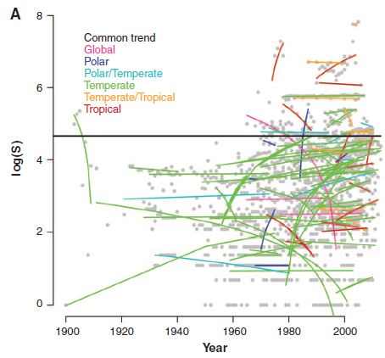
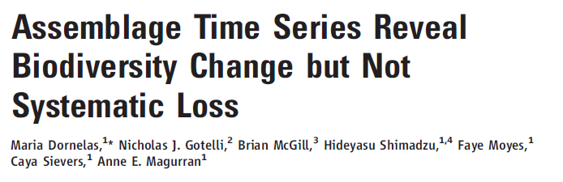
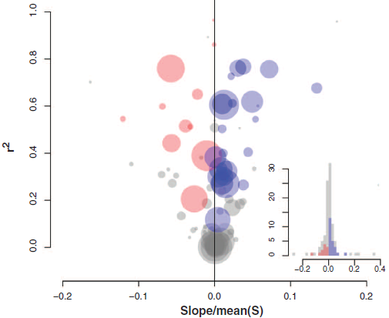
Non-trivial biodiversity changes – local and regional species richness
Dornelas et al. 2015 Science

Slide 20
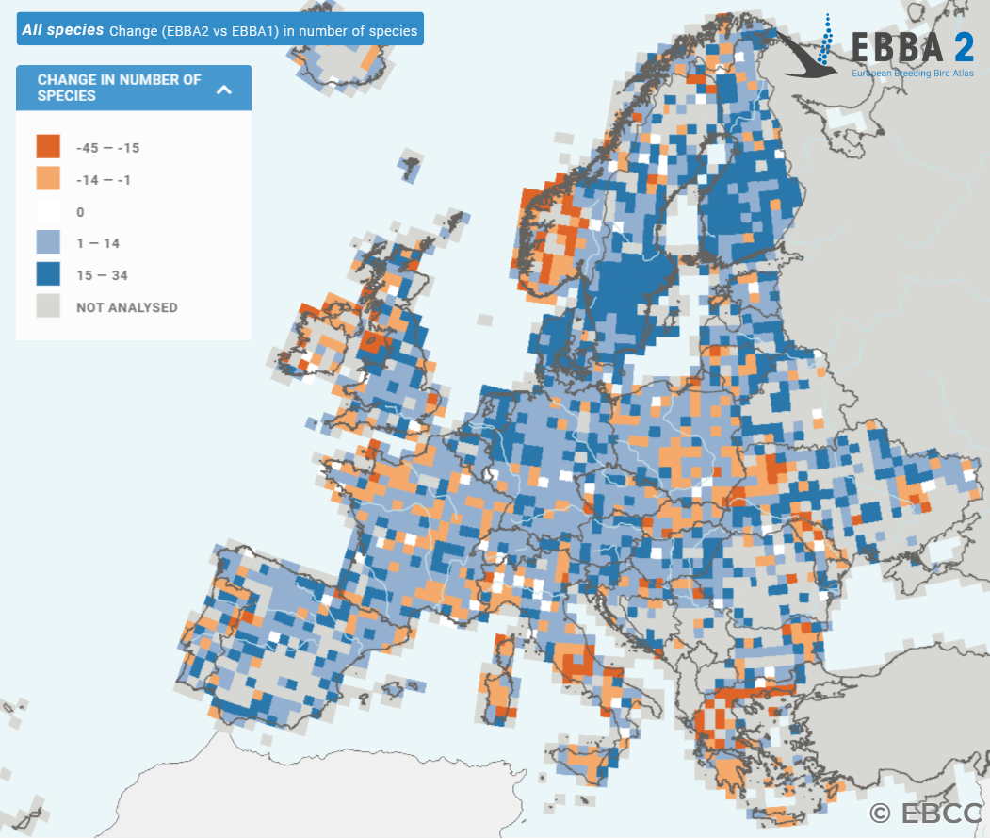
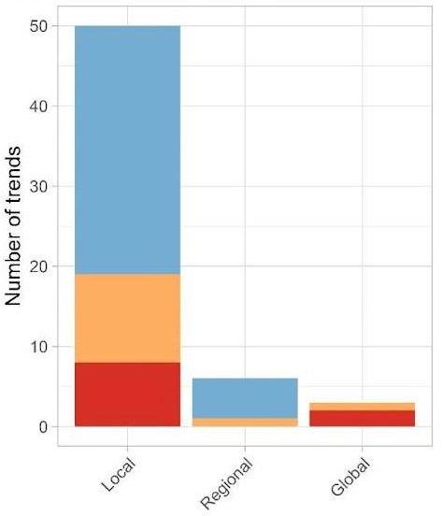
Non-trivial biodiversity changes – local and regional species richness
In some groups and regions, species richness even increases
https://ebba2.info/maps/
Leroy et al. 2023 Bas. Appl.Ecology

Slide 21
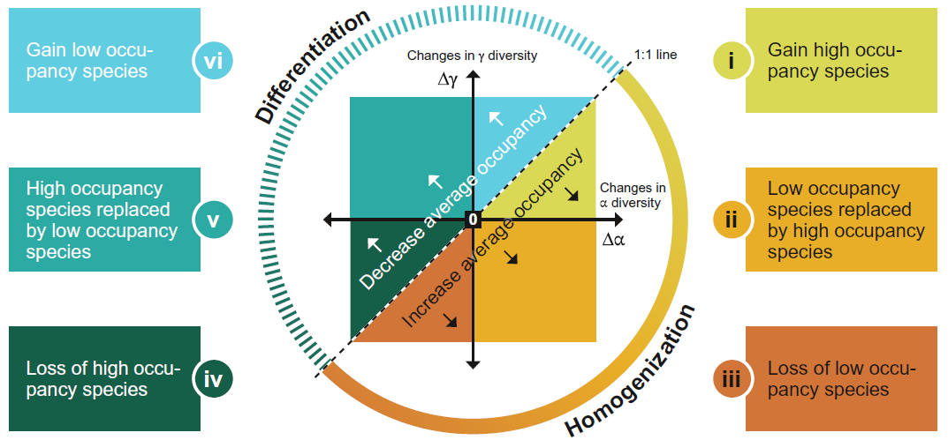
Biosphere homogenization?
In some groups and regions, species richness even increases
Effect of homogenization? (spreading of common species and disappearing rare ones?
Blowes et al. 2024 Science Advances

Slide 22
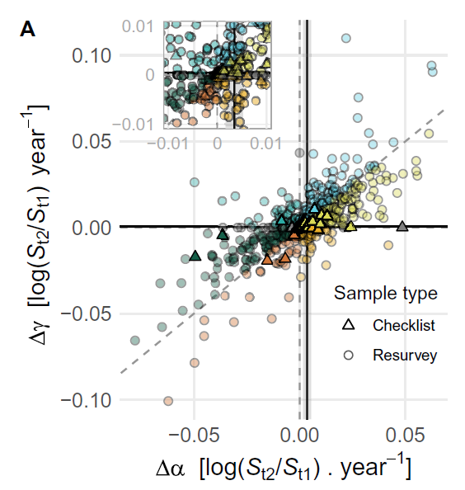
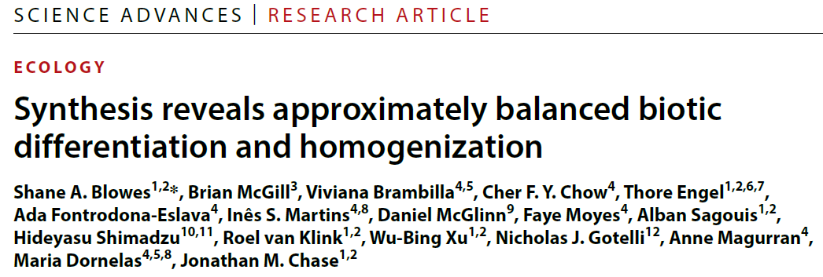
Biosphere homogenization?
In some groups and regions, species richness even increases
Effect of homogenization? (spreading of common species and disappearing rare ones?
Blowes et al. 2024 Science Advances

Slide 23
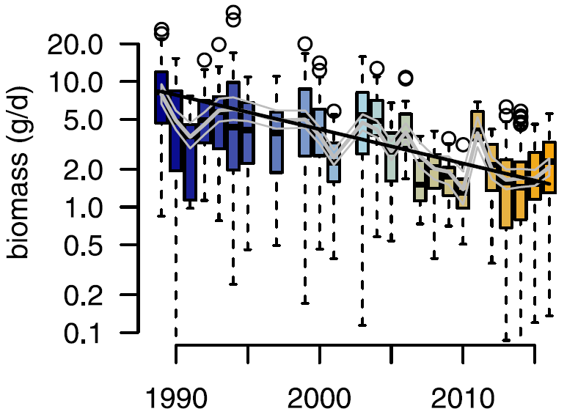
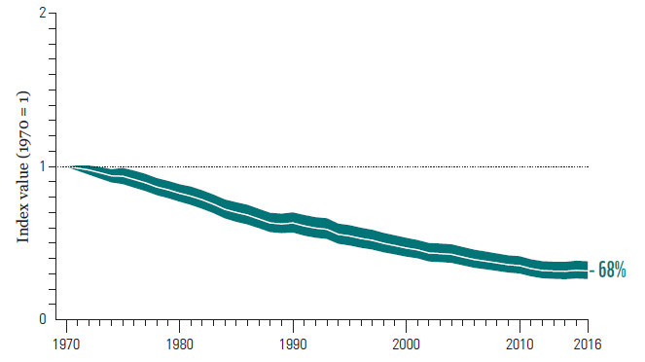
Non-trivial biodiversity changes – population abundances
Vertebrates
Insects
Living Planet Index – all populations of vertebrates since 1970
Hallman et al. 2017 PLoS One

Slide 24
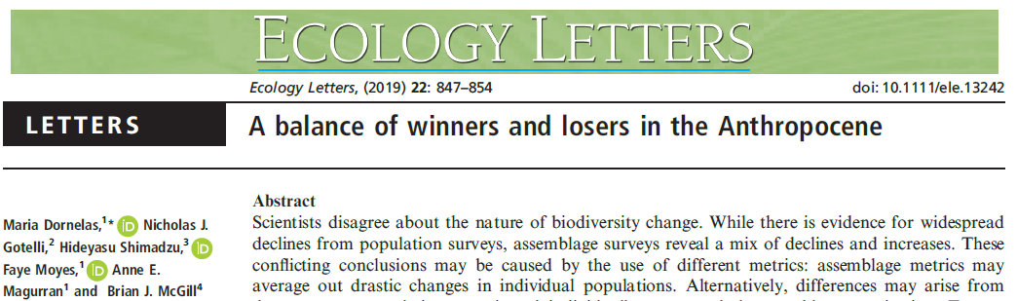
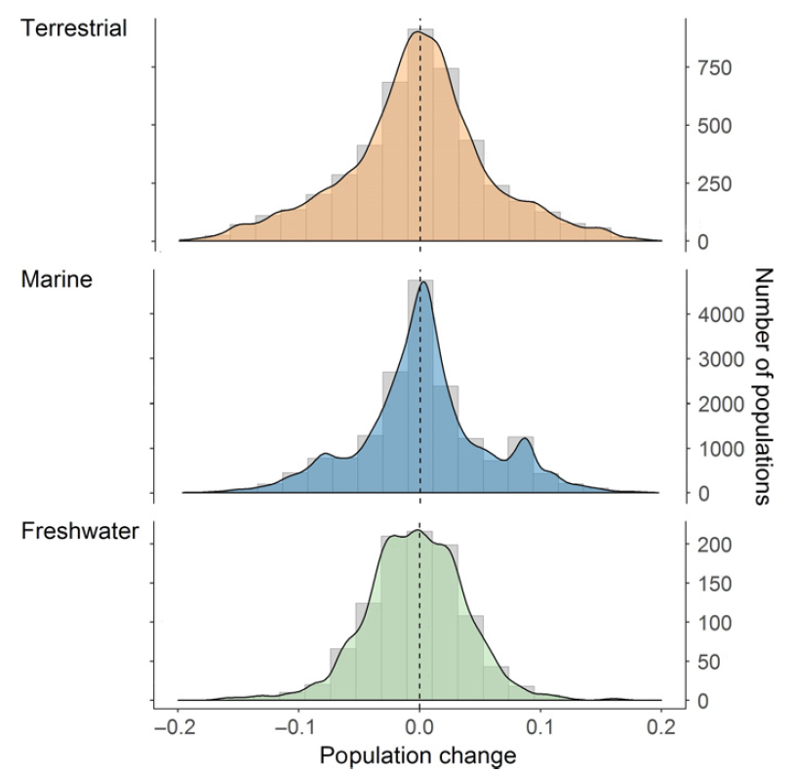
Non-trivial biodiversity changes – population abundances
Living Planet Index – all populations of vertebrates since 1970
Dornelas et al. 2019 Ecology Letters

Slide 25
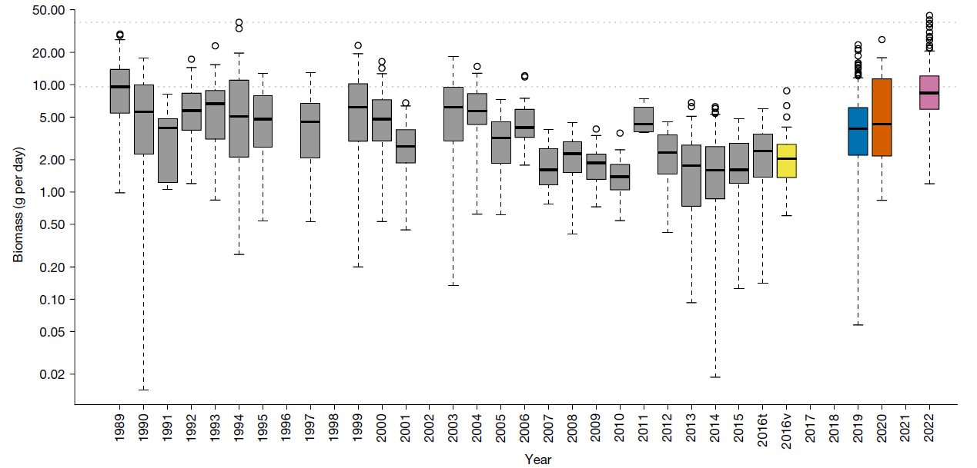
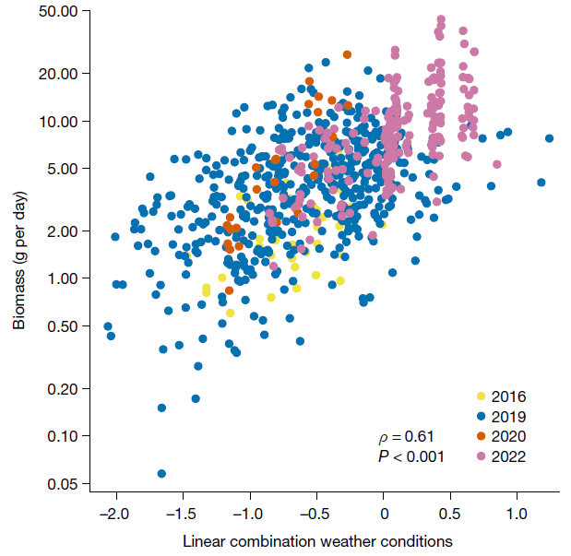
Non-trivial biodiversity changes – insect apocalypse?
Weak evidence of declining insects
No evidence of the prevalence of declining vertebrate populations
Biodiversity loss and increase are balanced
Homogenization does not prevail over heterogenization
Hallman et al. 2017 PLoS One
Mueller et al. 2023 Nature

Slide 26
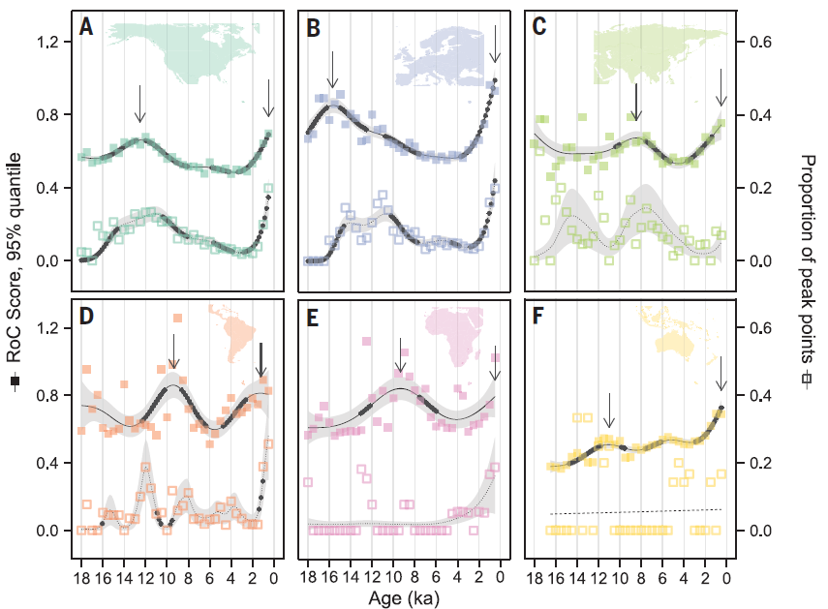
BUT changes in nature are accelerating!
Mottl et al. 2021 Science

Slide 27
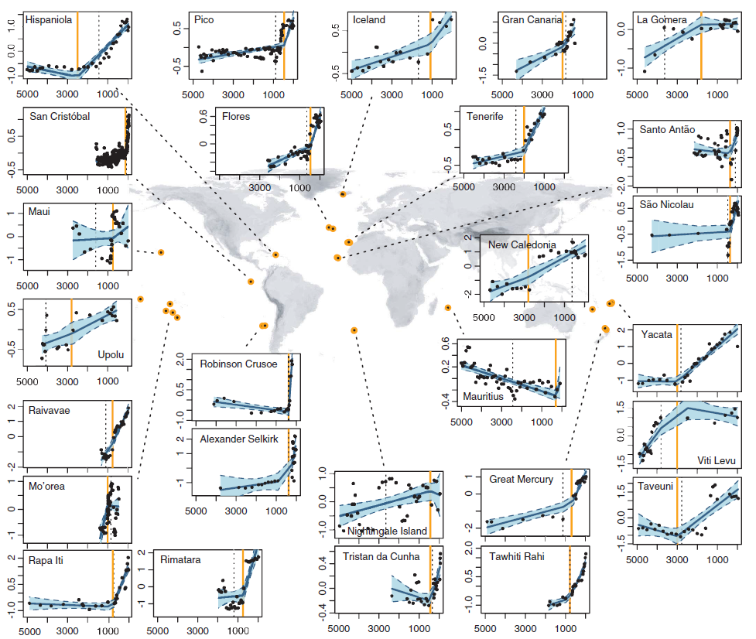
BUT changes in nature are accelerating! And are driven by humans!
Nogue et al. 2021 Science

Slide 28
Why the situation is not much worse?
There is extinction debt and we are above equilibrium point
Lack of data about negative changes
Most negative changes already happened and now the situation is improving
There are many other things going on in the Anthropocene, and this compensates biodiversity loss

Slide 29
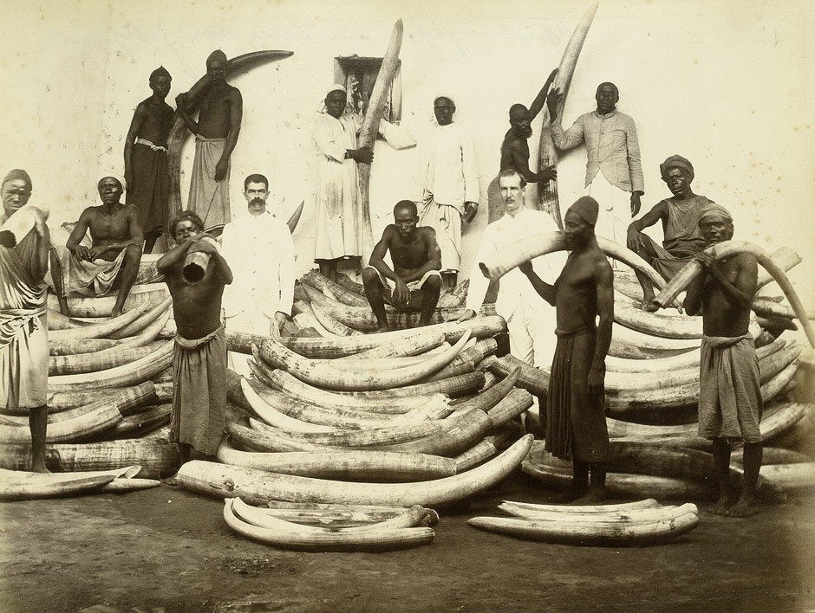
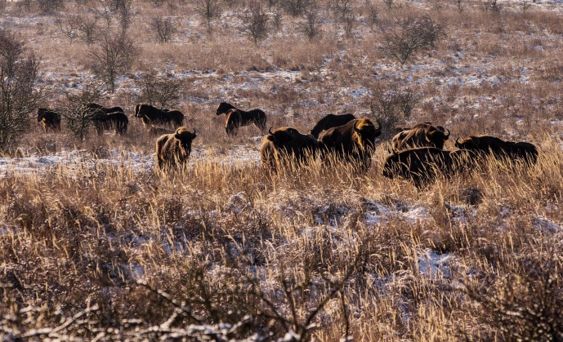
Why the situation is not much worse?
Nature conservation and the end of limitless exploitation

Slide 30




Why the situation is not much worse?
Nature conservation and the end of limitless exploitation
Spreading of non-native species and the emergence of new ecosystems

Slide 31


Why the situation is not much worse?
Nature conservation and the end of limitless exploitation
Spreading of non-native species and the emergence of new ecosystems
Global vegetation greening
Causes:
Global warming
Fertilization (enrichment by nitrogen and CO₂)
Green revolution and high-tech agriculture
Associated land abandonment
Chen et al. 2019 Nature Sustainability

Slide 32





Why the situation is not much worse?
Nature conservation and the end of limitless exploitation
Spreading of non-native species and the emergence of new ecosystems
Global vegetation greening
Red deer shootings in CR 1966-2016

Slide 33



Typical narrative – diversity decrease due to decreasing resource levels (AREA x NPP)
Miko & Storch 2015 Ecosystem Services

Slide 34


Paradox of HANPP
Main causes of habitat endangerment
according to the Red list of habitats of the Czech Republic
OVERGROWTH OF WOODY VEGETATION
Chytrý et al. 2019 Ecological Indicators

Slide 35

Paradox of HANPP
Jandt et al. 2022 Nature

Slide 36
Three phases of the Anthropocene
Jmax
hunting, overfishing
(increases extinction rate)
community abundance J
CHANGING ORIGINATION
OR EXTINCTION RATES
species richness S
Jmax
habitat destruction/transformation
(decreases total community size)
community abundance J
CHANGING RESOURCES
species richness S
Jmax
change of species interactions
(affects ability of resource use)
community abundance J
CHANGING THE WAY SPECIES UTILIZE RESOURCES
species richness S
Storch, Šímová, Smyčka, Bohdalková, Toszogyova & Okie 2022 Ecography

Slide 37








Three phases of the Anthropocene
population management
hunting, overfishing
(increases extinction rate)
protected areas
habitat destruction/transformation
(decreases total community size)
rewilding, keystone species
change of species interactions
(affects ability of resource use)

Slide 38
Principles of ecological sustainability
Avoiding overexploitation (and thus risk of nonlinearities and a collapse)
Maximum harvest model
maximum
yield
Increasing effort of resource utilization
production(parabola) or
extraction(lines) of the resource
resource abundance
Maximization of yield necessarily leads to the edge of collapse

Slide 39



Principles of ecological sustainability
Avoiding overexploitation (and thus risk of nonlinearities and a collapse)
Maximization of suitable habitat area
Lenore Fahrig

Slide 40

Principles of ecological sustainability
Avoiding overexploitation (and thus risk of nonlinearities and a collapse)
Maximization of suitable habitat area
Support for the weakest

Slide 41


Principles of ecological sustainability
Avoiding overexploitation (and thus risk of nonlinearities and a collapse)
Maximization of suitable habitat area
Support for the weakest
Proper management sustaining desiderable equilibria
Ellis et al. 2021 PNAS

Slide 42

Concluding remarks
So far there is no sixth mass extinction, but it can happen if the trends continue
The ultimate cause of extinction crisis is human population growth; the proximate cause is the transformation of agriculture (including forestry), not climate
There are many other processes comprising biodiversity change, and they typically cannot be interpreted as culture x nature or just the destruction of nature
Absolutely essential is spreading of non-native organisms and the emergence of novel ecosystems (anthromes)
The dynamics of nature and human civilization is entangled at least since the neolitic
Disruption of ecological interactions becomes more and more important
There are many things that can be done to preserve biodiversity, it is only necessary to be aware of simplistic „popular“ political decisions (biofuels, plantations)

