Slide 1
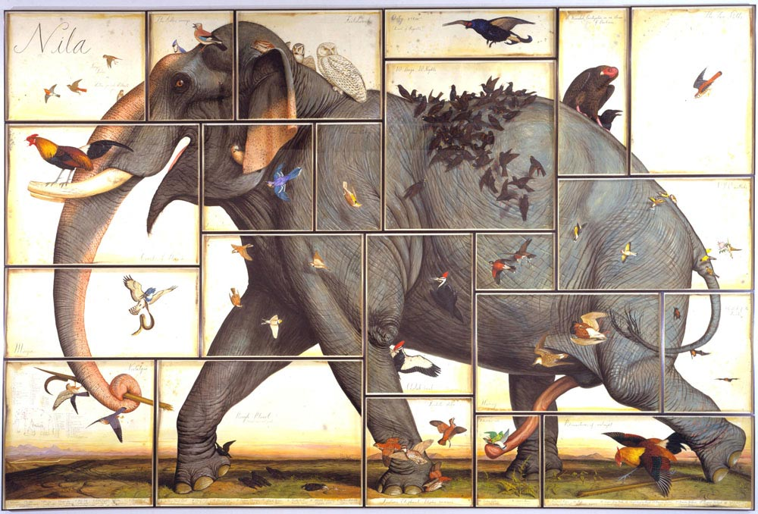
Foundations of macroecology
Patterns of body mass, abundance and distribution

Slide 2


What is macroecology?
Macroecology – deals with general ecological patterns or statistical regularities observable at large spatial and temporal scales
Typical questions
Why so many species are rare and only a few common
Why most species are small
Why are there geographic trend in organism properties
Why species richness decreases from the equator
James Brown 1995
Typically studied variables
Species body size
Metabolic rate (energy flow)
Species abundance
Species range size
(Biodiversity) – separate lectures
Distribution of body sizes
Relationship between body size and biological rates
Body size-abundance relationship
Species-abundance distribution
Range size distribution
Latutudinal trends in range size, body size, abundance

Slide 3
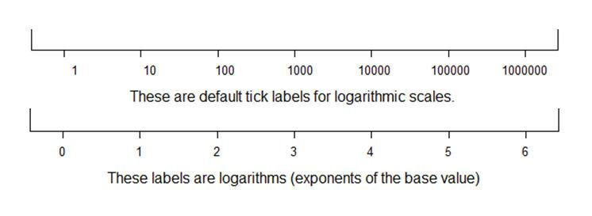
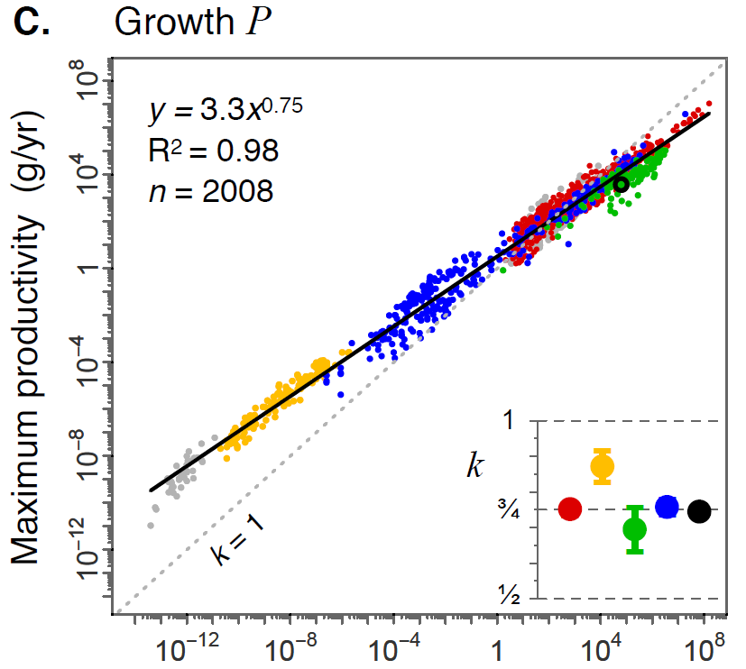

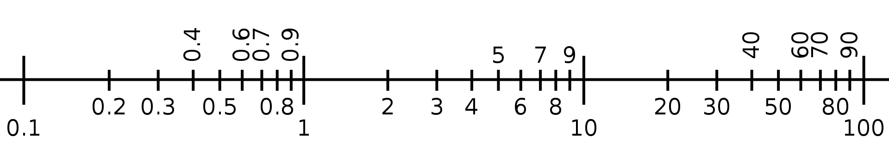



Macroecological patterns
Correlations or scaling relationships
Statistical distributions
$$y=ax+b$$
$$logP=klogM+logP_{0}$$
$$P=P_{0}M^{k}$$

Slide 4
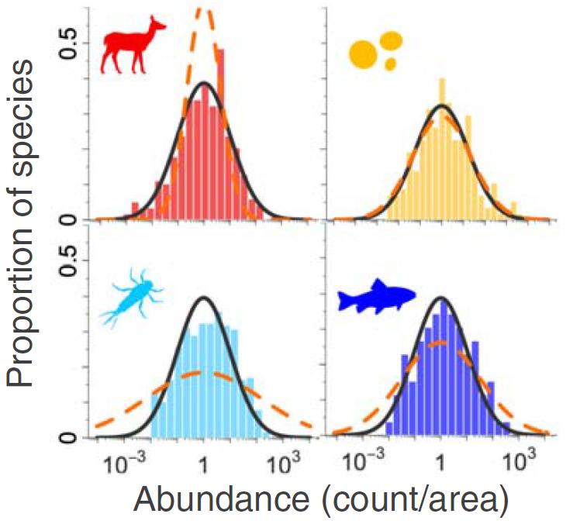
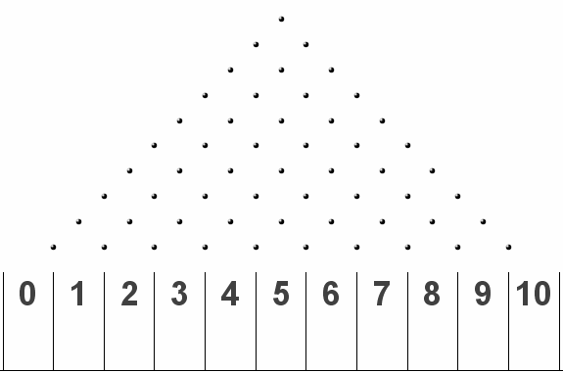

Macroecological patterns
Correlations or scaling relationships
Statistical distributions
$$logX+logY=log⁡(XY)$$

Slide 5
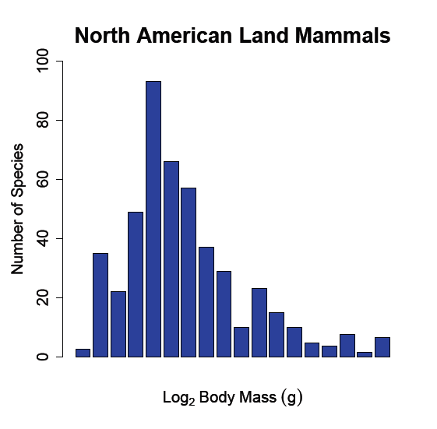
Body size distribution
Explanatory frameworks:
Null (macroevolutionary) hypothesis: Result of random multiplicative evolution of body size

Slide 6
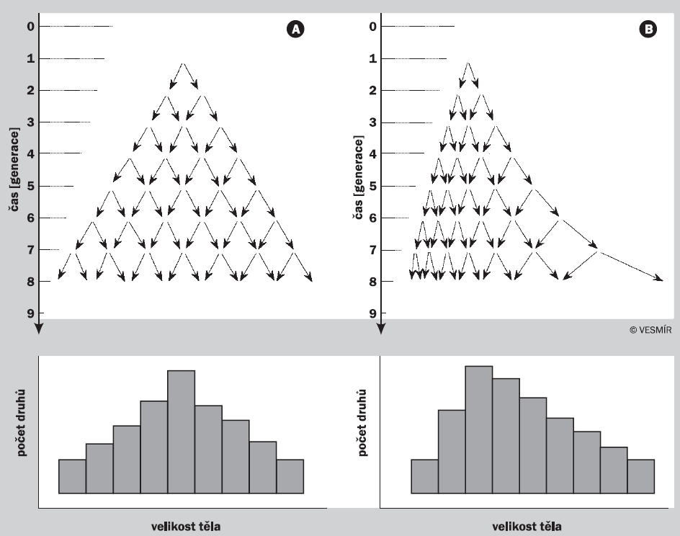
Body size distribution
Explanatory frameworks:
Null (macroevolutionary) hypothesis: Result of random multiplicative evolution of body size
But the distribution is more right-skewed and the ancestor is not always small
time
time
number of species
number of species
body mass
body mass

Slide 7
Body size distribution
Explanatory frameworks:
Null (macroevolutionary) hypothesis: Result of random multiplicative evolution of body size
Ecological explanation: Large species cannot be specialized and have viable populations
But the distribution is more right-skewed and the ancestor is not always small
But it does not explain unimodality of the distribution and its relationship to domain area
biome A
biome B
habitat 1
habitat 2
habitat 3
habitat 4

Slide 8

Body size distribution
Explanatory frameworks:
Null (macroevolutionary) hypothesis: Result of random multiplicative evolution of body size
Ecological explanation: Large species cannot be specialized and have viable populations
Ecophysiological explanation: Trade-off between biomass production and maintenance
But the distribution is more right-skewed and the ancestor is not always small
But it does not explain unimodality of the distribution and its relationship to domain area
Island rule
number of species
reproductive power
relative change of body size on island (%)
body size (g)
body size at the mainland (g)

Slide 9
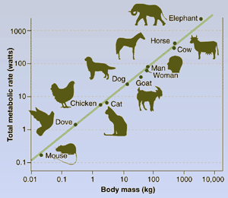
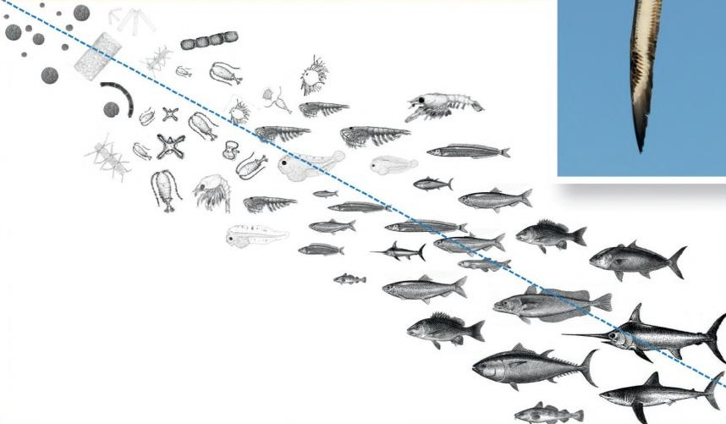
Effect of body size on biological rates
log P
slope 3/4
log B
slope -1/4
metabolism (P)
body mass (M)
log M
log M
Y = aX + b
P = P₀M^{3/4}
logP = 3/4logM + logP₀
B = P/M
B = B₀M^{3/4}×M⁻¹
B = B₀M^{-1/4}

Slide 10
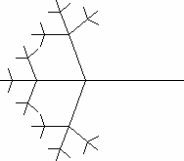
Central dogma of the Metabolic Theory of Ecology
Constraints on transportation networks
Scaling of metabolic rate with body mass
Scaling of all other rates including biomass production
log Total metabolic rate
P
slope 3/4
biomass production
log M
log Relative metabolic rate
(P/M)
slope -1/4
population growth
log M
West, Brown & Enquist 1997 Science, Brown et al. 2004 Ecology

Slide 11
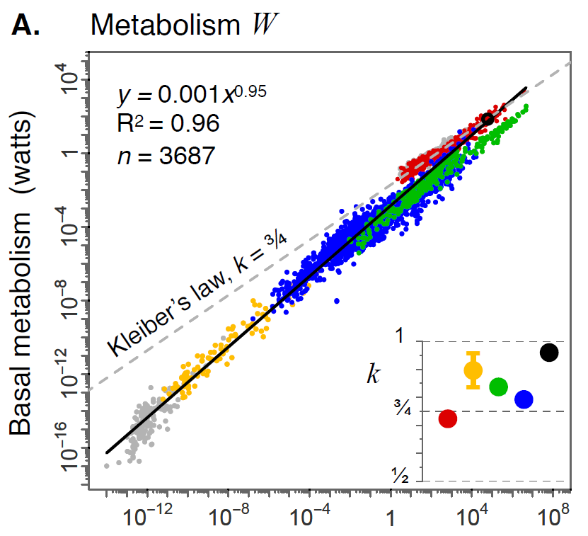


Is metabolism really the driving process?
¾ scaling within groups but isometric scaling (k≈1) across all ekaryotes
¾ scaling both within groups and across all ekaryotes
Hatton, Dobson, Storch, Galbraith & Loreau 2019 PNAS

Slide 12
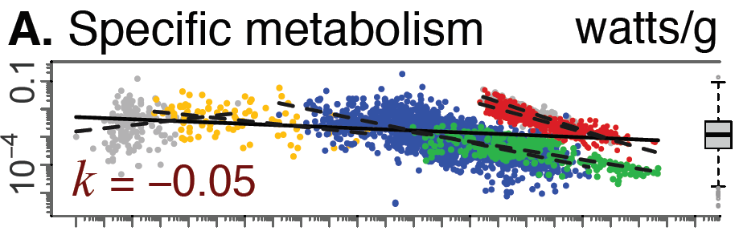
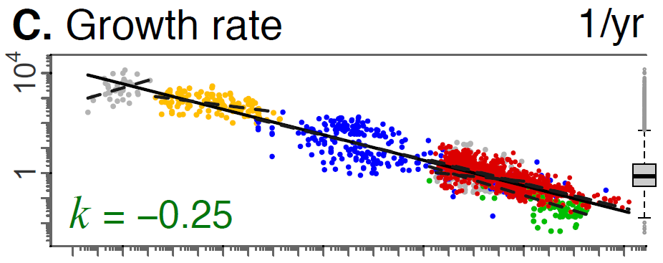

Is metabolism really the driving process?
Hatton, Dobson, Storch, Galbraith & Loreau 2019 PNAS

Slide 13
Body size – important remarks
Body size affects all biological rates via affecting metabolic rate
However, ¾ scaling could be due to body mass effect on growth
On the other hand, body mass is itselft an output of life-history optimization
Body size is in major focus of macroecology, as it is a generally shared property, but it does not necessarily mean it is the key variable

Slide 14
Body size-abundance relationship
density D = KM^{-3/4}
metabolism P = P₀M^{3/4}
energy C = D×P
C = KM^{-3/4}P₀M^{3/4} = KP₀M⁰ = kP₀
population density D (n/km)
Energy equivalence rule
(Damuth rule)
Population energy consumption C
body mass (g)

Slide 15
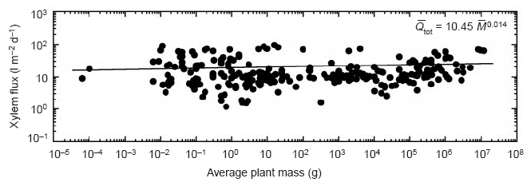
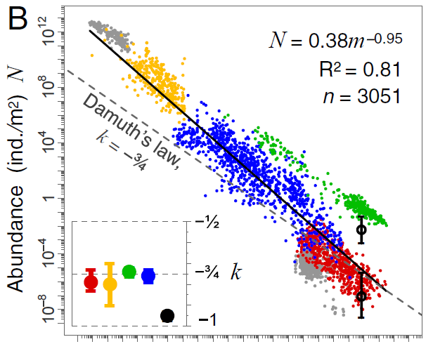
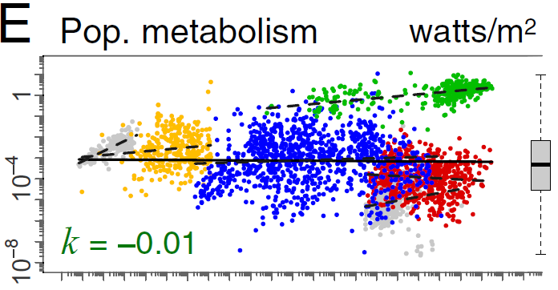

Body size-abundance relationship
EER works well for maximum densities, less for total abundance for a region
Hatton, Dobson, Storch, Galbraith & Loreau 2019 PNAS

Slide 16
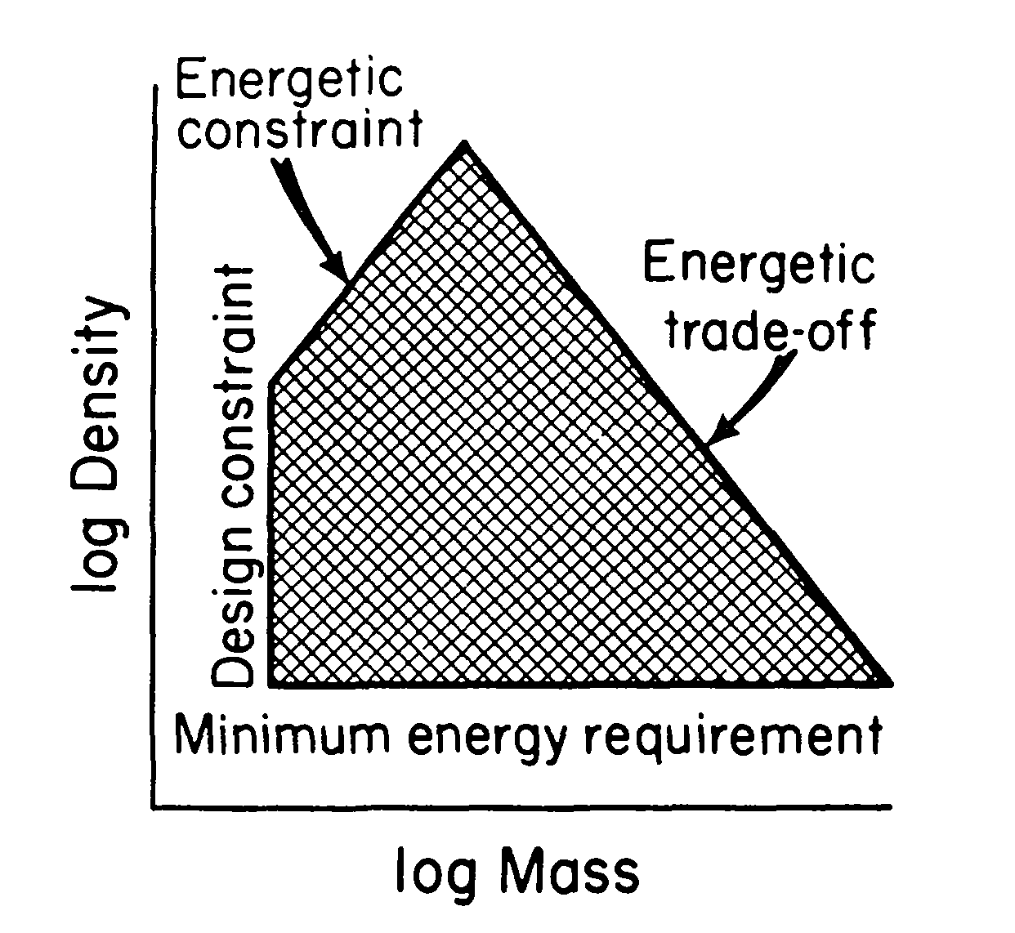
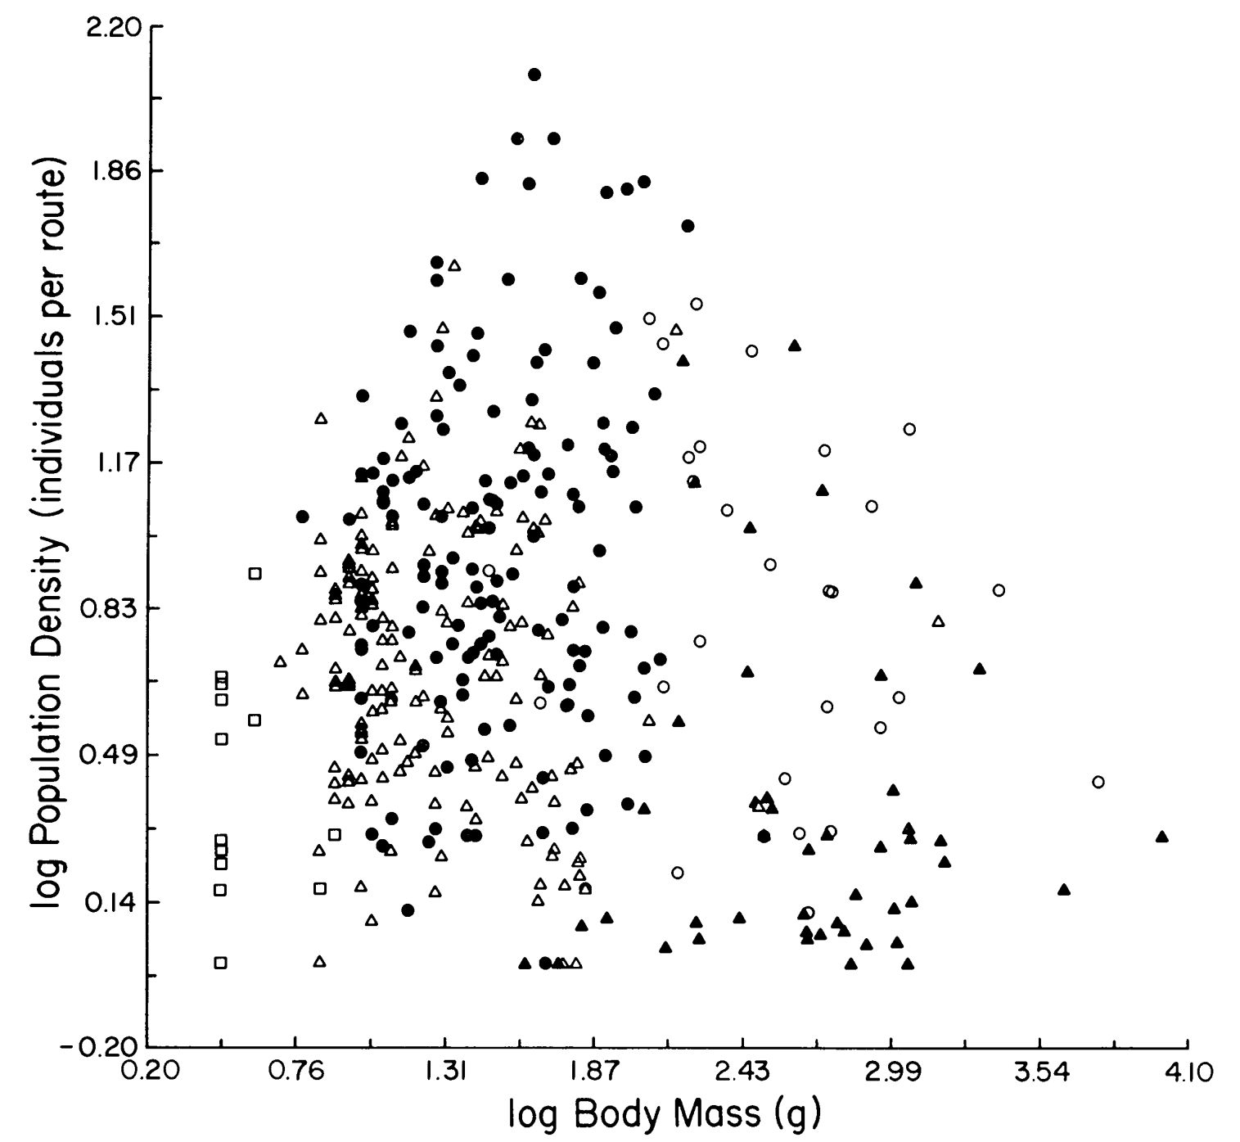
Body size-abundance relationship
EER works well for maximum densities, less for total abundance for a region

Slide 17
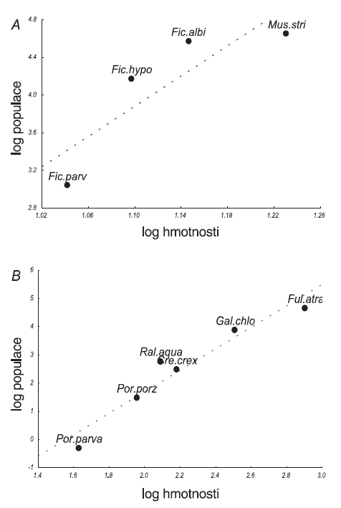
Body size-abundance relationship
May be reversed (positive) for groups of closely related species
Abundances can strongly differ between taxa (flying x non-flying)

Slide 18
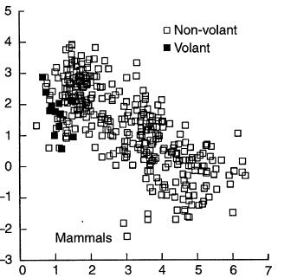
Body size-abundance relationship
Explanation:
birds fly, so they must specialize to most profitable food
birds fly, so they can afford to live in low densities
→ Abundances do not need to be maximized! Only stability counts in evolution!

Slide 19
Species-abundance distribution
Abundances are relatively equally spread across logarithmic classes (orders of magnitude)
Most species are orders of magnitude rarer than the commonnest ones
number of breeding pairs in the Czech republic
number of species
species ranked by abundance
number of breeding pairs

Slide 20
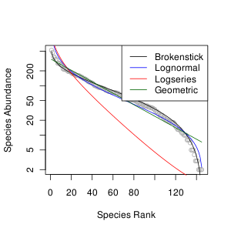
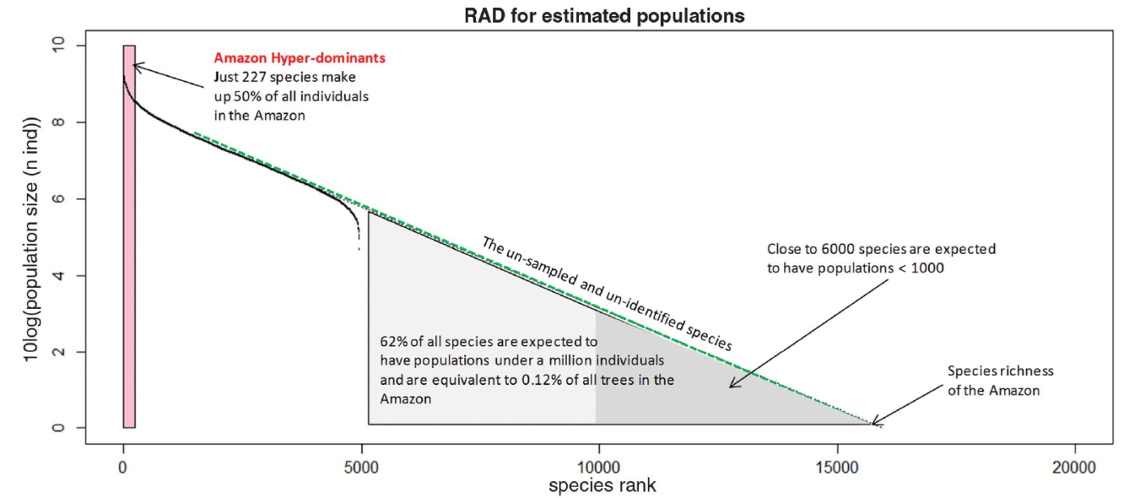
Species-abundance distribution
Abundances are relatively equally spread across logarithmic classes (orders of magnitude)
Most species are orders of magnitude rarer than the commonnest ones
Hyperdominance of a few species

Slide 21
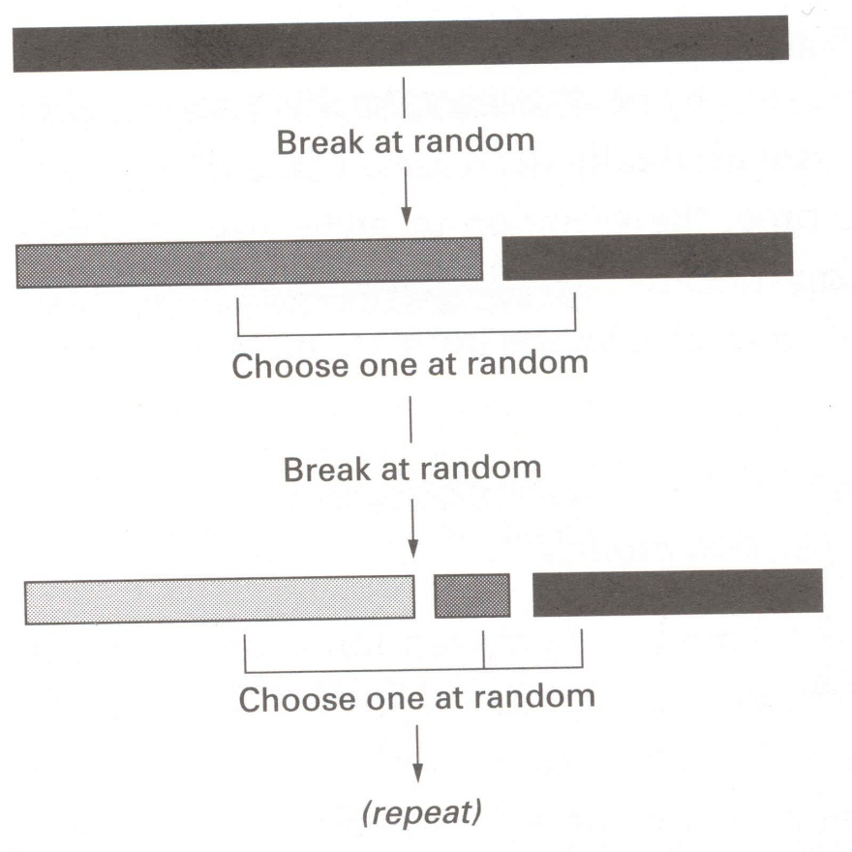
Species-abundance distribution
Explanatory frameworks
Unequal division of resources
Random population multiplicative processes
Extensions of the Central Limit Theorem

Slide 22

Species-abundance distribution
Explanatory frameworks
Unequal division of resources
Random population multiplicative processes
Extensions of the Central Limit Theorem
Bob May (Lord May of Oxford)

Slide 23
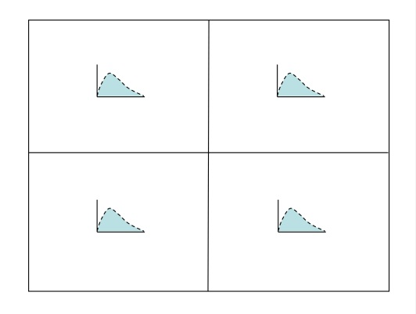
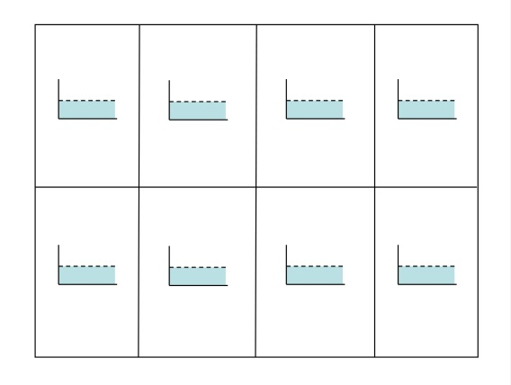
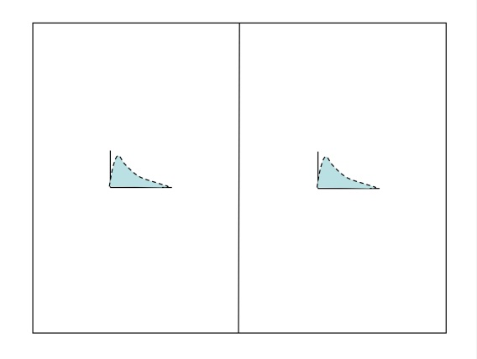
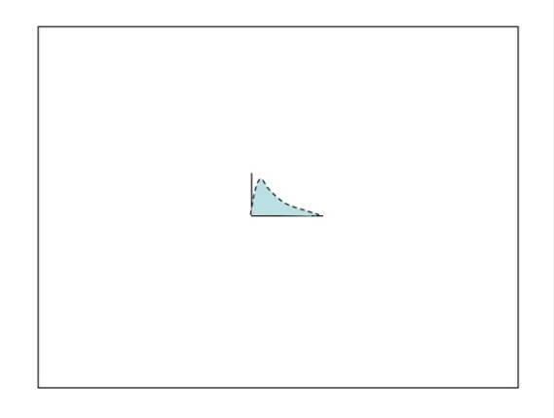
Species-abundance distribution
Explanatory frameworks
Unequal division of resources
Random population multiplicative processes
Extensions of the Central Limit Theorem
lognormal
lognormal
log abundance class
not-lognormal
log abundance class
Šizling, Storch et al. 2029 PNAS

Slide 24
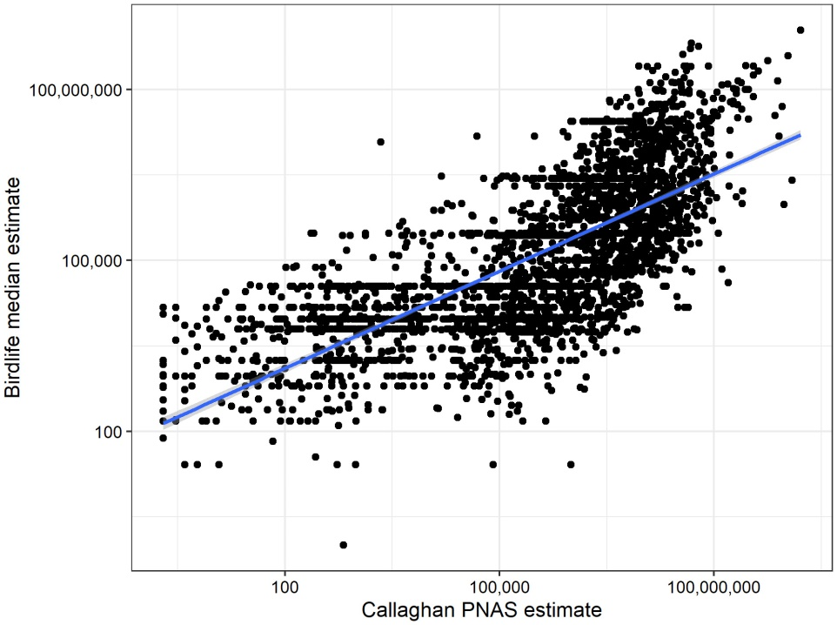
Abundance – important remarks
Abundance is related to body size, but it may mask other, more important variables determining abundance (like population growth rate)
None of these patterns is particularly strong, abundance varies considerably in space and time and we do not understand inter- as well as intraspecific variation
Species-abundance distribution is one of most general patterns, but we lack a generally accepted universal explanation
We entirely lack information about global species abundances (in contrast to ranges)
ABUNDANCE – A BLIND SPOT OF ECOLOGY!
Global bird abundance estimates for all species

Slide 25
Range size distribution
Explanatory frameworks
Consequence of link with species abundances
Abundance-range size relationship
Very general, but not particularly strong
Many theories
Classically explained either by niches (generalists have both large ranges and densities) or spatial population dynamics

Slide 26
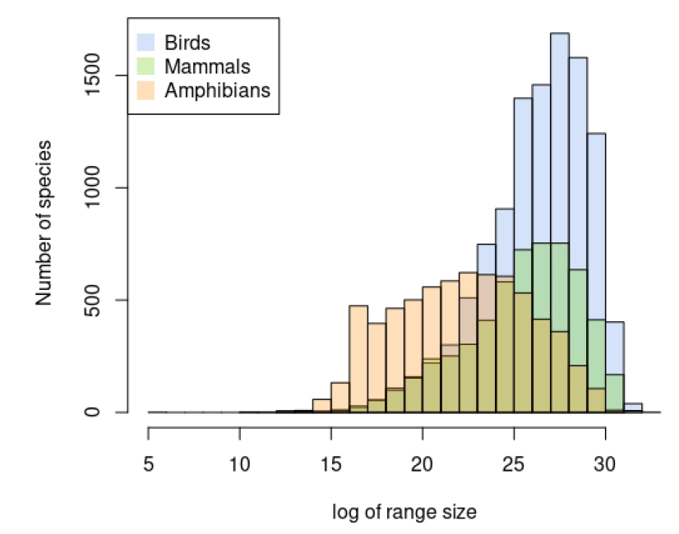
Range size distribution
Explanatory frameworks
Consequence of link with species abundances
Result of evolutionary dynamics

Slide 27
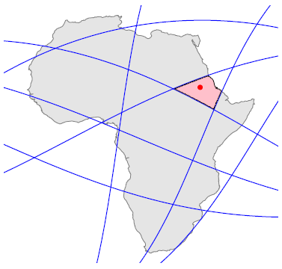

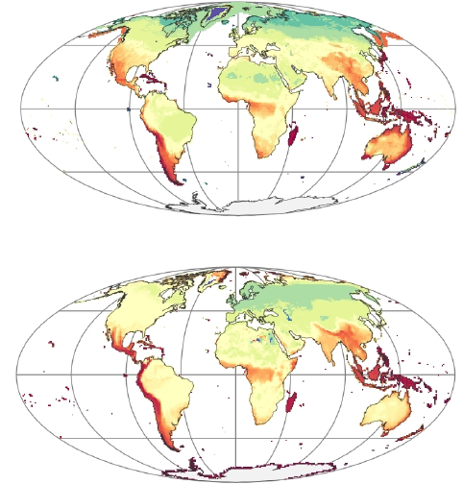
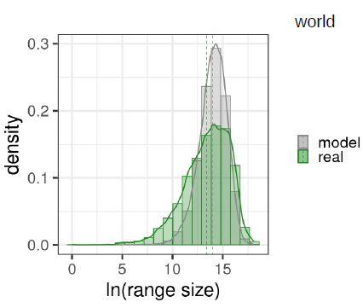

Range size distribution
Explanatory frameworks
Consequence of link with species abundances
Result of evolutionary dynamics
Barriers

Slide 28
Geographic trends
Rapoport rule (smaller ranges in the tropics)
Specialization in the tropics due to low seasonality
Extinction of small-range species during ice ages
Barriers

Slide 29
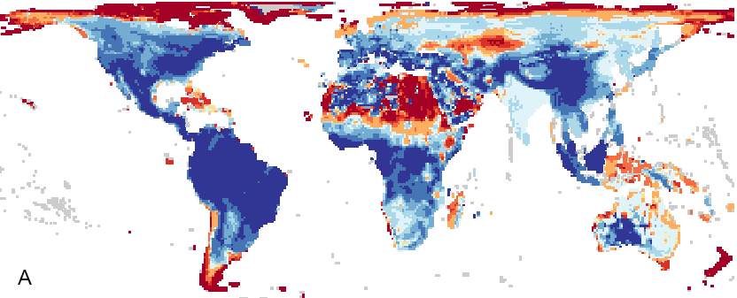
Geographic trends
Rapoport rule (smaller ranges in the tropics)
Specialization in the tropics due to low seasonality
Extinction of small-range species during ice ages
Barriers
Bergmann rule (larger endotherms in large latitudes)
Ability of large animals to starve longer in harsh areas

Slide 30
Geographic trends
Rapoport rule (smaller ranges in the tropics)
Specialization in the tropics due to low seasonality
Extinction of small-range species during ice ages
Barriers
Bergmann rule (larger endotherms in large latitudes)
Ability of large animals to starve longer in harsh areas
Density trends (population densities lower in the tropics)
Holds in trees, seems to hold in ectotherms
Pattern relatively weak and not fully consistent

Slide 31
Overall interspecific correlations
positive correlation
negative correlation
density
Core-Satelite
range size
Energy equivalence rule
Rapoport´s rule
body size
Bergmann´s rule
latitude

Slide 32
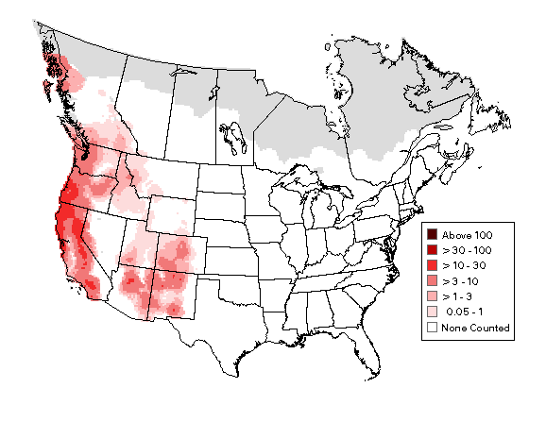
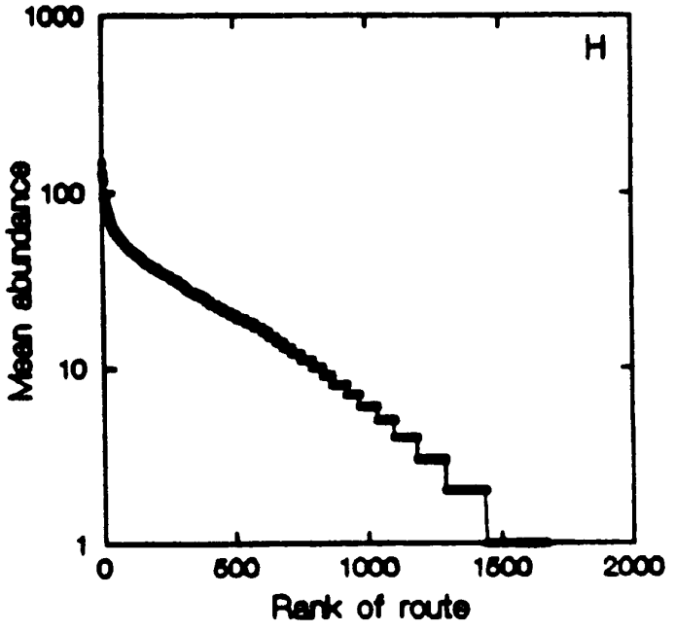
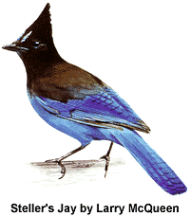
Intraspecific patterns
Abundances highly varies within a range, only few spots with high abundance
Species distribution is aggregated

Slide 33
Intraspecific patterns
Abundances highly varies within a range, only few spots with high abundance
Species distribution is aggregated
Species-abundance distribution
(due to extended Central Limit Theorem)
Abundance-range size relationship
Species-area relationship

Slide 34
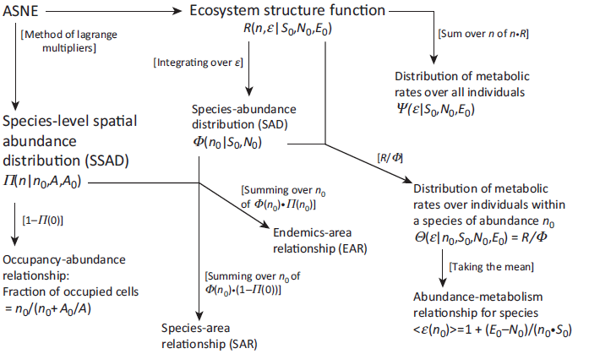
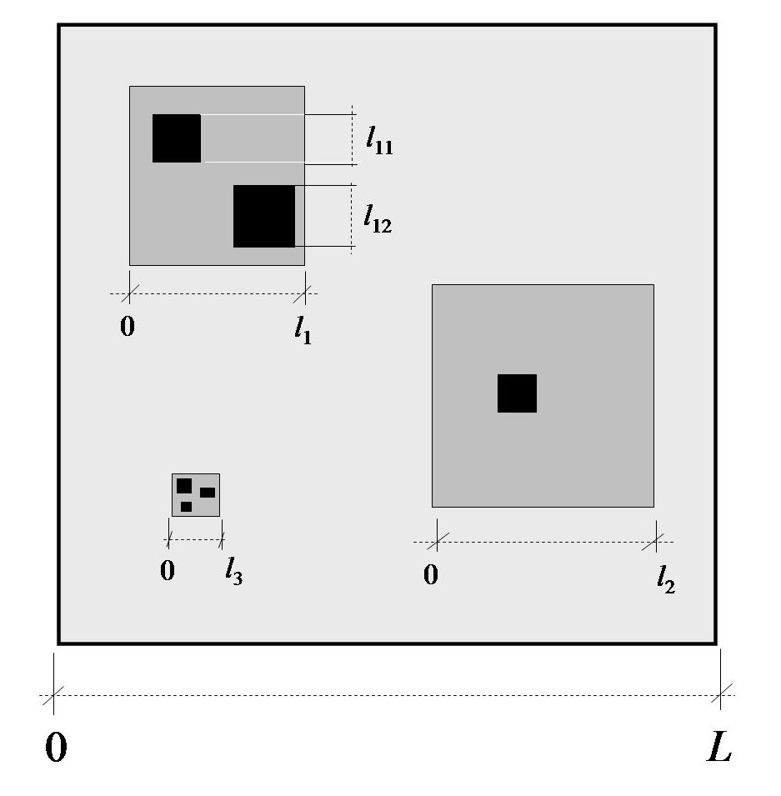
Synthetic approaches to macroecological patterns
Neutral theory (Hubbell 2001)
Theory based on peaked species distributions within ranges (McGill 2003)
METE theory based on Maximum Entropy distributions (Harte 2008)
Theory based on generalized fractals (Storch et al. 2008)

Slide 35
Synthetic approaches to macroecological patterns
General principles:
Multiplicative nature of biological processes
Energetic considerations
Niches (species differ in their relationship to environment)
Spatial aggregation of individuals
Spatial dynamics

