Slide 1
THE “SYMBOLICAL”
IN MATHEMATICS
IN HUSSERL’S EARLY WORK
Gabriele Baratelli
University of Graz

Slide 2
MAIN GOAL
To offer a historical and systematic overview of the relationship between mathematical knowledge and phenomenology.

Slide 3
INTRODUCTION
Husserl’s Logical Investigations: Phenomenology “goes back to the things themselves” as an antidote to “empty,” “merely symbolic comprehension” carried out by a passive understanding of signs.
“Meanings inspired by remote, confused, inauthentic intuition – if by any intuition at all – are not enough” (2000, 168).

Slide 4
THESES OF THE TALK
The symbolic dimension of mathematical thought challenged Husserl’s initial beliefs and led him to transform his philosophical attitude.
This new approach is relevant for the clarification of fundamental mathematical concepts.

Slide 5
The Philosophy of arithmetic (1891)
Main goal: provide a foundation of arithmetic through “psychological and logical investigations.”
Weierstrass’ Principle: the whole theoretical construction of mathematics has its ultimate ground in elementary arithmetic, and thus in the concept of cardinal number.
This principle has to be demonstrated with philosophy and psychology.

Slide 6
Authentic presentation: if “a content is directly given to us as that which it is” [ein Inhalt ist direkt gegeben als das, was er ist]
Symbolic presentation: if it is given “only indirectly through signs that univocally characterize it”

Slide 7
Husserl’s interpretation of Weierstrass’ Principle:
Cardinal numbers, as they are authentically given and conceived, are the ultimate ground for mathematics, even when it is symbolically practiced and conceived.

Slide 8
THE AUTHENTIC CONCEPT OF CARDINAL NUMBER (ANZAHL)
The concrete (i.e., non-symbolical) phenomena at the basis of this concept are aggregates of objects.
Those objects are unified through a “collective combination” (kollektive Verbindung).

Slide 9
Twofold process of abstraction:
the objects, insofar as they are collected, “are considered and attended to only as some content or other, each one as a certain something, a certain one [irgend etwas, irgend eins]” (2003, 83).
“the main interest is concentrated upon the collective combination,” so that “a collection originates in that a unitary interest distinctly picks out and encompasses various contents” (2003, 77).

Slide 10
By reflecting on this act, the general concept of multiplicity and its specific determinations arise, namely the cardinal numbers having this general form:
one and one, one and one and one, and so forth.

Slide 11
Authentic collecting is not symbolic counting.
Authentic collections and “sets.”
Husserl’s psychological analysis and “psychologism.”

Slide 12
THE FIRST CHALLENGE
What do “0” and “1” denote?
Their use is practical acceptable, but this should not hide the logical difference between authentic and “imaginary” numbers:
“One must pay close attention to the fact that the designation of zero and one as ‘numbers’ [Zahlen] presents a transference [Übertragung] of that term to concepts of a different kind, even though they stand in close relationship with the authentic numbers [eigentlichen Anzahlen]” (2003, 138).

Slide 13
THE SECOND CHALLENGE
How should we interpret expressions in the decimal system?
5 + 7 = 12 would mean something like: any group of five units and any group of seven units collected together make up a group of twelve units.
If arithmetic is founded upon the authentic concept of number (Weierstrass’ Principle), then those symbols must be general names.

Slide 14
“If in arithmetic we were dealing with the actual numbers, then the evaluation of those symbolizations [Symbolisierungen] would always require the recourse to the actual activities underlying them and thus to the actual additions and partitions. But in all of arithmetic not even a trace of this can be found” (2003, 200).
Arithmetical calculus is based on algorithmic rules of reducing “complex signs” (e.g., 5+7) to “normal signs” (e.g., 12).

Slide 15
“The presupposition from which we set out at first, as from something self-evident – namely that each arithmetical operation is an activity with and upon actual numbers – cannot correspond to the truth.”
“All number representations that we possess, beyond the first few number series, are symbolic and can only be symbolic. This is a fact which totally determines the character, sense, and purpose of arithmetic” (2003, 200-201).

Slide 16
TWO CONSEQUENCES
Different number-presentations have an epistemological (not simply psychological) value because they determine the objective nature of mathematical concepts.
“Our ordinary decimal system is not a mere method of symbolizing concepts which are given, but rather one of constructing new concepts and simultaneously designating them along with their construction” (2003, 247).

Slide 17
2) Husserl’s discovery specifically concern modern symbolic mathematics.
“It is a fact highly significant for the deeper understanding of mathematics that one and the same system of symbols can serve in several conceptual systems which, different as to their content, exhibit analogies solely in their structural form [Bildungsform]. They are, then, as we say, governed by the same calculational system [Rechensystem].” (2003, 273)

Slide 18
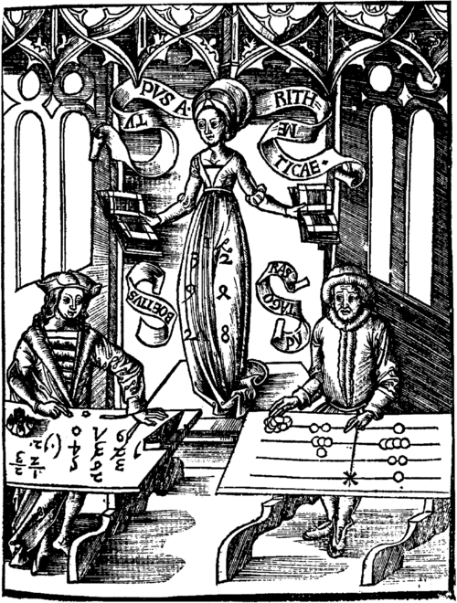

Slide 19
THE SYMBOLICAL AND ITS DANGERS
Husserl’s Semiotics (1891):
“Signs do not merely accompany psychic development, but rather they essentially condition it, making it possible to begin with. […]. Upon conscious application of symbols, the human intellect raised itself to a new and truly human level. And the progress of intellectual development runs parallel with progress in symbolic technique. The magnificent development of the natural sciences constitutes above all else the pride and glory of recent centuries. But it certainly seems that no less a claim to fame belongs to that remarkable symbol system – which has not yet received its clarification – to which the sciences and technology owe most: the system of general arithmetic, the most wonderful machine that ever arose” (1994, 29-30).

Slide 20
The symbolic danger lies in the fact that
“The signs stand in place of the genuine concepts, but that they do so is unnoticed to us. […]. We feel ourselves to be confidently in touch with the matter at hand, and proceed onward in the expectation that the mechanism of reproduction will function well” (1994, 33).
Mathematical knowledge is particularly exposed to this danger because of its symbolic nature.

Slide 21
“To be sure, in precisely this perfection of modern arithmetic there also lies one of the chief sources of error. It is all too easy for the practicing mathematician to succumb of confusing the methods of development for the extension of arithmetical technique in the most consistent way possible with the methods of a logical developments of arithmetical science itself. The arithmetic of today is an unrivaled technique, with respect to the extension and practical reliability of its rules. But it is no science, provided that by “science” we understand, precisely, a system of knowledge [ein System von Erkenntnissen]” (1994, 4).

Slide 22
EXAMPLE: THE ACTUAL INFINITE
Felix Kaufmann’s The Infinite in Mathematics and its Elimination (1930):
“One main origin of the problems concerning the ‘actual infinite’ (the transfinite in Cantor’s sense) is to be found in the use of mathematical symbolism beyond its sphere of significance, and that if we eliminate its ‘extravagant’ [überschwänglicher] use (in Kant’s sense) we can separate genuine knowledge from illusion” (1978, 11).

Slide 23
Husserl’s Philosophy of Arithmetic: There is a “natural tendency” to go beyond the limits even of an idealized intellect and objectify a symbolic concept independently of its principle of formation.
This leads to the unnoticed “transposition [Übertragung] of the concept of multiplicity over formations that, in their logical character, are essentially different” (2003, 233).

Slide 24
CONCLUSIONS
How the phenomenological attitude was occasioned by philosophical reflections on mathematical knowledge.
How phenomenological critique can be relevant to the philosophical clarification of mathematical concepts.
The connection between the two is the (problematic) role of the symbolical in mathematical thought.

