Slide 1


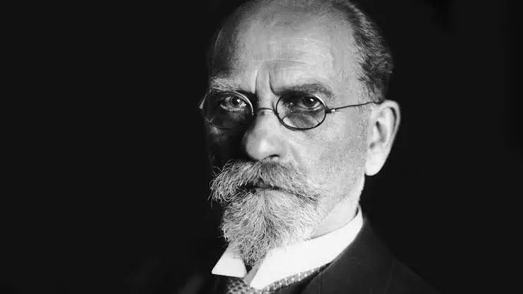

Husserl and Vopěnka on Evidenz
Mirja Hartimo
University of Helsinki
october 25, 2025

Slide 2
Outline
On phenomenology
The ”worlds”
The transcendental attitude
Vopěnka on epoché
Intention-fulfilment structure and the three kinds of Evidenz
Husserl on clear, klar Evidenz
Husserl on distinct, deutlich Evidenz
Vopěnka on the kinds of mathematics
Vopěnka on Evidenz
Vopěnka on Indistinctness
Husserl on distinctness, Vopěnka on indistinctness
Vopěnka on indistinct properties, Husserl’s morphological essences
12. Conclusion: Vopěnka is primarily concerned only on clarity, indistinctness is a property of the world, not a kind of Evidenz.

Slide 3
1. On phenomenology
Husserl begins his investigation with how we naturally relate to the world.
General thesis: we take the world for granted.
Natural attitude vs. Transcendental attitude.
Epoche: the thesis is ”bracketed”, put out of play so that we can
    ”reflect upon and understand the natural attitude itself: its structures, its activities, in other words, its essence, including that of all the sciences that are built upon it or within it. Another way of stating this is to say that phenomenology seeks the conditions of the possibility of the natural attitude itself” (Carr 2021)
Focus on mathematics: to reflect on the structures (e.g., horizontality) and activities of mathematics (e.g., intention – fulfilment).

Slide 4
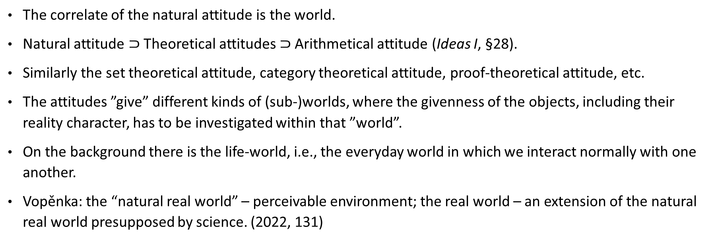
2. The ”worlds”
The correlate of the natural attitude is the world.
Natural attitude $⊃$ Theoretical attitudes $⊃$Arithmetical attitude (Ideas I, §28).
Similarly the set theoretical attitude, category theoretical attitude, proof-theoretical attitude, etc.
The attitudes ”give” different kinds of (sub-)worlds, where the givenness of the objects, including their reality character, has to be investigated within that ”world”.
On the background there is the life-world, i.e., the everyday world in which we interact normally with one another.
Vopěnka: the “natural real world” – perceivable environment; the real world – an extension of the natural real world presupposed by science. (2022, 131)

Slide 5
3. Transcendental attitude
“Turning reflectively from the only themes given straightforwardly (which may become importantly shifted) to the activity constituting them with its aiming and fulfilment – the activity that is hidden (or, as we may also say, ’anonymous’) throughout the naive doing and only now becomes a theme in its own right – we examine that activity after the fact. That is to say, we examine the evidence awakened by our reflection, we ask it what it was aiming at and what it acquired; and, in the evidence belonging to a higher level, we identify and fix, or we trace, the possible variations owing to vacillations of theme that had previously gone unnoticed, and distinguish the corresponding aimings and actualizations, - in other words, the shifting processes of forming concepts that pertain to logic.” (Husserl 1974/1969, §69)
The intention- fulfilment structure found in the activity of mathematics (noetic)
The fulfilment is given by various kinds of evidence, that function as normative goals and that should be clarified and fixed.
Also possible presuppositions of these activities will be clarified.

Slide 6
4. Vopěnka on epoché
“… whether the domain of all natural numbers is actualisable can only be sought in the mysterious understanding we have for the passing of natural numbers towards infinity … If we carry out … the phenomenological epoché as Edmund Husserl would call it, we have no option but to state that the purified understanding of the passing of natural numbers towards infinity does not give us the slightest cause to shorten the domain of all natural numbers. On the contrary, the raw infinity present in this domain a priori excludes all the obstacles which could hinder natural numbers as they flee towards infinity” (2022, 109)
Focus is on the structures of the givenness of the natural numbers (noematic)
Vopěnka: In the natural attitude we have a rudimentary conception of “raw infinity”.
This conception is brought into “purified understanding” in the epoché.
No finitistic restraints; the attitude is metaphysically neutral, phenomenological.

Slide 7
5. Intention-fulfilment structure and the three kinds of Evidenz
”the act of pure meaning, in the manner of a goal-seeking intention, finds its fulfilment in the act which renders the matter intuitive” (Husserl 2001, II, 206)
Dynamic fulfilment = takes place in time > highlights the role of construction highlighted (not that construction is an objective, here looked at from a different attitude)
These investigations ”concerned the contrasting of three different focusings in judging, … and the pointing out of three different evidences, three correspondingly different modes of empty expectant intention and of fulfilment, and three different concepts of the judgment, which become originally separated accordingly” (FTL, §70a)
Intention – fulfillment: doing something in accordance of a method gives the particular kind of evidence.
Three kinds of evidence: grammaticality, distinctness harmonious co-givenness and clarity givenness ”in person”; and possibly sub-types of these.

Slide 8
6. Husserl on clear, klar Evidenz
Different notions of evidence are associated with different kinds of construction (intention – fulfilment)
Husserl’s Klarheit: (possibility of) seeing/possessing the object ”in person.”
These clear objects can be both abstract (ideal) or objects of perception.
Thus it goes with both the traditional constructivism where the objects are constructed, but also about judgments applicable to perceived objects, i.e., and the idealized perceived world, the world of mathematical physics.
i.e., in the natural real world and the real world as conceptualized by Vopěnka

Slide 9
7. Husserl on distinct, deutlich Evidenz
Evidence of Deutlichkeit, evidence of non-contradictoriness refers to co-positability, Einstimmigkeit, harmony; impredicative definitions. Not in Vopěnka.
Husserl: the mathematics of the mathematicians is free construction concerned with distinctness, not with clarity.
Husserl suggests that there are even further kinds of evidence:
” Mathematics is the realm of infinite constructions [unendlicher Konstruktionen], a realm of ideal existences, not only of ”finite” [sic] senses but also of constructional infinities [konstruktiven Unendlichkeiten]. Obviously we have here a repetition of the problem concerning subjective constitutive origins: as the hidden method of constructions which is to be uncovered and reshaped as a norm, the method by which ”and so forth”, in various senses, and infinities as categorial formations of a new sort become evident… Precisely this evidence, in all its particular formations [in allen ihren Sondergestalten], must now become a theme” (FTL, §74).
Kinds of evidence related to various other epistemic norms (other than non-contradiction/distinctness and empirical adequacy/clarity)
E.g., simplicity, “naturalness,” and so forth.
Mathematics seen as aiming, assuming given presuppositions, at a constellation of different kinds of evidence that sometimes overlap.

Slide 10
8. Vopěnka on kinds of mathematics
Hilbert’s Grundlagen der Geometrie (1899) axiomatization
Capturing a formal structure of some community by means of axioms.
Purely formal, no reliance on intuition
In set theory: Zermelo, Mirimanov, Fraenkel, Skolem, von Neumann, Bernays, Gödel.
This development is what Husserl sees as guided by distinctness [Deutlichkeit]
Hilbert: consistency with mathematics of calculations blending calculation and intuition.

Slide 11
Mathematics of calculation: ”the task is to gain the results by applying correct calculations with signs”
Emerged already in ancient India in the creation of arithmetical and algebraic calculus.
Husserl talks about this as mathematics as games and games-meanings [Spielbedeutungen]
Mathematics of intuition: the task is to make results evident. ”To evidence something means to see it (in the widest sense of this word) and to know that we are seeing it” (99); to justify new axioms.
- Corresponds to Husserl’s clarity, Klarheit.
Blend in set theory: Mathematicians new interest in assertions such that could not be proved from the axioms of set theory; instead of looking for true set-theoretical assertions.
Mention of Gödel’s constructible sets as a model of axiomatic set theory.
- Husserlian could see this as a type of evidence, actualizing something Deutlich.

Slide 12
9. Vopěnka on Evidenz
“A primarily evident phenomenon is a phenomenon which we are able to evidence, that is we are able to see it and know that we are seeing it as soon as it can be evidenced, that is, as soon as it has appeared to us.” (Vopěnka 2022, 159). > Husserl’s clarity
When we start to interpret the world, we “enrich it with sets and classes of these objects” (Vopěnka 2022, 161) (Husserl would talk about objects falling under types [typen], concepts and eventually essences)
A domain is “actualized” by substitution by a collection of objects.
Any collection of given objects is a class, which is an autonomous entity.
When considering the collection as an object, we “concede” it a “personality” (editor’s introduction, xvii)
A set is a sharply defined class. (“Sharpness refers to distinctness, clarity and definiteness, …” (Vopěnka 2022, 135n))
A semiset is an indistinctly defined class which is a subclass of a set.

Slide 13
10. Indistinctness
“Indistinctness is a phenomenon of the natural real world … Moreover, indistinctness is the primary phenomenon; it is no poorly captured sharpness. On the contrary, in most cases sharpness is idealized indistinctness.” (2022, 131)
“Indistinct” and “indistinctness” translates the Czech words “neostrý” and “neostrost” respectively, which is literally “non-sharp” and “non-sharpness”. [Ed]
”Greenness, interestingness, dirtiness, largeness are primary bearers of the phenomenon of indistinctness. In contrast, the class of all green leaves on the trees in some autumnal deciduous wood, the class of all interesting books in a given municipal library, the class of all dirty cars in Prague or the class of all heavy stones in a quarry are merely secondary bearers of this phenomenon and this is mediated through its primary bearers” (2022, 161).

Slide 14
With the exception of small natural numbers, ”only those phenomena are sharply defined that have been created by people affected by the European civilization … In contrast, what we may call natural phenomena and especially those amongst them which are primarily evident, are almost always indistinct.
Such a natural phenomenon becomes sharp only when it is possible to make a list of all its occurrences. However, if we produce such a list then we usually distort the original phenomenon and, strictly speaking, this distortion yields a new phenomenon” (2022, 169).
Semisets are secondary, artificial bearers of the phenomenon of indistinctness. (2022, 161).
The semiset FN of all finite natural numbers can be applied in the real world. (2022, 147)

Slide 15
13. Husserl’s distinctness vs. Vopěnka’s indistinctness
Primary evident phenomena – Husserl’s clarity.
But what about Husserl’s distinctness?
Is Vopěnka’s indistinctness lack of Husserl’s distinctness?
No, these seem to be separate notions:
Vopěnka’s distinctness means distinguishability and indistinctness is lack of distinguishability of one object from another.
Husserl’s distinctness is related to non-contradiction; coherent co-positability, and it has its source in Einstimmigkeit – harmony.
Different notions.

Slide 16
14. Vopěnka’s indistinct properties, Husserl’s morphological essences.
For Vopěnka indistinctness is a property of a natural world that is being idealized by means of semisets. For Husserl distinctness is a normative goal of the mathematicians’ otherwise free creation.
The program of the new infinitary mathematics: “Wherever there is indistinctness, look for a horizon and natural infinity that has caused this indistinctness; then idealise this situation!” (2022, 133)
Shows that for Vopěnka clarity is the primary norm, i.e., the evidence applicable to the world. The world can be found to be clearly(?) indistinct.
Vopenka does not have interest in other kinds of evidence, or pure mathematics.
Indistinctness is a feature of the world that is represented and studied in the infinitary mathematics.
Husserl, Ideas §74: Morpohological concepts: vague, directly apprehended on the basis of sensory intuition.
”The vagueness of concepts, the circumstance that they have fleeting spheres of application, is no flaw attaching to them, since for the sphere of knowledge served by them they are absolutely indispensable or, more precisely, they are the only legitimate concepts in that sphere” .
For Husserl these are unmathematical. Or if mathematical, then contextual and finite…

Slide 17
Conclusion:
Different terminology – but the general conception of phenomenology as a method is roughly the same.
Different emphases – Husserl thinks that pure mathematics, that is, mathematics of the mathematicians – i.e., operating with the distinctness alone is perfectly legitimate.
When talking about mathematics as applied he seems to be interested in mathematical physics.
Vopěnka sees the source for infinitary mathematics in the worldly indistinctness.
His approach can be seen to be based on Husserl’s morphological essences.
His approach is indeed very phenomenological, but with different terminology, different focus, and different level of detail.

Slide 18
Thank you

Slide 19
7. Passive vs. Active Syntheses
In Husserl’s so-called genetic phenomenology Husserl divides the constitutive activities into passive and active ones.
Active synthesis: e.g., the object about which is being judged is actively determined ’s is P’.
Active constitution is what is attentively done, hence most kinds of constructions.
What is actively constituted will sink into passivity, so that it becomes a part of the passive ”background” of the actions.
The latter is important for considering e.g., habits, ”expertize” that consists of, say, possession of methods, sense of what could work. Includes also inherited beliefs of the aims of the work, etc.
Hence, the differences in whose world we are talking about.
Explicating the passive syntheses > active formulation of the presuppositions of the research, clarification of concepts, etc. (”awakening”)
Example: Developing uniform convergence:
“When one begins from the certainty thus obtained that the proposition cannot be generally valid, then its proof must basically lie in some still hidden supposition. When this is subjected to a precise analysis, then it is not difficult to discover the hidden hypothesis. One can then reason backwards that this cannot occur with series that represent discontinuous functions” (Seidel, 1847, 36-37)
The question: what extent this was what Vopenka was doing?

Slide 20
8. Horizon
The passive ”halo”, the background of the experiences that is not currently actualized. (Ideas I, §35)
Characterizes all intentional experiences. Objects are not experienced in isolation but always in a context or background.
Geniusas 2025: “The concept of the horizon refers to the plethora of ways in which consciousness is aware of what transcends direct intuitive givenness” (3).
Inner horizon: e.g., unseen side of the object. Given in determinable indeterminacy.
Outer horizon about what is co-given with the object, the background.
Horizon is practical horizon; connected to ”I can” of the lived body.
In genetic phenomenology laws of genesis with which the consciousness synthesizes the intuitively given with what is non-intuitively given.
Horizon of horizons = the world.

Slide 21
12. Vopěnka on Horizon
A sharp boundary between illuminated and unilluminated part.
”by a horizon we understand only the border itself,” (136)
The phenomenon of indefiniteness: Principle of continuous transition. The illuminated part (of an object) passes continuously into the unilluminated part.
The further away from the horizon something is the more indistinct it gets.
The overflow of the known land – what lies simultaneously in the known land and in the unilluminated part (Husserl’s horizon)
“In the overflow of the known land vagueness clouds phenomena to such an extent that it is only our knowledge of their existence that remains and our awareness of these phenomena slips into passively now expecting anything unexpected” … (138).
Principle of Backward Projection – Husserl’s passive syntheses.

Slide 22
11. Semisets
“How is it possible that some phenomena of the natural real world, namely the indistinct phenomena, can be modeled in classical infinitary mathematics, and sometimes even very accurately?” (132)
- infinity applicable because of the prior indistinctness of the world.
- gives a rise to the semisets.
- a set is a class that is sharply defined (i.e, distinctness) – the ancient perfection of geometric objects studied in Euclid’s Elements.
- a semiset is an indistinctly defined class which is a part of a set.

